Slide 1
ExaLearn: Co-design Center for Exascale Machine Learning Technologies
Annual Review
September 19, 2019
Project PI: Francis J. Alexander, Brookhaven Lab
Partner PIs and Institutions:
Ian Foster, ANL
Aric Hagberg, LANL
Peter Nugent, LBNL
Brian Van Essen, LLNL
David Womble, ORNL
James A. Ang, PNNL
Michael Wolf, SNL

Slide 2
Outline
Brief Overview
Goals, Principles, Evaluation Criteria, Methods, Collaboration
Machine Learning (ML) Software Development Types
Surrogates, Control, Design, Inverse Problems
ExaLearn Software
Version 1.0 release, Uncertainty Quantification (UQ), Objective-driven experimental design (ODED), Searchable Repository, Online Access
Outreach Opportunities
Events, Vendor Interactions
Summary and Looking Ahead

Slide 3
Overarching Goals for ExaLearn
ExaLearn: Year One
Initial Discussions: April 2018
Project Kickoff:
September 2018
Provide exascale ML software for use by:
  ECP Applications Projects
  Other ECP Co-design Centers
  DOE Experimental Facilities
  DOE Leadership Class Computing Facilities
Establish multidisciplinary collaborations in learning technologies that cross-cut ECP projects:
  AD projects that share an interest in ML methods
  ST projects
  HI/PathForward projects
Key idea is to leverage ongoing ML efforts at labs, extend them to new projects, and find a way to draw new ideas out of their original projects without requiring unfunded mandates.
Proposal Submitted:
June 2018
Exploring Options/
Making Plans...

Slide 4
Guiding Principles
ExaLearn produces a Software Toolset that:
  Is applicable to multiple problems within the DOE mission
  Has a line-of-sight to exascale computing, e.g., uses exascale platforms directly or provides essential components to an exascale workflow
  Does not replicate capabilities easily obtainable from existing, widely available packages
  Builds in domain knowledge where possible (not often done industry, although efforts beginning at IBM, GE, etc.); “physics”-based ML and AI are recurring themes
  Quantifies uncertainty in a predictive capacity
  Is both interpretable and reproducible
  Is based on mathematically well-grounded methods
    For example, some nice theory now for GANs, but more work needs to be done.

Slide 5
Application Priorities Determine Machine Learning Methods
ExaLearn focuses on employing the “right tool for the job”
Deep Learning (CNN, RNN, etc.)
Ensemble Methods and Random Forest Methods
Reinforcement Learning
Kernel Methods
Tensor Methods
Graph-Based Learning
Large-scale System Integration (combining traditional HPC workloads with machine learning)

Slide 6
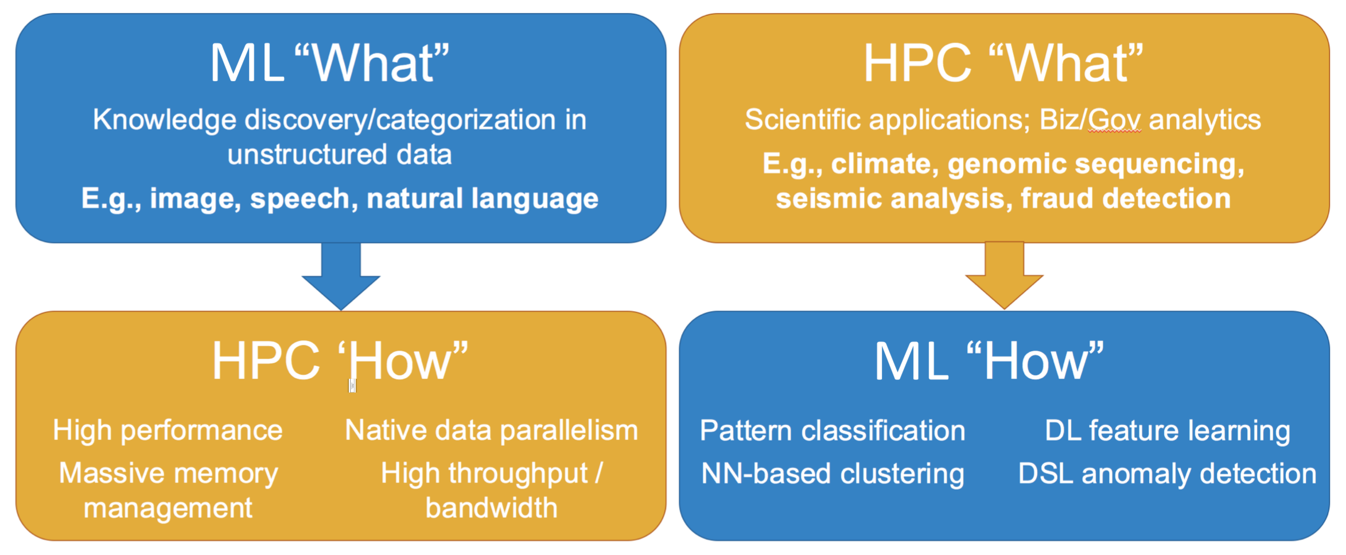
Relationships between Machine Learning and HPC
HPC for ML
ML for HPC
Courtesy of: Gadi Singer
HPC for Machine Learning: HPC technologies are applied to learning tasks to accelerate computation and/or solve larger problems.
Machine Learning for HPC: Learning technologies are applied to HPC computations to improve their performance in some way, e.g., by choosing the next simulation(s) to perform.

Slide 7
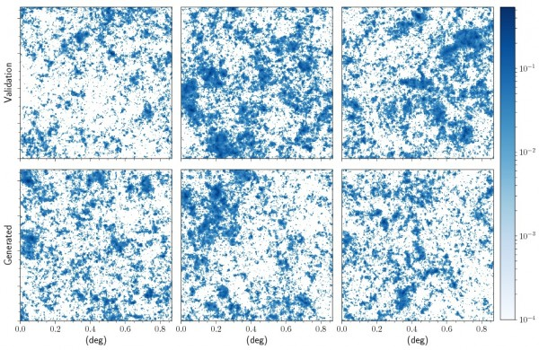
A Collaboration that Delivers More than the Sum of its Parts
Leveraging:
Scalable deep learning software toolkits:
  LBANN and CANDLE hyperparameter supervisor
Emerging expertise across labs in running open-source toolkits at scale
  TensorFlow and PyTorch on Summit and Theta via Horovod
Developing:
New methods for training on large-scale samples
  3D distributed convolutions
  Scaling parallel I/O
Unique science machine learning data sets
Integration of DOE simulations as environments for reinforcement learning (e.g., OpenAI Gym)
  Managing execution of environments on heterogenous compute platforms CPU and GPU
Cross-cutting among labs brings significant added value by merging collective expertise in an emerging area; plans in place to connect with other labs

Slide 8
Machine Learning Software Development Types:
Surrogates
Control
Design
Inverse Problems

Slide 9
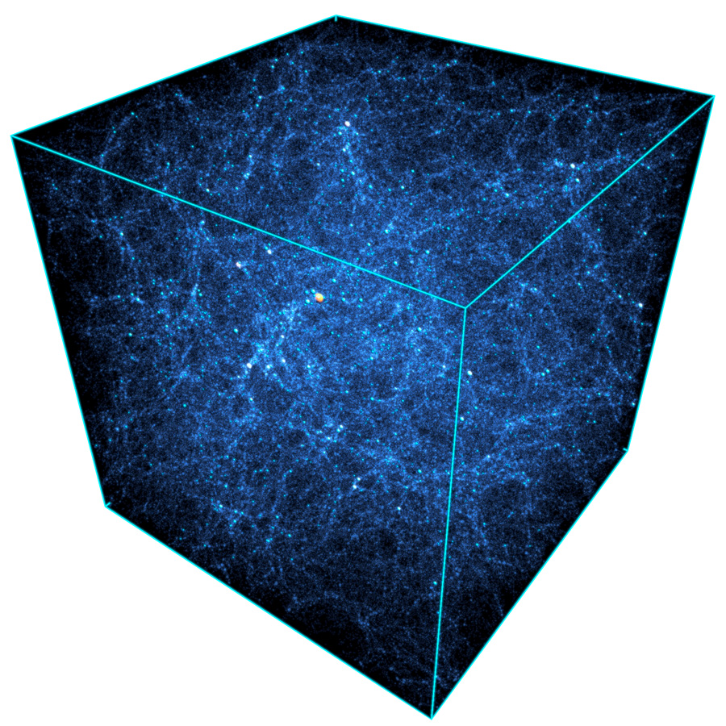
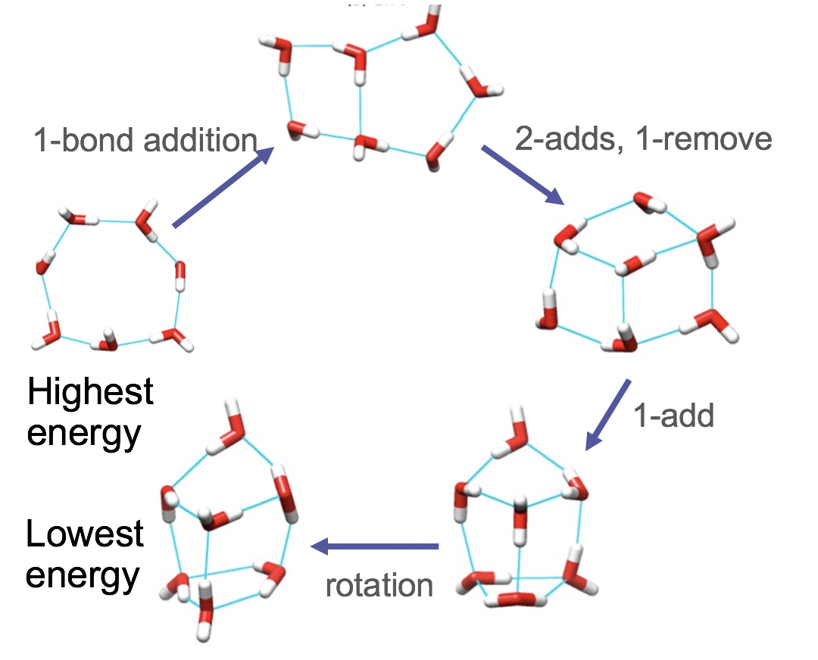
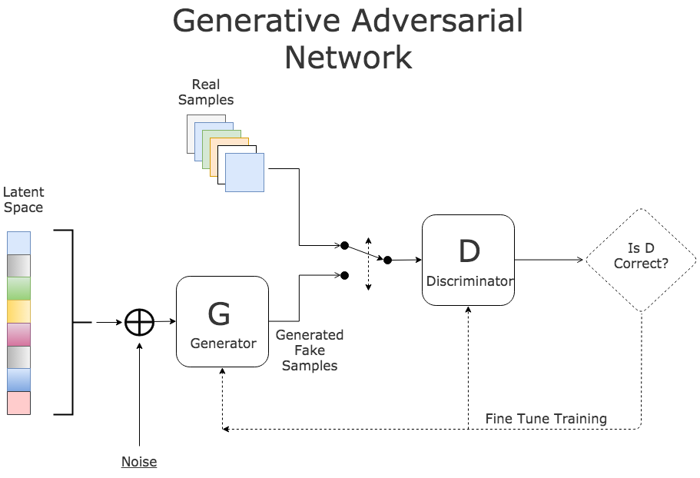
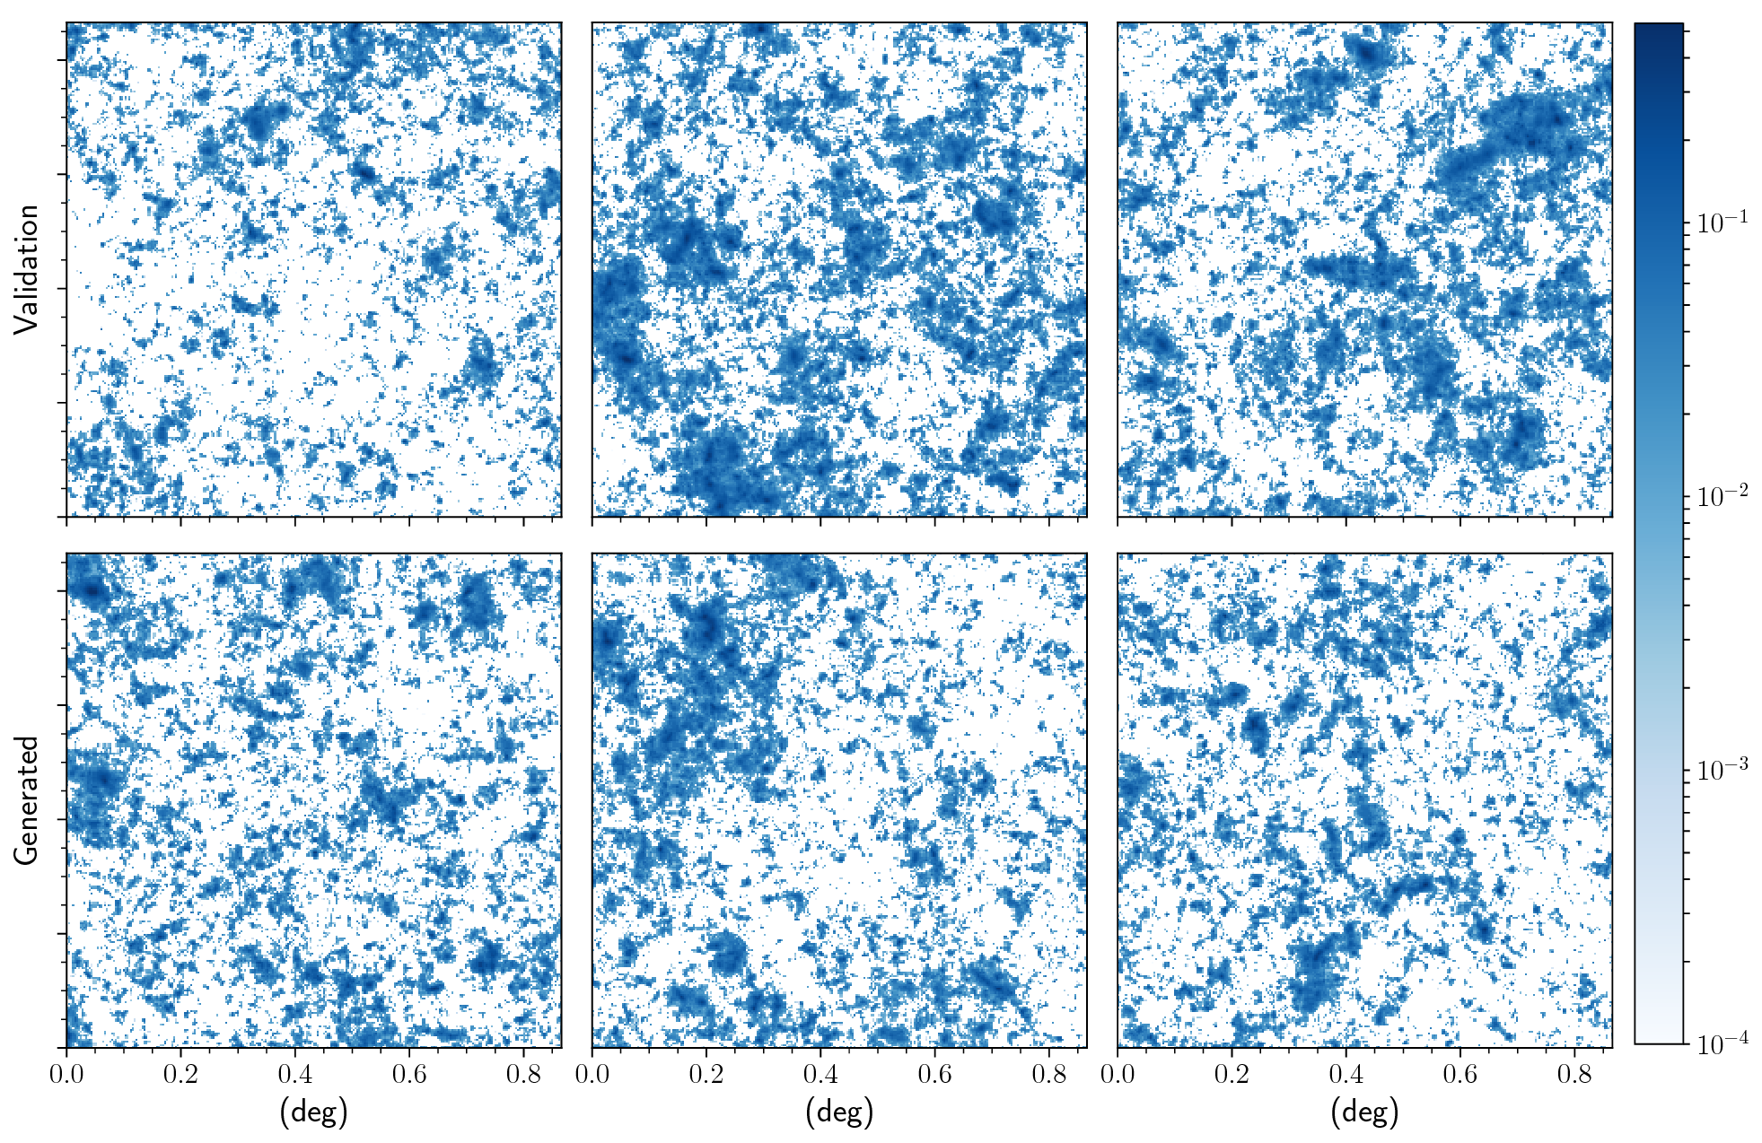
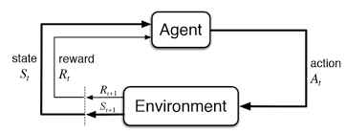
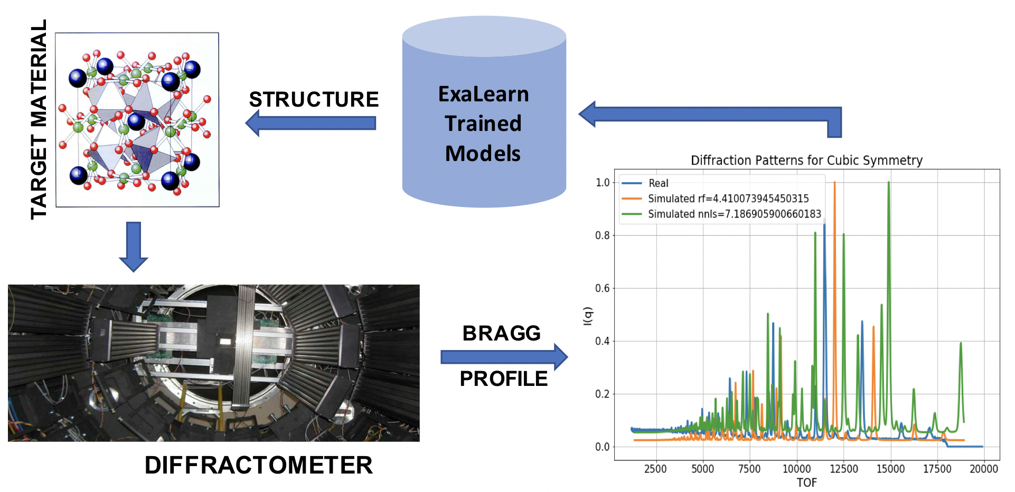
ExaLearn Application Pillars
Surrogates
Control
Design
Inverse
ML-created models
Faster and/or higher fidelity models
Generative networks
Using ML to replace complicated physics
Cosmology
ML-controlled experiments
Efficient exploration of complex space
Reinforcement Learning
Use RL agent to control light source experiments
Temperature control for Block Co-Polymer (BCP) experiments
ML-created physical structures
Optimized proposal for desired behavior of structure within complex design space
Graph-Convnets
Use Graph-CNN to propose new structures that respect chemistry
Molecular Design
ML projection from observation to original form
Back-out complex input structure from observed data
Regression models
Predicting crystal structure from light source imaging
Material structure from neutron scattering
Ω_{Λ} Ω_{M} σ8…
Image courtesy Sutton, Barto, Reinforcement Learning 2017

Slide 10
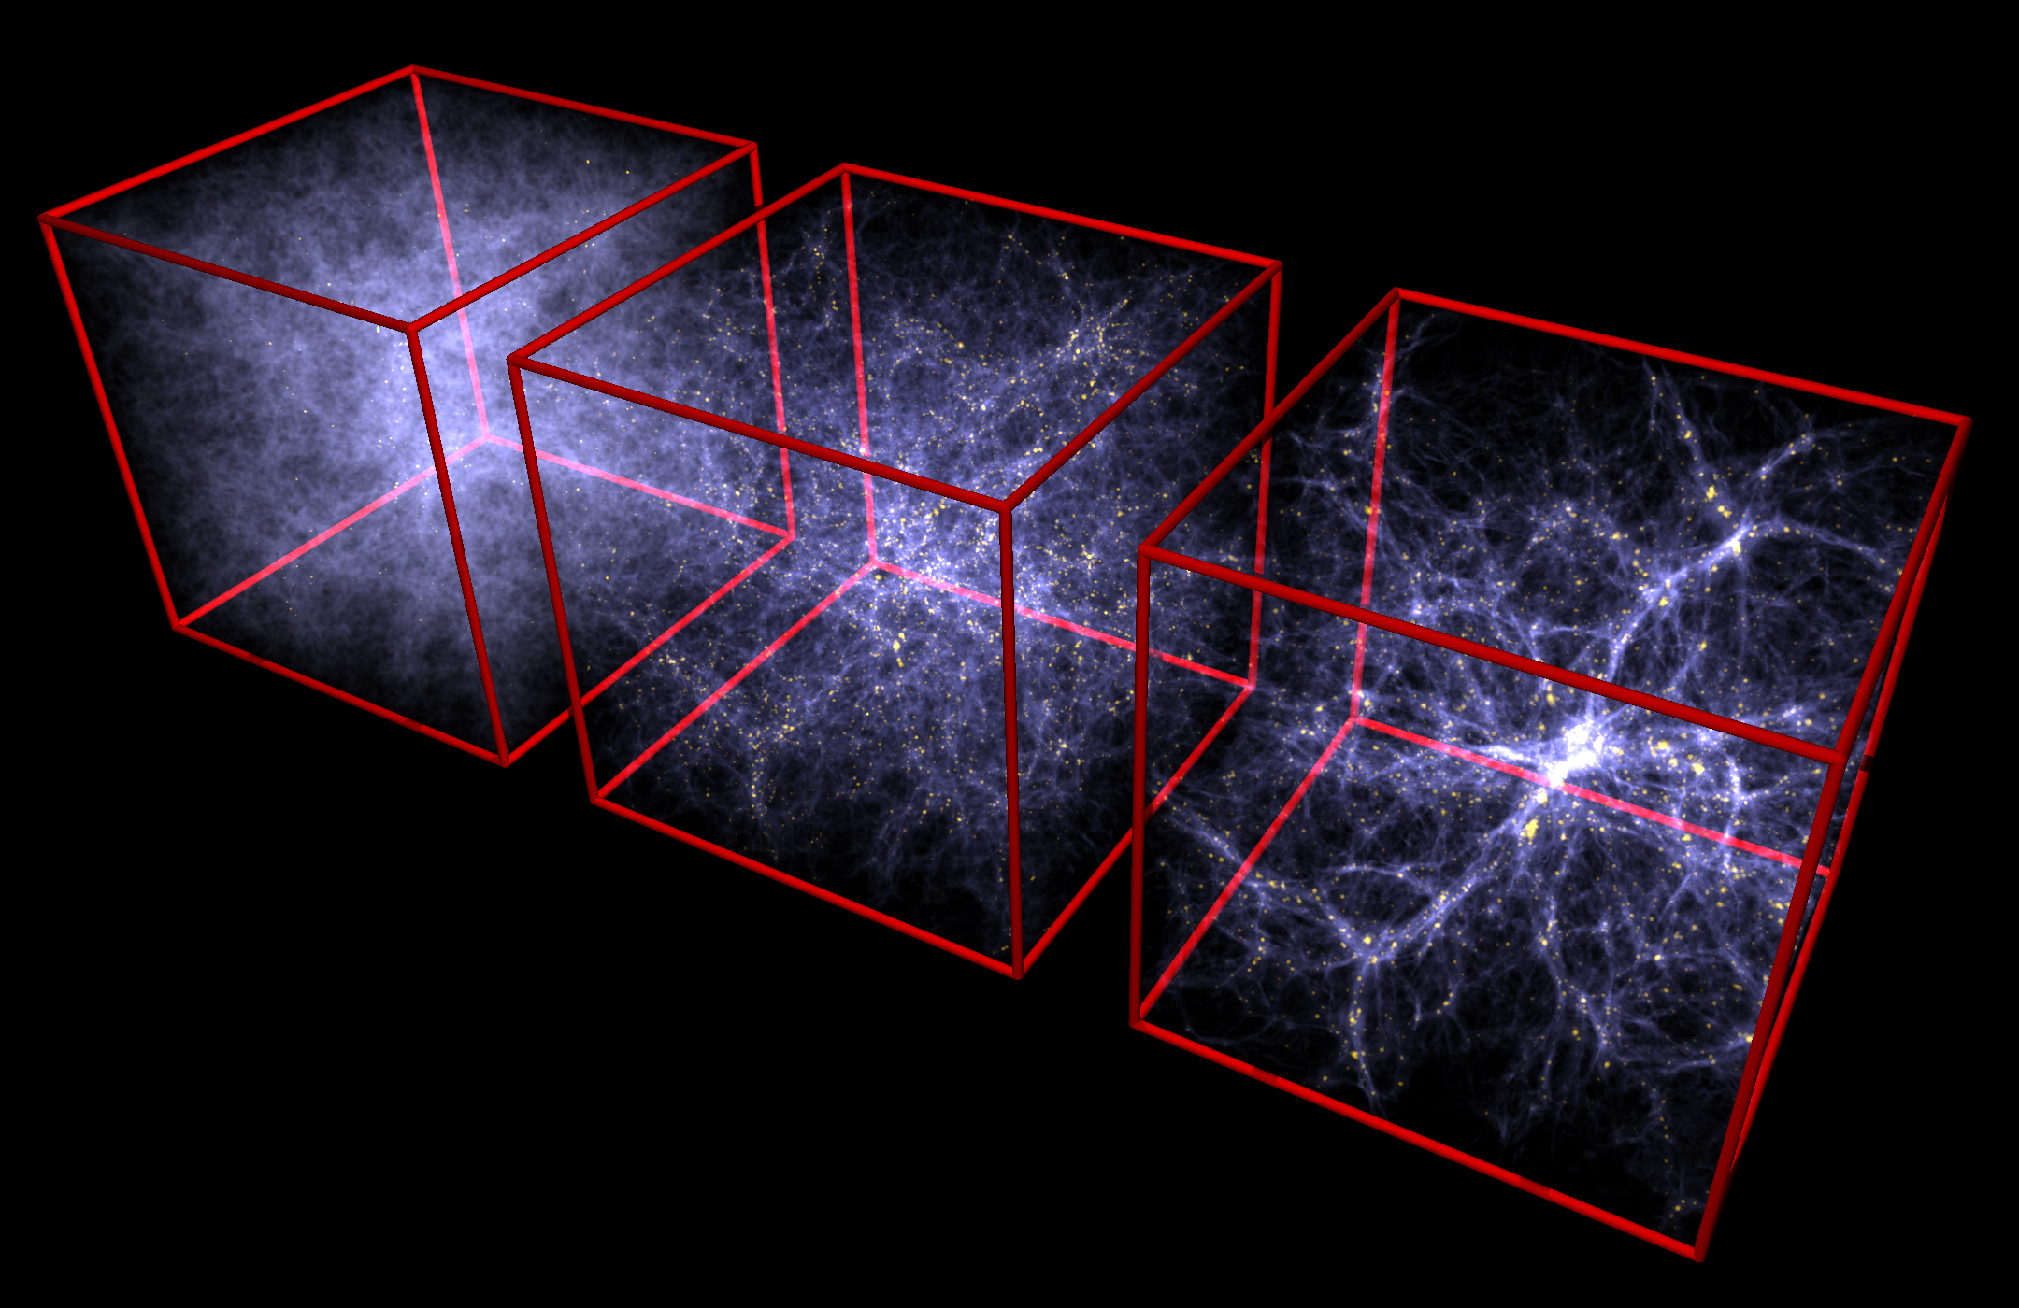
Surrogates: Realistic Simulations on the Cheap
Challenge and Importance: Many DOE simulation efforts could benefit
from having realistic surrogate models in place of computationally expensive
simulations. These can be used to quickly flesh out parameter space, help
with real-time decision making and experimental design, and determine
the best areas to perform additional simulations. We are targeting large-scale structure simulations of the universe. As the field is well developed, the scale can easily be ramped up to an exascale ML challenge, and the field is robust enough to explore systematics at the sub-percent level.
ML impact: Neural-networks-based generative models can make reliable surrogate models of expensive simulations for data augmentation purposes. Such surrogate models can be used to aid in cosmological analysis to reduce systematic uncertainties in observations.
Timeliness: The ExaSky application project is producing the largest LSS simulations now, the DESI experiment starts next year, and LSST takes its first science images in 2021.
Urgency: All cosmological measurements today are limited by systematics, not statistics. To reduce these uncertainties and make the most of these future experiments, thousands (if not millions) of exascale-sized simulations will need to be carried out. Surrogate models are a viable path forward to achieve this goal—but only if their limitations are fully understood.
Benefit to ECP-Large DOE Experiments: Once demonstrated, this software framework can be easily adapted to other fields and simulation areas, such as combustion.

Slide 11
GANs and Cosmology
Exascale in Size
Our surrogate model is based on the Generative Adversarial Networks (ExaGAN, formerly CosmoGAN) framework, and we are experimenting with Variational Autoencoders (VAE). Both models will eventually need hyperparameter tuning at exascale to extend to larger maps and build conditional generative models.
For complex conditional models on large maps (currently 512² and intent to go to 1024³), we expect to use intra-node model parallelism (up to a few GPUs) and inter-node data parallelism (10s-100s of nodes) for faster experimentation during algorithm development and final model training. When such models’ hyperparameters are being tuned, they will need thousands of nodes.
After training, when applied to generation, this GAN/VAE approach would be coupled with large-scale cosmology applications running on exascale machines (e.g., ExaSky apps HACC and Nyx).
We test the robustness and accuracy of this approach with an ExaLearn-developed regression code (CosmoFlow).
As part of the ExaLearn 1.0 release, we have published the
3D spatially distributed convolution optimizations within the
LBANN framework
  Builds on the existing DistConv extension
  Includes early phase optimizations for parallelizing I/O for
  large samples
Ω_{Λ} Ω_{M} σ8…

Slide 12
Current State
Simulation ML approaches have been attempted at full-machine scale on Summit and Cori with the ExaLearn CosmoFlow software running stably at 2400 nodes on Summit.
All data are available at: https://portal.nersc.gov/project/m3363
https://petreldata.net/exalearn/projects/cosmoflow/
10,000 1 GB universes used to train our regression or GAN algorithms.
Codes are available at:
ExaGAN: https://github.com/pzharrington/ExaGAN
CosmoFlow: https://bitbucket.org/balewski/cosmoflow/src/master

Slide 13
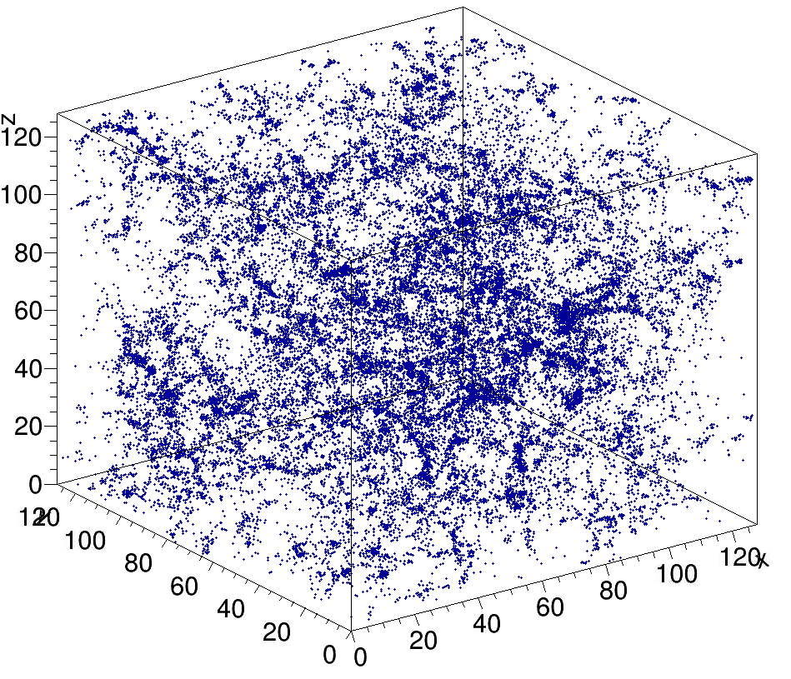
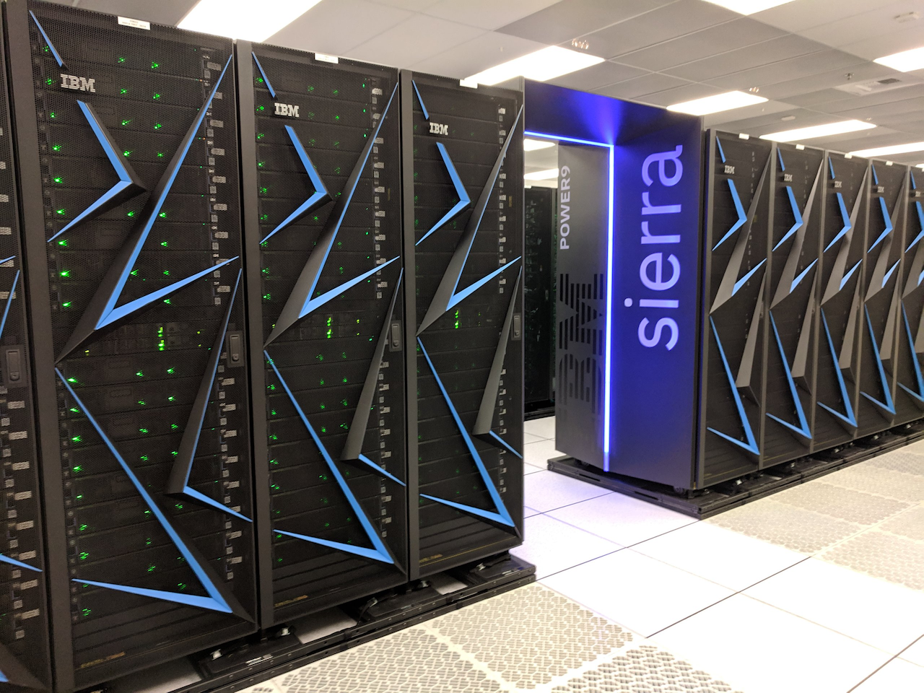
Training DNNs on Very Large Data Samples
Sure, that should be possible as we have large-scale GPU machines!
Even a mini-batch with just one sample may require O(10) GB of memory
For example, cosmological data sets
  512^3, 4 channels, 2 bytes per element → 1 GB per sample
  A regression model for the 512^3 dataset does not fit to the GPU memory of Sierra
  Splitting one sample into smaller disjoint samples can work around the memory pressure but discards long-range information
→ Not actually true
Notes:
Weak scaling increases the global mini-batch size (cannot increase arbitrarily)
Prior techniques: AlexNet grouped convolutions, Coates COTS HPC for locally connected layers, lots on fully connected layers or with parameter servers

Slide 14
CosmoFlow: 3D Distributed Convolution for Surrogates
Key idea: Convolution is like a stencil
  Static compute graph
  Partition data spatially
  Halo exchange provides strong scaling
111x speedup with 128 nodes
  Exploit 2-way spatial + 2-way sample parallelism
Reduce memory pressure
Notes:
Split mesh onto 4 GPUs visually w/ fluid sim + lassen node

Slide 15
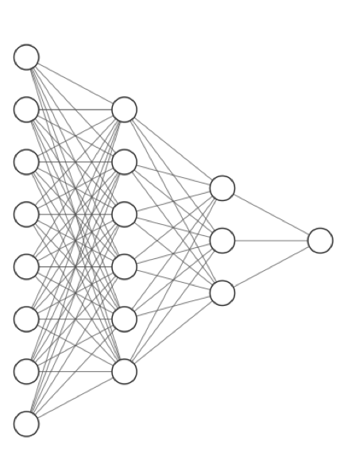
Scalable Deep Learning Provides 10x Improved Prediction Accuracy with Large Samples
Cosmological Simulation
Scalable 3D distributed convolution is a game changer…
Every code in ECP using AMRx could take advantage of this:
  Combustion, ExaSky, and ExaStar…
512^3 training samples
Data set: cosmoUniverse_2019_05_4pare
  https://petreldata.net/exalearn/
  https://portal.nersc.gov/project/m3363/cosmoUniverse_2019_05_4parE
CosmoFlow model [Mathuriya18] + batchnorm
Prediction of Omega_m
128^3 split samples
Notes:
Exciting results to our cosmology collaborators

Slide 16
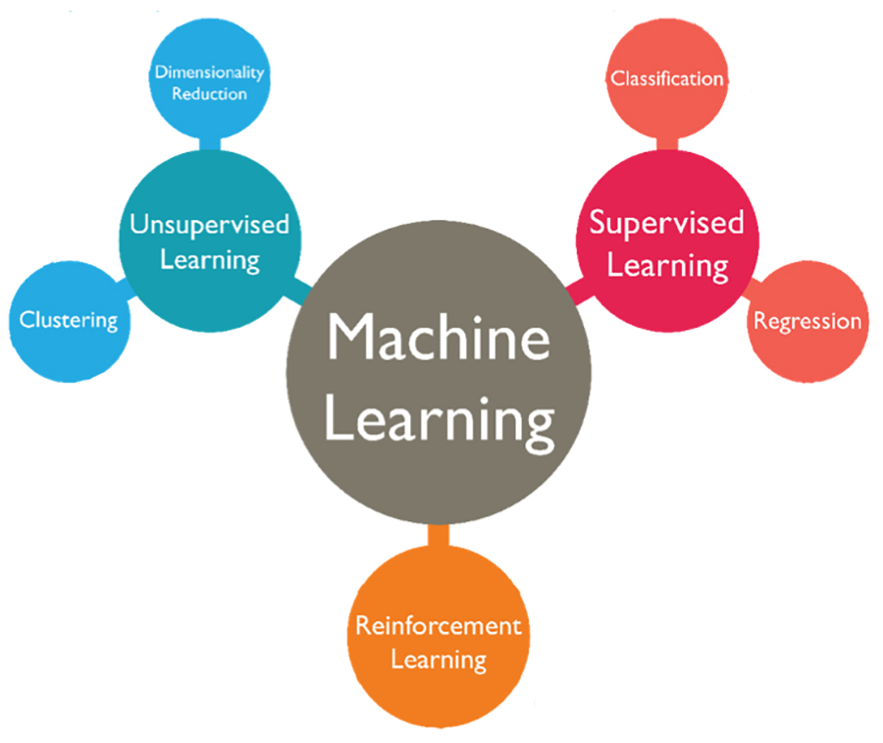
Machine Learning for Control: Why Reinforcement Learning?
Components of Reinforcement Learning:
Agent–sees observable environment states, has goals, chooses actions
Environment–everything outside agent, agent interacts with it
Policy–provides actions to perform
Reward–goal of reinforcement learning problem, maximize
Image courtesy Sutton, Barto, Reinforcement Learning 2017
RL versus other ML:
Considers the whole uncertain environment, not specific situations or subproblems—realistic problem
Agent’s goal is to maximize reward
Many actions in environment are required to learn optimal policy
Need to maximize rewards not find hidden structure
Uses unlabeled training data (cheap and easy to store)
Suitable for problems that need prediction capability
Learning from interaction not from labelled data
Unique challenge for agent to explore versus exploit
Image courtesy Vishakha Jha
https://www.techleer.com/articles/203-machine-learning-algorithm-backbone-of-emerging-technologies/

Slide 17
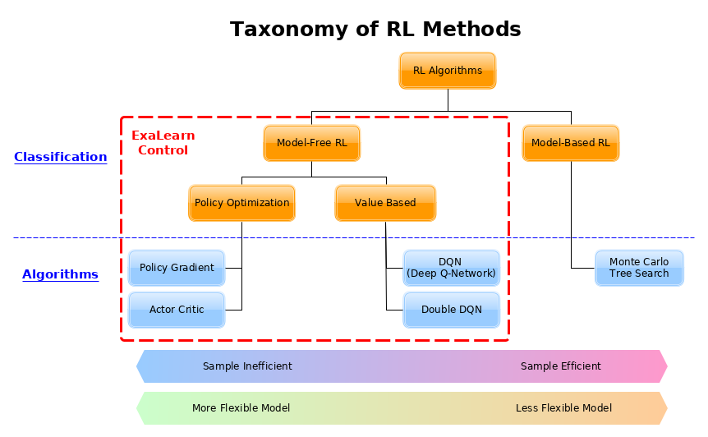
Developing Software for Various Reinforcement Learning Algorithms
Reinforcement Learning algorithms used: Focus on Model-Free RL (explicitly trial-and-error learners)
Value-Based Algorithms (based on temporal difference learning, create deep networks to represent value/Q functions):
  Using: Deep Q-network (DQN), Double Deep Q-network
Policy Optimization Algorithms (learn parameterized policy that can select actions without consulting a value function):
  Using: REINFORCE, Actor-Critic (AC), Advantage Actor-Critic (A2C) and Asynchronous Advantage Actor-Critic (A3C) for discrete and continuous action space. Continuous is useful for our domain and complex problem.
  Future: Deep Deterministic Policy Gradient (DDPG)

Slide 18
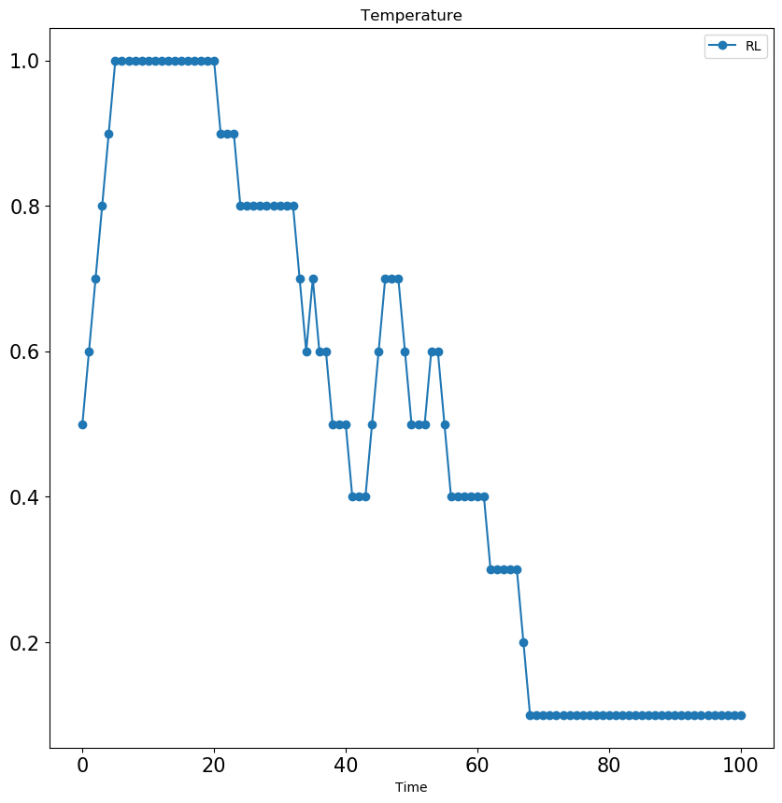
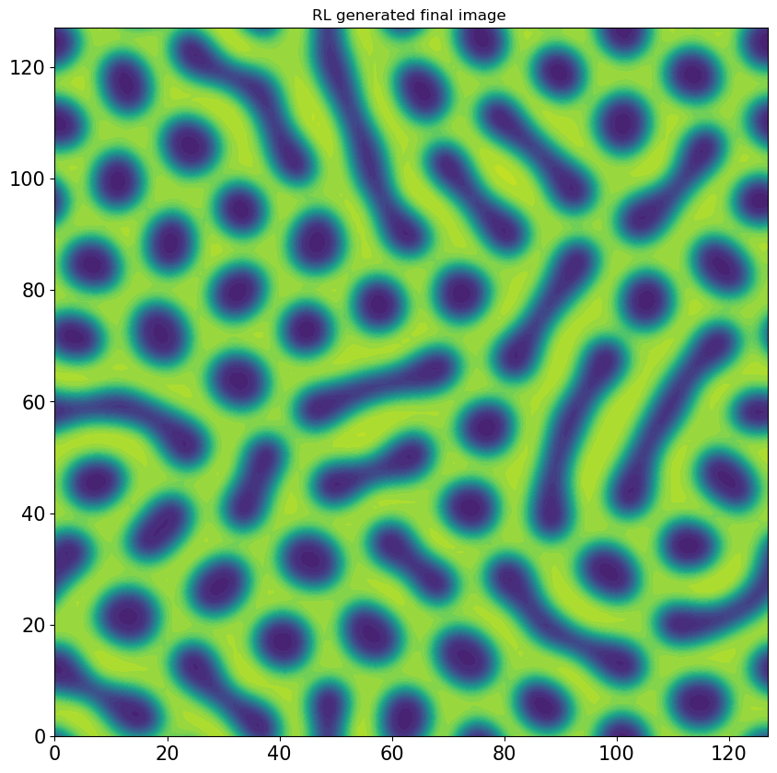
Status of BCP Control Use Case Software
Reinforcement Learning software to be available Sept 2019
  Online RL using 2D BCP simulation training data [1].
    Algorithms: Deep Q Network (DQN) and Double DQN, Software: PyTorch
  Offline RL using 2D BCP simulation training data [2].
    Algorithm: Deep Q Network. Software: PyTorch
  Online RL using 3D BCP simulation training data [3, 4].
    Algorithm: Actor-Critic and DQN. Software: OpenAIGym, Keras/TensorFlow
  2D and 3D structure vector generation code for training
  Hyperparameter optimization for 2D BCP RL via CANDLE framework
Scaled RL BCP use case software to be available FY 2020
a
b
Simulations and Training Data Now Available:
[1] 2D images using DeGennaro Cahn-Hilliard PDE simulation for fast online RL use
[2] 2D images using modified FEniCS Cahn-Hilliard PDE simulation (~3000 sims)
[3] 3D images using LAMMPS simulations (100s of sims)
[4] 3D images using Welch Cahn-Hilliard PDE simulation for fast online RL use
DQN RL algorithm develops policy that helps control temperature during self-annealing (a), which results in BCP morphology (b).
LA-UR-19-27506

Slide 19
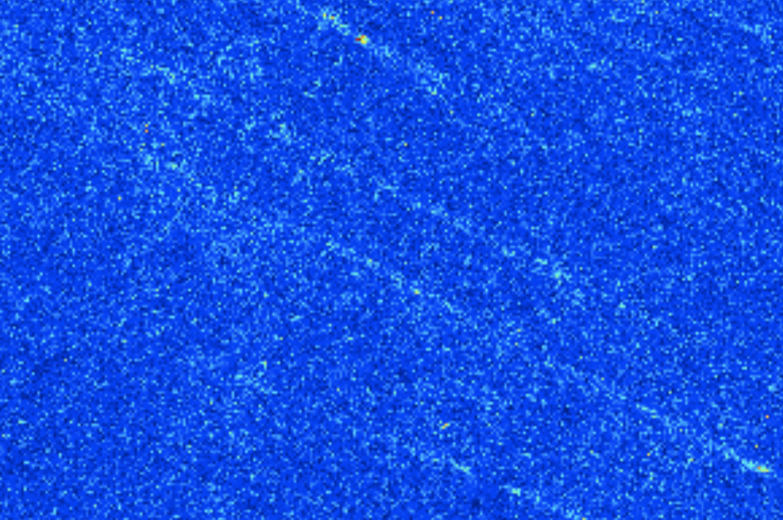
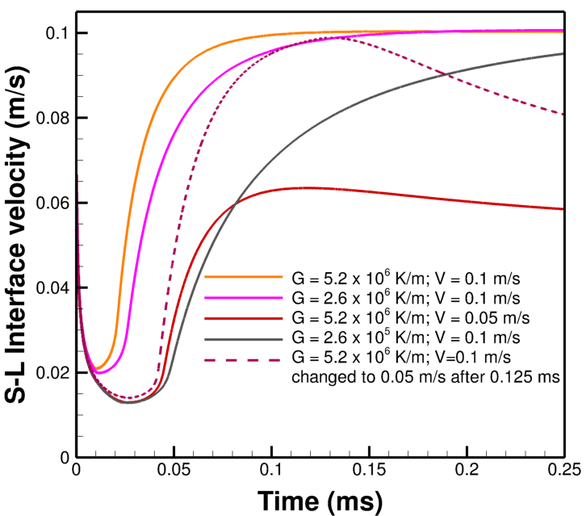
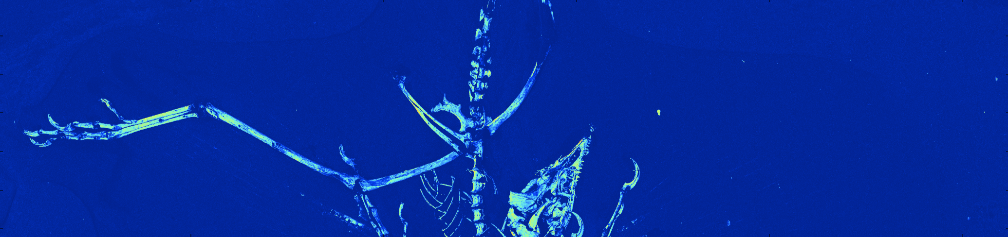
Upcoming Control Use Cases for FY20 and Beyond
Adaptive Illumination
Additive Manufacturing
SLAC/Stanford use case, training data and RL system (D. Ratner, J. Betterton, M. Kochendorfer)
AI use case: exploit image sparseness to improve acquisition time/X-ray dose/resolution by adaptively controlling acquisition.
Impact: Reduced imaging needed (shorter experiment time) at both synchrotron and XFEL light sources.
Example:
ExaAM use case, training data available (MEUMAPPS sim)
AI use case: Predict next steady-state behavior in the solidification of a metal to guide real-time annealing in line with the experiment.
Impact:
  Reduce expensive simulations because can predict the next steady state response for a thermal stimulus.
  Model system more dynamically to achieve desired end state.
Example:
Archaeopteryx feathers and bone chemistry fully revealed via synchrotron imaging. (left)
Image courtesy of U. Bergmann et al.
Simulation of directional solidification of a ternary Ni-Fe-Nb alloy. (left) The metal is in an unsteady state (dotted line) when transient behavior (slowed cooling rate) is introduced after the initial steady state was achieved.
Image courtesy of R. Balasubramaniam
Close-up of quills
LA-UR-19-27506

Slide 20




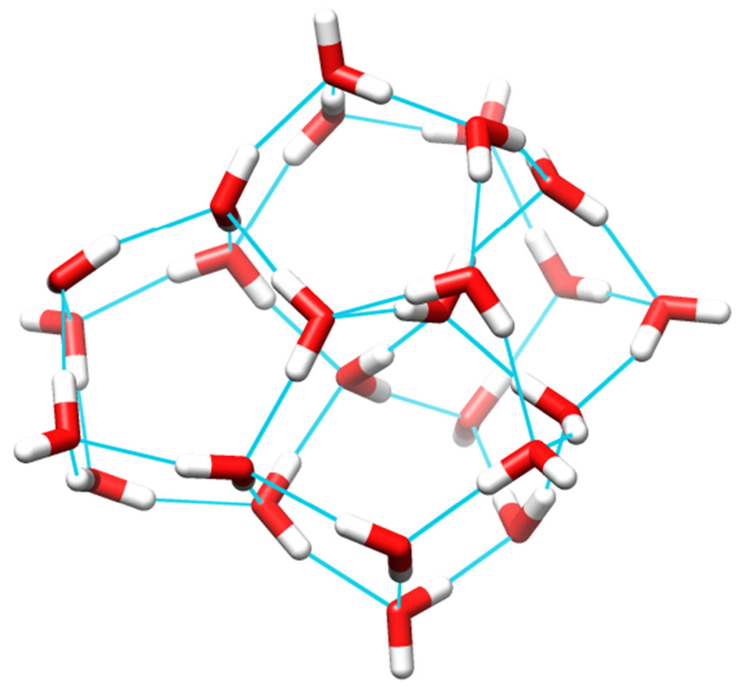
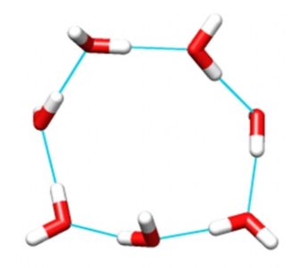
Design: Expanding Computational Design to the Exascale
HPC
Electrolytes
Better Batteries
Generate
Designs
Simulate Designs
Existing Solutions
Optimized Systems
Generate
Designs
Simulate Designs
Water Clusters
Better Science
Exascale HPC
Current Model: Humans steer HPC, HPC performs simulations (Months-Years)
Why is this limited? Humans are slow. Slow decisions, slow to learn
Needed Solution: HPC steering itself (Days-Weeks)!

Slide 21
Steering HPC Requires Extensive Machine Learning
Generative Models
Existing Solutions
Create Designs
Simulate Designs
Optimized Designs
ExaLearn
Design App
Score Designs
Select Simulations
Supervised Learning
Active Learning
Our goal is to provide a generalized framework for common data abstractions.
For example, data in multiple chemistry applications is modeled as graphs.
Our API will require users to focus on implementing a few functions.

Slide 22
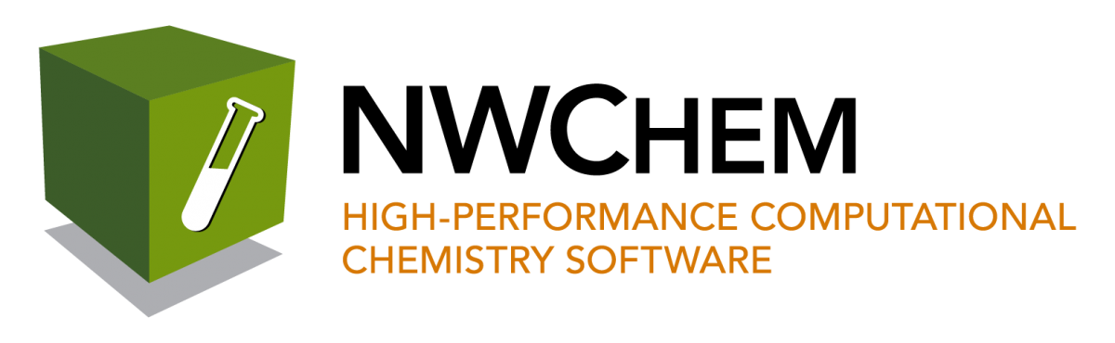
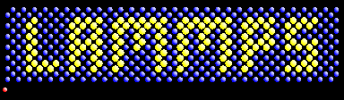
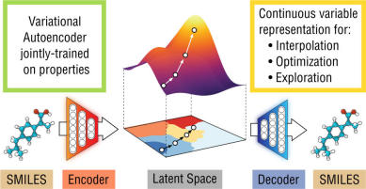
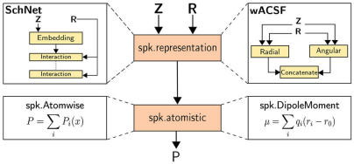

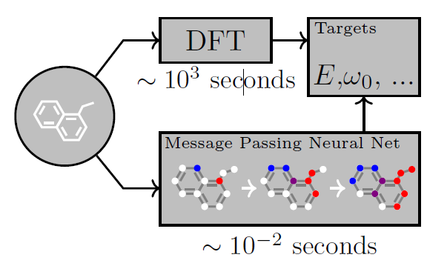
Example Workflow: Molecular Design
Graph/Molecular generative models (Autoencoders,
GANs, RL algorithms)
Atomistic Calculations:
Quantum or Classical
Existing Solutions
10³ mols
Create Designs
[10¹ node-hr]
10³ calcs
Simulate Designs
[10⁴ node-hr]
Optimized Designs
10⁵ mols
10³ cycles
10³ mols
1 calc/mol
Score Designs
[10² node-hr]
Select and Explanation of Top Designs
[10² node-hr]
10⁵ mols
Ensemble of Deep Neural Networks
Continuous-filter CNNs
Message-Passing Networks
[…]
Active Learning policies driven by graph descriptors, tuned with reinforcement learning

Slide 23
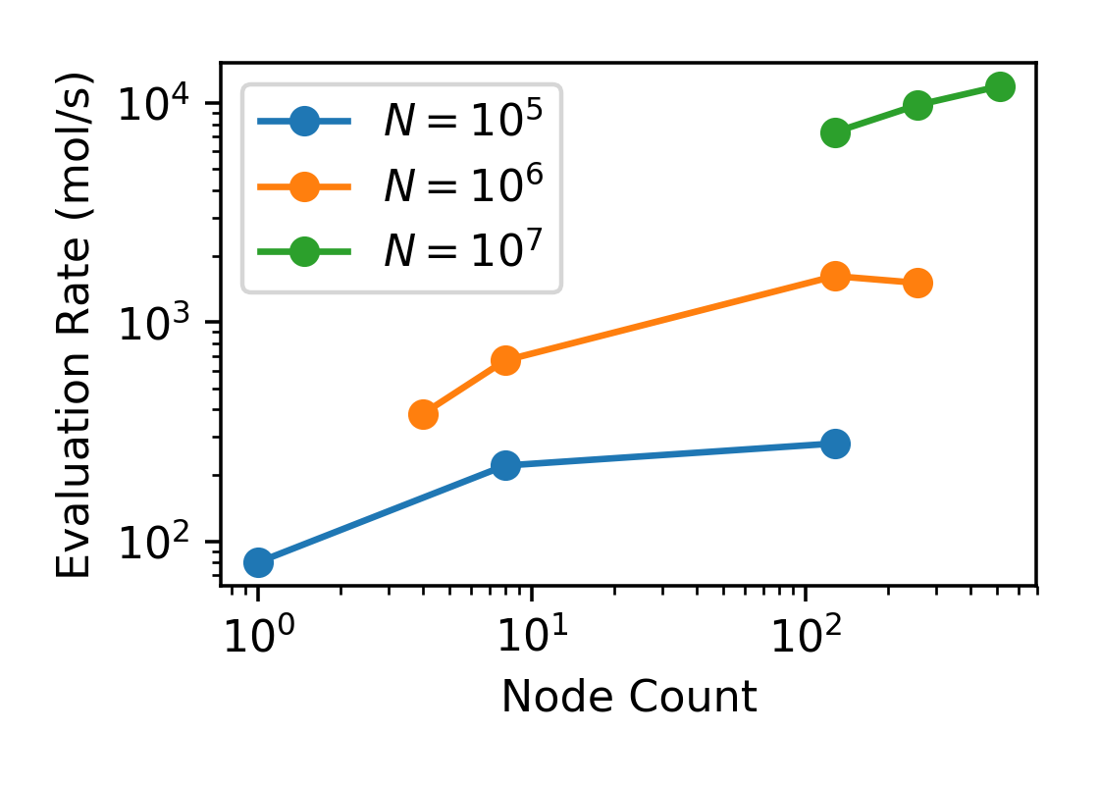
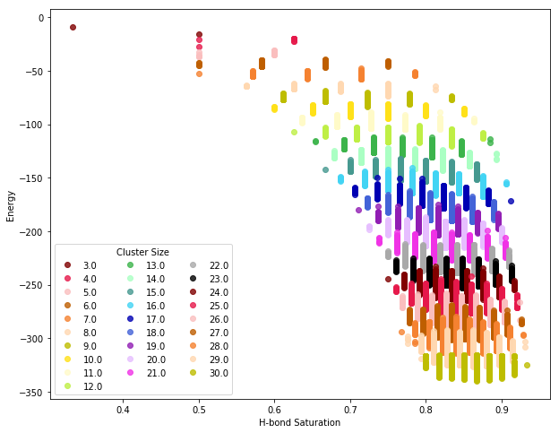
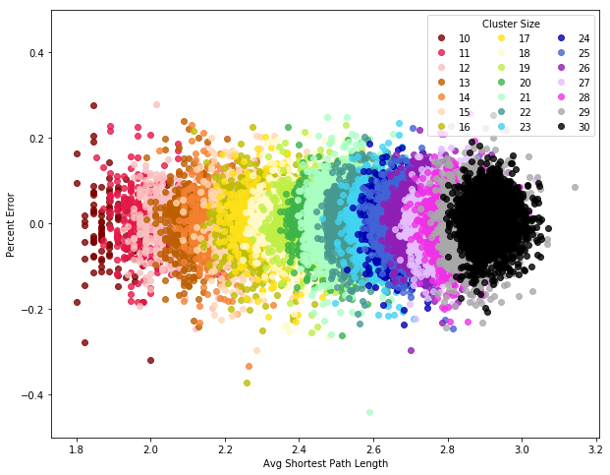
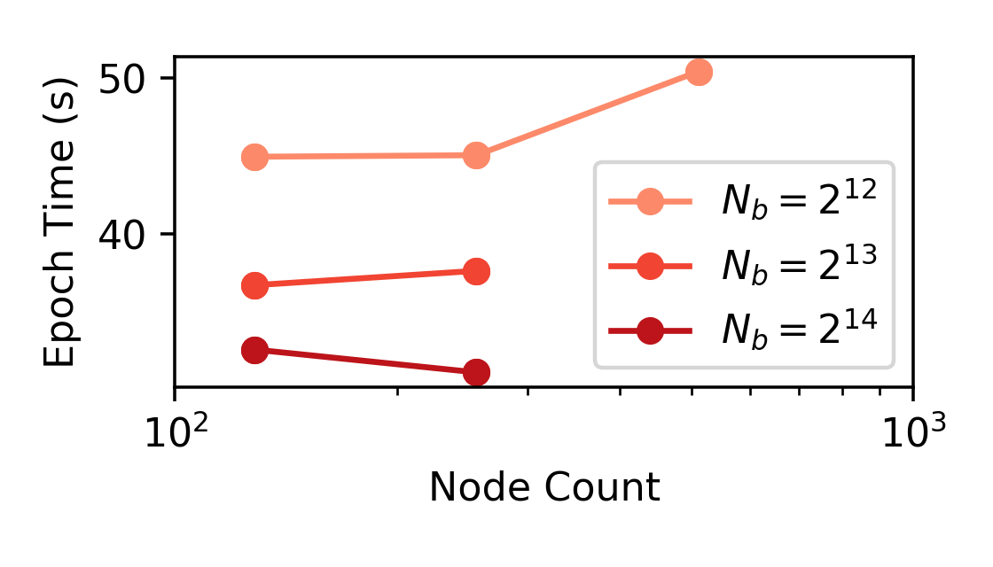
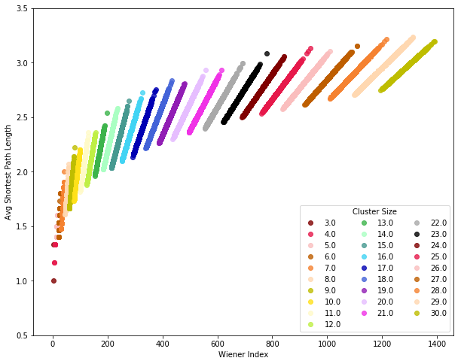
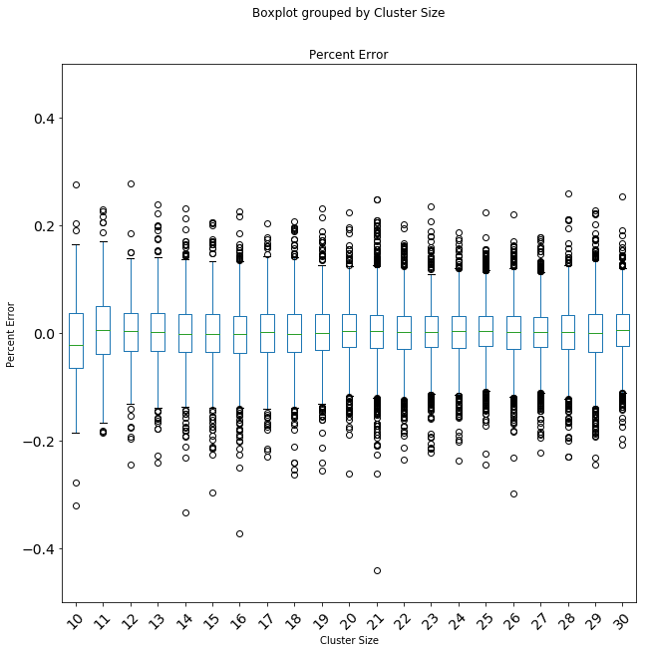
FY19 Results: Building Problem-Specific Components
RL-based implementation
of structure design
Scalability studies with
Graph-CNNs (on Theta and Summit)
General-purpose descriptors for interpretable models
1-bond addition
2-adds, 1-remove
Highest
energy
1-add
Lowest
energy
rotation
Develop Reinforcement Learning pipeline for graph-based networks (with ExaLearn control)
Tailor Reinforcement Learning algorithms with physics-aware ML algorithms
Develop interpretable ML models for graph-based models of atomic/molecular structure
Generate novel electrolyte molecules and water clusters
Notes:
Modeling water clusters
Graphs are from runs on Theta – starting runs on Summit
Right hand side is showing the structure of graphs for the molecules as descriptors
- Plotting
Bottom right – training error for different structures
LL – scatter plot of weiner index (measure of connectivity) and distance
ExaGraph is focusing on huge graphs, this is focusing on millions of small graphs

Slide 24
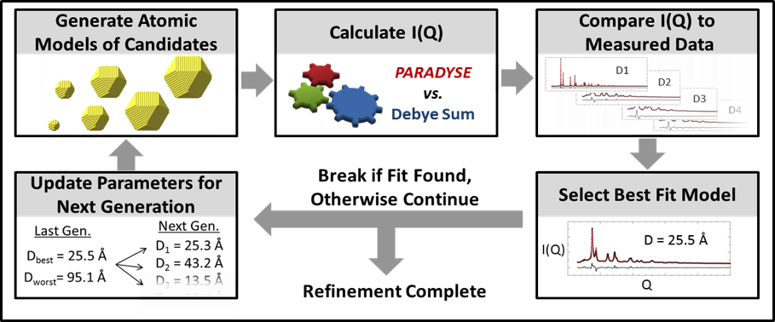
Machine Learning for Inverse Problems
Current Loop Refinement Method
Problem Definition
Use ML methods to solve the inverse problem of predicting material structures from experimental data
(diffraction patterns called Bragg profiles in this demo)
Expensive Forward Simulation
Main FY19 Outcomes
Scalable distributed framework for generation of labelled simulated neutron diffraction data set implemented; Framework potentially generalizable to other simulators.
Multiple labelled data sets of modest sizes generated; Initial design of a classifier for structural symmetry prediction tested.
Multiple shallow regressor models for parameter predictions trained; Using best model, about 90% prediction accuracy demonstrated.
Together, these constitute one of the first evidences of the feasibility of material structure prediction using neutron scattering data.
All efforts in the inverse problem application built ground up from scratch; Paper reporting this effort to be submitted in October, 2019
Inferences are time-consuming, less accurate and model-driven
Proposed ExaLearn Method
Team
Cristina Garcia Cardona (LANL), Ramakrishnan Kannan (ORNL), Thomas Proffen (ORNL), Travis Johnston (ORNL), Katherine Page (ORNL/UTK), David Womble (ORNL), Sudip K Seal (ORNL, POC)
Once trained, predictions are fast, more accurate and data-driven
Notes:
This slide lays out the scope of the specific inverse problem we are tackling – predicting material structure from its neutron scattering profile.
Top right figure is to highlight the expensive (many days to weeks) loop refinement process currently used to determine material structure from diffraction profiles
Bottom right figure shows that trained ExaLearn ML models will directly predict material structure from scattering profile.
Green pane lists FY 19 outcomes (ALL work done from scratch within ExaLearn)
Blue pane lists Inverse Problems team

Slide 25
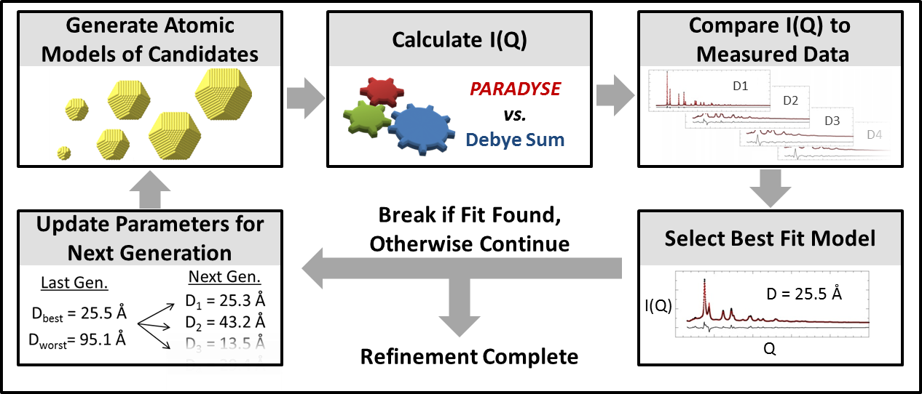
Inverse Problems in Materials Science : ML Pipeline
ExaLearn Pipeline for Material Structure Determination from Neutron Scattering Data
Instrument Information
Predict Symmetry of Structure
(Trained ExaLearn Classifier)
Predict Internal Parameters of Structure
(Trained ExaLearn Regressor)
Inter-ionic distances
Bond angles
Thermal parameters
…
Bragg Profile
Symmetry
There are seven crystallographic classes in all
No. of parameters vary depending on the symmetry class.
Preliminary
ExaLearn
classifier classifies three symmetry classes
Preliminary
ExaLearn
regressor is based on random forests
Notes:
Top figure: The proposed ML pipeline is shown on top. Has two main steps:
Use a classifier to predict one of seven possible space group symmetry groups the target material can belong to.
Once space group symmetry is determines, the regressor predicts structural parameters like inter-atomic distances, bond-angles, etc.
Bottom left figure: preliminary classifier (preliminary design next slide) can classify three out of seven symmetry groups.
Bottom right figure: preliminary regressor (using shallow models) can predict parameters with about 90% accuracy.
Bottom right figure shows that experimental diffraction pattern (from the NOMAD diffractometer in SNS) compared with the pattern simulated using parameters predicted by ExaLearn ML pipeline.

Slide 26
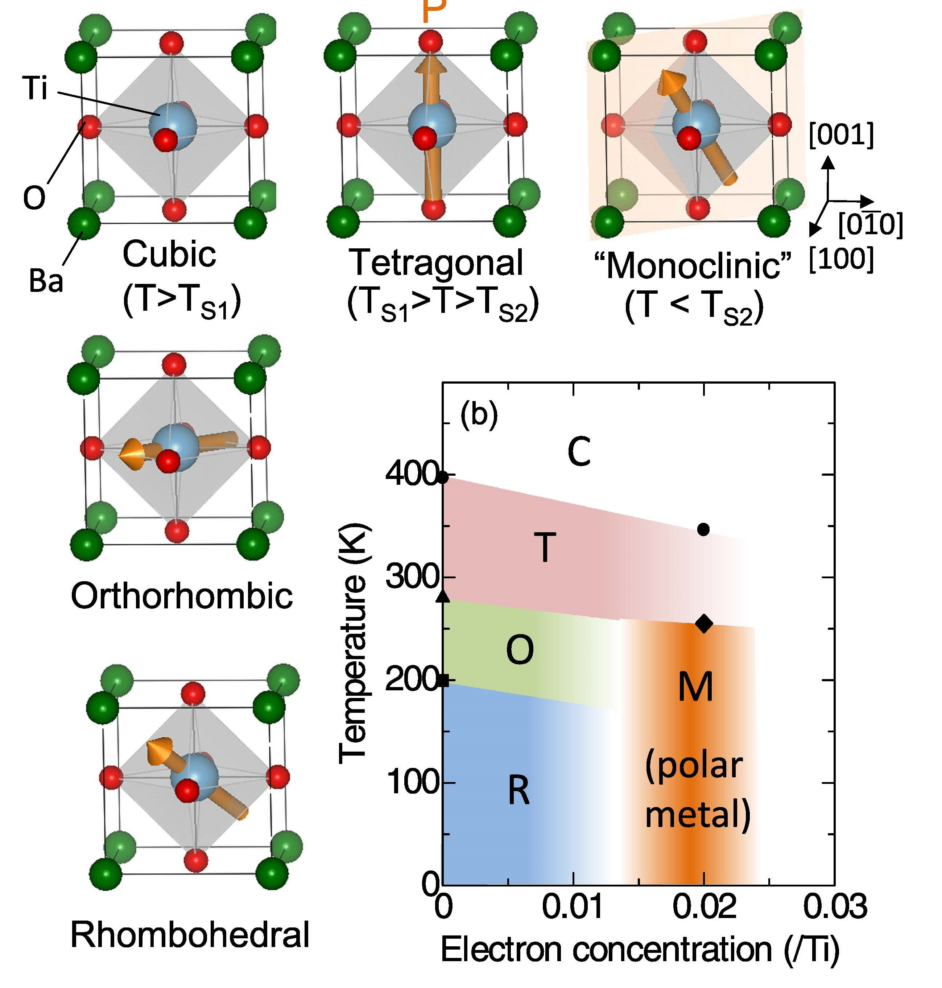
Inverse Problems in Materials Science : Status
Input
Information
Parallel Distributed Surrogate Simulations
Labeled Samples (Bragg Profiles)
Training Data Generation
Instrument specifications
Inter-ionic spacings
Bond angles
Thermal parameters
…..
<X₁,y₁>
Class Label | Data Size | Time Taken (in hr) | No. of Cores
Cubic | 125,000 | 120 | 2
Monoclinic | 297,910 | 32 | 24
Triclinic | 804,357 | 10 | 48
Tetragonal | 998,584 | 96 | 48
GSAS Diffraction Simulation
<X₂,y₂>
GSAS Diffraction Simulation
….
GSAS Diffraction Simulation
GSAS Diffraction Simulation
<X_{i},y_{i}>
….
<X_{n},y_{n}>
Bragg profile
Parameters
Generation of Large-scale Training Data
Initial Design of Classifier
1D-Convolution (16 kernels, width 3)
1D-Max Pooling (kernel width 2)
1D-Convolution (32 kernels, width 4)
1D-Max Pooling (kernel width 2)
Fully Connected Layer (256 hidden neurons)
ReLU (non-linear activation)
Fully Connected Layer (3 output neurons, one for each class)
Softmax (probability distribution over the 3 classes).
Initial Evaluation of Regressors
Unconstrained Least Squares
Non-Negative Least Squares
Multi-Label Regressor with Gradient Boosted Trees
Support Vector Machine – Regression
Random Forests
Best performance
(about 90% accuracy with cubic symmetry)
Labelled data generation for the full problem space and training deeper networks will require extreme scale compute time and resources – next steps!
Models were tested against annotated experimental data from the NOMAD diffractometer in SNS
Notes:
This slide summarizes the status of this demo application
Three main accomplishments:
Training data generation (top blue pane)
A parallel framework to generate labelled training data sets using a pre-existing sequential neutron diffraction simulator called GSAS was developed.
Using this parallel generator, labelled examples of several symmetry groups were generated on Theta (ALCF). See table.
Initial design of classifier was tested (see green pane for initial design )
Initial evaluation of multiple shallow models was performed. Random forests provided the best prediction with about 90% accuracy.
Testing and validation as performed against real experimentally obtained and annotated data as the ground truth data. The experimental data was from the NOMAD diffractometer in SNS on a perovskite material called barium titanate (BaTiO₃).
These shallow models established the baselines against which the performance of deep models will be compared (to be done next).
Data generation to sample the complete structural space of the seven symmetry groups as well as training deep models on these large data will require extreme-scale leadership class resources.

Slide 27
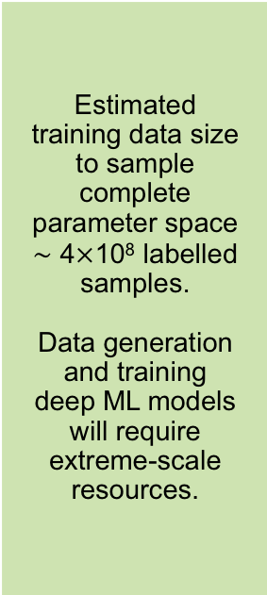
Next Steps
Estimated training data size to sample complete parameter space $\sim$ 4$×$10⁸ labelled samples.
Data generation and training deep ML models will require extreme-scale resources.
TASK | NOW | TARGET
Training Data Generation | Labelled examples of three crystallographic symmetry classes generated; partial parameter space sampled. | Generate labelled examples of seven crystallographic symmetry classes; sample complete parameter space.
Classifier Development | Classifies three of seven symmetry classes. | Improve classifier to classify seven symmetry classes.
Regressor Development | Shallow models with about 90% prediction accuracy. | Deep learning models with greater than 90% prediction accuracy.
Instrument Dependence | Models are currently diffractometer specific (NOMAD, SNS). | Instrument-agnostic models (transfer learning).
Domain Dependence | End-to-end ML pipeline is neutron scattering specific. | Generalize ML pipeline to include other domains.
The pipeline will be generalized to include inverse problems in other domains, for example:
Predictions of plasma equilibria configurations in tokamaks and stellarators based on measured diagnostics.
Structure prediction from X-ray crystallography data.
Potential Partnerships with Other ECP Projects
EXALEARN INVERSE PROBLEM
NWCHEMEX
EXAALT
Notes:
This slide outlines some next steps and is self-explanatory.

Slide 28
Principles of
ExaLearn Software

Slide 29
ExaLearn Software v1.0: Coordinated Collection of Tools Employed by All Four ExaLearn Application Pillars
A credible collection for use within HPC centers that address the DOE’s unique infrastructure
  Intended for expert users
  Includes mechanisms for distributing data and for accessing models
Includes capabilities developed by the cross-cut teams for addressing learning at scale
  For example: support for 3D-distributed convolutions
Use case:
  What it is? ​Proof of concept for surrogate or control use case
  Who can use it? Multidiscipline teams who can see their problems through the lens of the application pillar
  How challenging would it be for a new user? Variable based on degree of alignment with pillar
  What’s new? Scalable 3D convolution support, environment and framework for RL, online RL with scientific use case

Slide 30
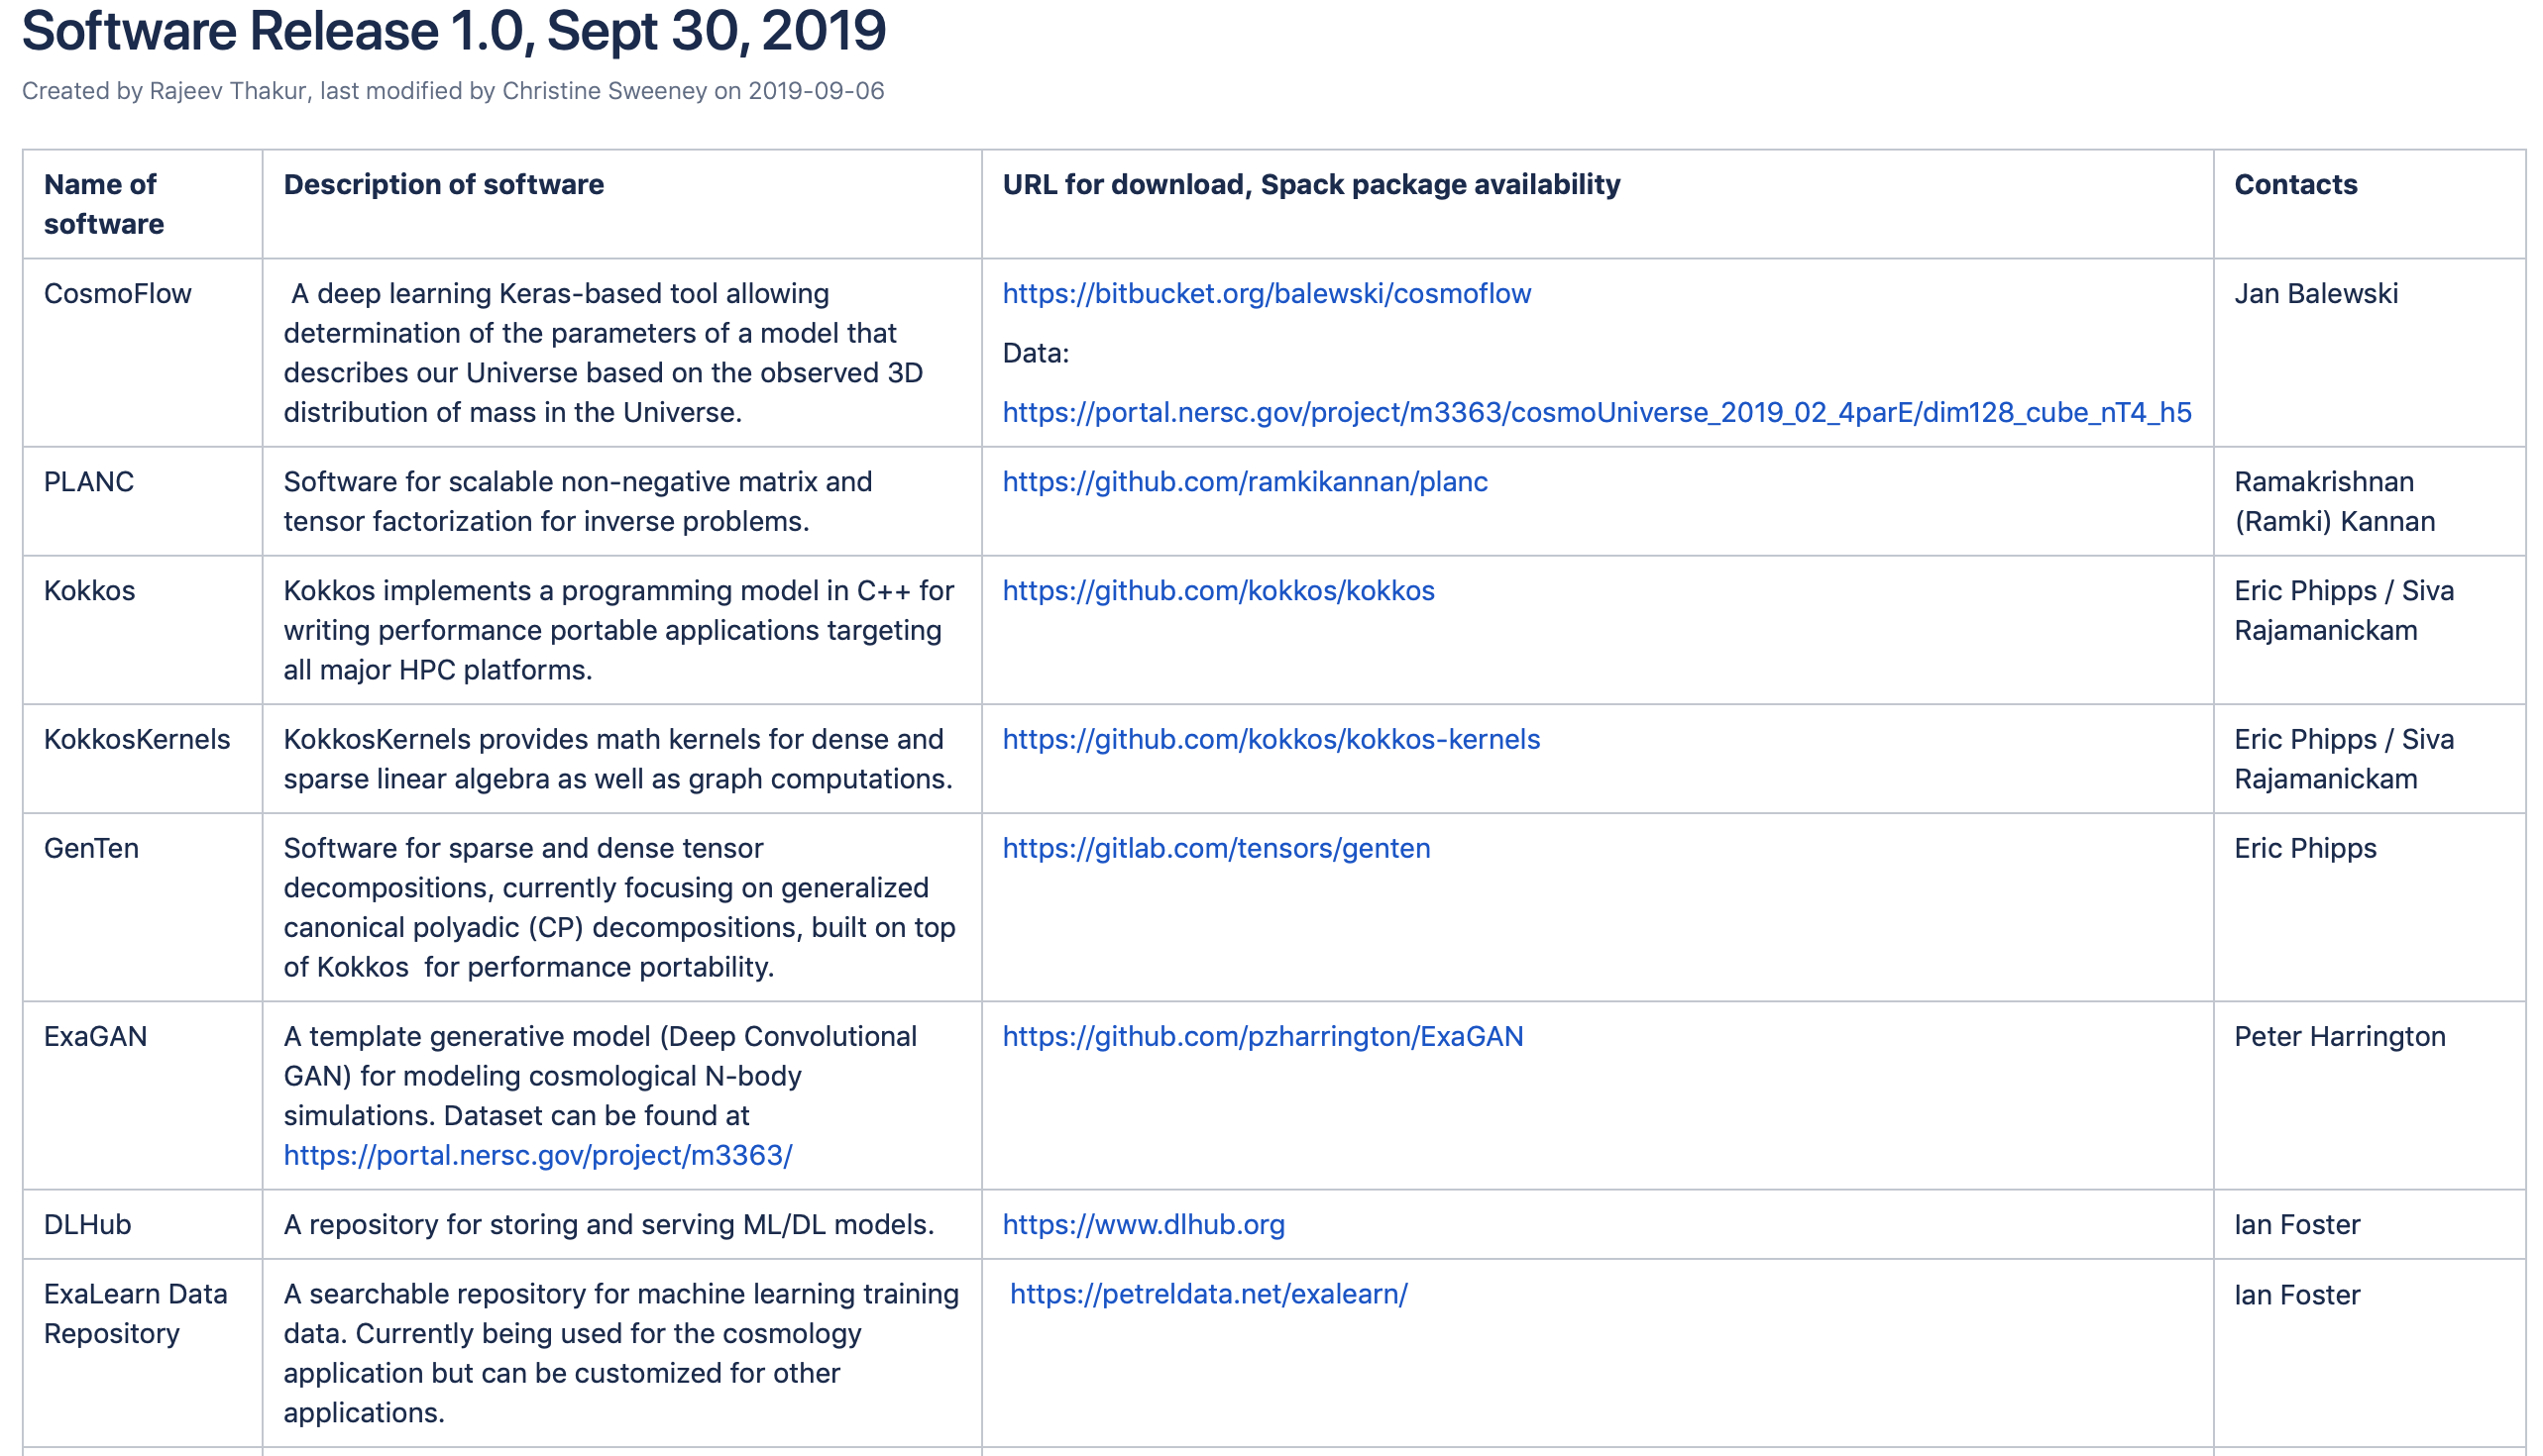

Slide 31
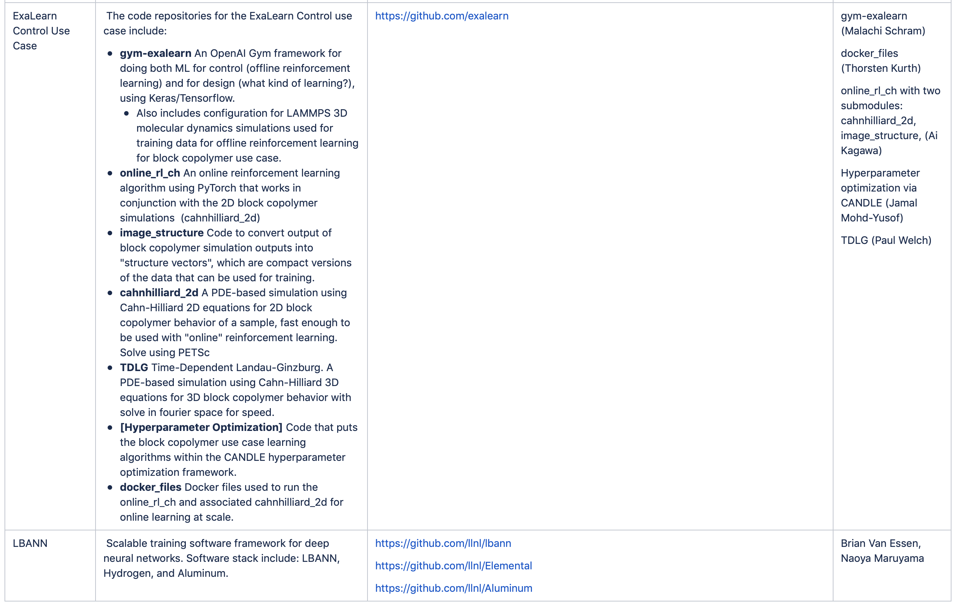

Slide 32
UQ: A Critical Component of All Scientific Machine Learning Efforts
ExaLearn will work in collaboration with domain scientists to develop appropriate
Uncertainty Quantification tools for the individual application pillars.
  Analyzed surrogate accuracy for increasing training data volumes, assessing generalization error and error in specific summary statistics of interest
    Preliminary results on combustion flame speed computations
  Planned: A-posteriori analysis of trained machine learning models, sensitivity analysis, robustness to data noise, NN architecture changes
combustion NN surrogate for laminar flame speed
generalization error for increasing data volumes
relative error on flame speed summary statistic for increasing data volume
Vision: Enabling probabilistic neural network training, with mean and variance estimates on network parameters, to assess predictive fidelity of surrogate models
Tiernan Casey, Bert Debusschere, Sandia National Labs
NN=Neural Network

Slide 33
Objective-Driven Experimental Design
Scientific Simulations
(MD, Cosmo...)
Motivation: At large scales, simulation “efficiency” runs
risk of being lower without careful steering. Or “wrong”
“suboptimal” calculations may be performed without
careful analysis of results generated.
Definition: ODED is an ML-enabled autonomous system
to design and execute computations.
End Results:
  To reach the objective earlier (with less computation)
  To produce a better result (within the computation budget)
How It works:
  Iterative learning, simulation, and objective evaluation
  Autonomous Control Module could be Reinforcement Learning, Active Learning, or other types of modules.
Autonomous Control Module
(RL, AL...)
Objective Evaluation

Slide 34
ODED Example: A Simplified Cosmology Problem–Parameter Estimation (Classification)
Cosmology Simulations (MUSIC, COLA)
Given a 3D sub-volume of the universe (from simulation), predict
the parameter \omega-m \in [0.15, 0.40] (6 classes in total)
Objective: Train an estimator with as few simulation
runs as possible
CosmoFlow CNN model is used.
Current Stage:
  Using PyCOLA as the simulation software
  One-degree of freedom to control the simulation (\omega_0)
  On local 8-GPU compute node
Future:
  Use a more expensive N-body simulation (e.g., GADGET)
  Expand to more degrees of parameters on leadership machines
  Provide a library to generalize the capability to other applications
Active Learning
DL network

Slide 35
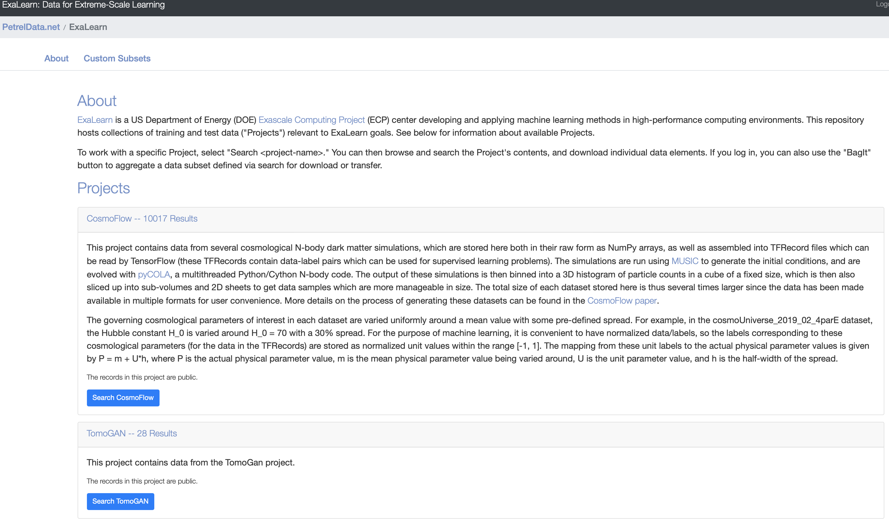
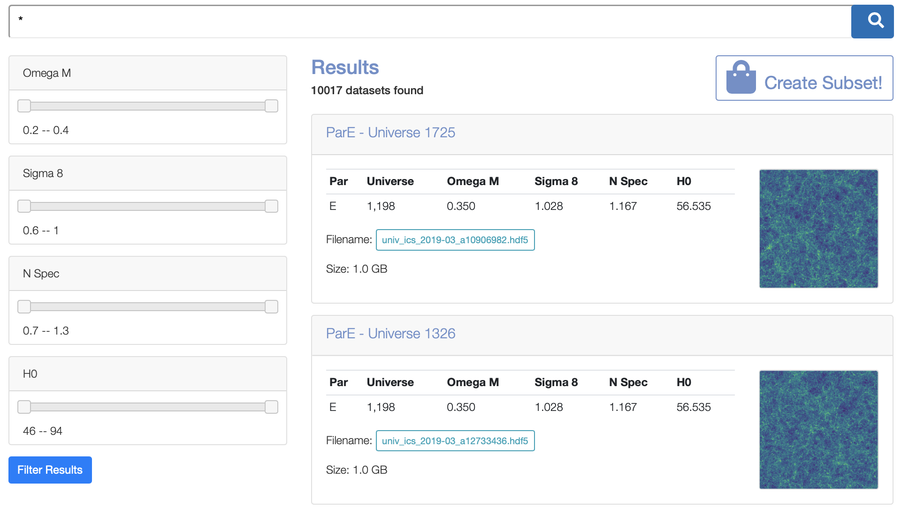
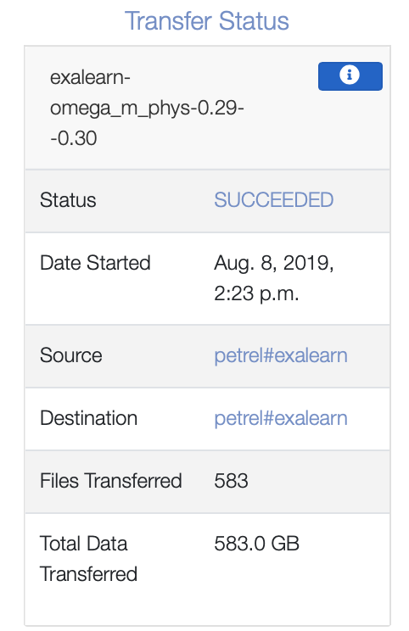
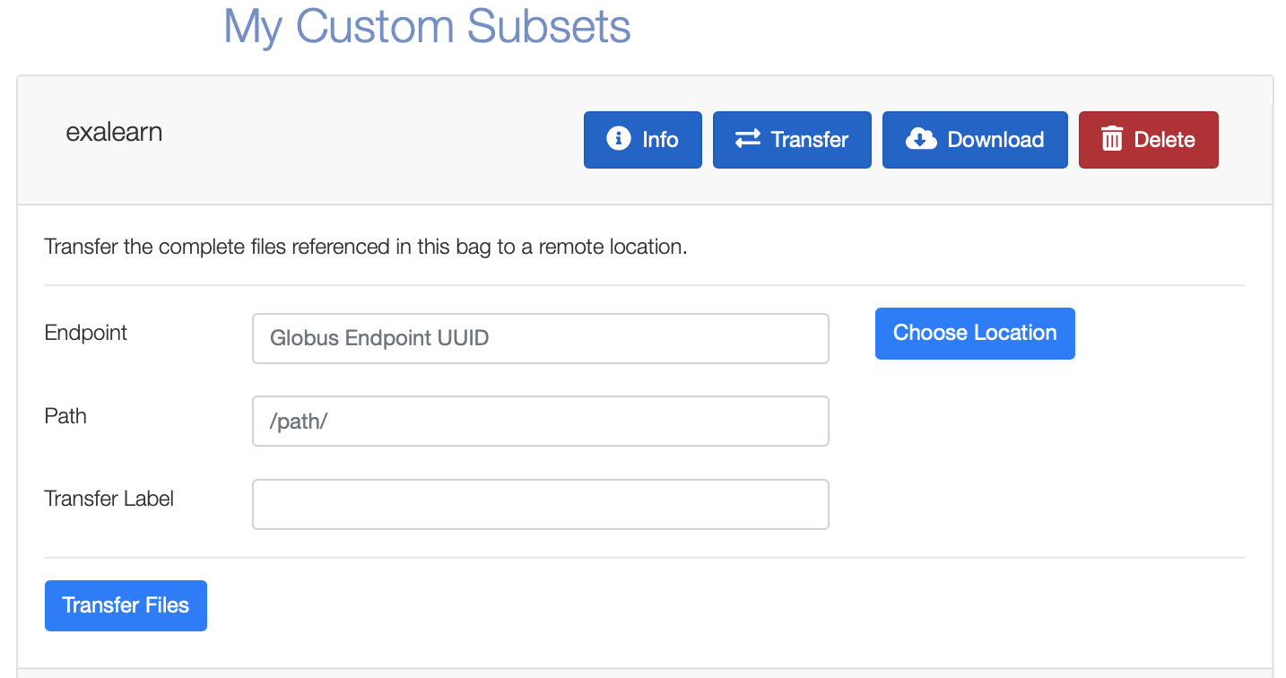
Searchable Repository for Machine Learning Training Data
Navigate
Select
Download
Subset
Creating a framework for organizing and distributing data is an important element of ExaLearn. To enable reproducible experiments, ExaLearn also is populating a searchable catalog of training data.
petreldata.net/exalearn

Slide 36
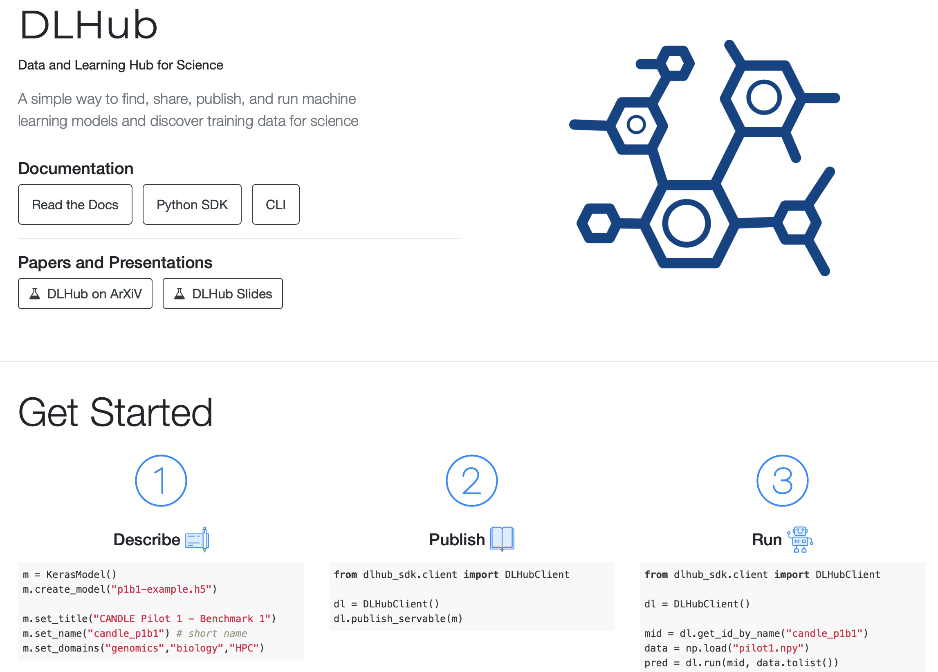
Online Access to ExaLearn Models
dlhub.org

Slide 37
Outreach Opportunities
2020 ECP Annual Conference:
ExaLearn Tutorial

Slide 38
Hackathon for ML Surrogates
Proposed for January 2020
The goal of the surrogate hackathon is to replicate the success of bringing scalable deep learning to the ExaSky application
The culmination of the hackathon will be a two-day, in-person gathering where domain scientists are able to bring their data to the meeting and leave with a recipe for training a relevant neural network at scale
Coordinating a successful event will require the following preparation steps for the ExaLearn scalable ML team and domain scientists:
  Identify the exact data set available: labels, sufficient diversity, known and accessible format type
  Understand the goals of a potential neural network and assure the core capabilities exist within LBANN
  Capture requirements for data ingestion and preprocessing
With these steps, during the hackathon, the teams will educate each other and bootstrap capabilities for domain scientists to begin using scalable deep learning and identify new research challenges for ExaLearn performance cross-cutting

Slide 39

ExaLearn Control Hackathon Spring 2020
Hackathon both for RL methods and for scalable RL
Users bring:
  Training data set
  Existing RL code
  A way to simulate quickly for “online” RL
  A means to visualize data sets
  Reliable reduced training data (”vector”)
  Value function (how close are data to goal?)
Team will:
  Provide instruction on scalable RL, what it is, and how they can use it
  Work with programmers to implement a few different scalable RL algorithms
  Help with techniques for hyperparameter optimization for scalable RL algorithms
  Teach programmers how to measure performance of scaled RL algorithms
  Help users to scale most promising algorithm on large clusters containing GPUs
Image courtesy hackernoon.com
LA-UR-19-27506

Slide 40
Vendor Interactions
Leads: Michael Wolf (SNL) and Jim Ang (PNNL)
Direct vendor engagement (Cray, Intel, HPE, AMD, IBM, NVIDIA)
  Introduced ExaLearn at vendor ”deep dives” for Intel, AMD
  Additional meetings/discussions with vendors: e.g., representing ExaLearn CDC at PathForward semi-annual reviews
Develop ECP ML proxy applications
  First cosmology/surrogate model ML proxy application
    End of FY internal release (software, data sets, report) to ExaLearn team and collaborators/vendors
  Future: Work with ECP proxy application team to define ExaLearn proxy apps and problem sets as part of ECP proxy application suite
  Future: Work with ECP vendors to integrate the proxy application into their suite, gather initial feedback, and establish connections among interested collaborators
  Future: Additional proxy applications for additional ML use cases
Scalable ML software
  Deliver initial version of the software performance portable 3D convolution and tensor decomposition kernels targeted toward exascale architectures (delivered through GenTen and KokkosKernels)
  Baseline for vendor improvements in ML math libraries: AMD, Intel, and NVIDIA

Slide 41
Connection to Other ECP Projects
ExaSky
  Working with CosmoGAN and CosmoFlow networks
CANDLE
  Leveraging Supervisor Hyperparameter framework
CODAR
  Coordination of multiple tasks (e.g., hyperparameter optimization via CANDLE supervisor, developed in collaboration with CODAR)
  Online analysis and model output reduction
Pele
  Uncertainty quantification
ASC
Facilities: NSLS-II
Future Plans
  Control: ExaAM, CoPA, ExaALT, LCLS-II
  Surrogate: Tokamak Plasma, ExaSTAR
  Inverse: Tokamak Plasma
  Design: NWChemEx

Slide 42
Thus Far, ExaLearn Has:
Integrated scalable ML with Cosmology with ExaSky as in KPP-3 metric
  Decided goal for 2020 hackathons will be to enable this type of exchange transfer with other ECP projects
Demonstrated unique capability to train models that provide quantitatively better science at unprecedented scale on Sierra (Surrogate and Performance teams).
  Ongoing benchmarking for the I/O is taking place on Summit, and software is getting ported to Perlmutter EA systems.
  Within the surrogate application pillar, the task of training deep neural networks, such as CosmoFlow and CosmoGAN, is extremely GPU friendly.
  The LBANN scalable deep learning tool has trained CosmoFlow on 512 GPUs (128 nodes).
  LBANN also has trained another CycleGAN network using 16,384 GPUs on all of Sierra.
Run reinforcement learning on Summit and Cori with help from NESAP, a pre-Perlmutter program (Controls team).

Slide 43
A Summary Look
To achieve the results shown today, we have used a combination of existing state-of-the-art open-source software and ECP projects with new capabilities developed under ExaLearn.
Control use case leverages OpenAI Gym, PyTorch, TensorFlow, PetSC, LAMMPS, CUDA, profilers, and used ParaView a little as workflow building blocks.
For scalable deep learning, we are building on LBANN and CANDLE, both partially developed under ECP projects.
  For LBANN, we have a toolkit that provides easy management of large-scale parallelism while adopting a frontend that looks like an industry tool (PyTorch).
  Furthermore, we are adopting support for standard model exchange formats such as ONNX.
  Raw capabilities built into LBANN are easily generalized to other applications.
  We have developed a flexible data ingestion frontend that can natively execute Python code snippets from standard industry training pipelines.
These tools are released into the open source as is standard practice for the ML community.

Slide 44
Future Vision: Integrate the Four Machine Learning Types in ExaLearn for a Single Application
Example: Tokamak Plasma Fusion
Generate goal-driven surrogate models for dynamic processes to replace expensive whole device simulations (WDM)
Use these surrogates to generate training data for a RL-based real-time controller
Apply pipeline from the inverse problems pillar to predictions plasma equilibria configurations in tokamaks and stellarators
Apply tools from the design pillar to optimize tokamak design and control policy
EXAWIND: Exascale Predictive Wind Plant Flow Physics Modeling
Combustion-Pele: Transforming Combustion Science and Technology with Exascale Simulations
ExaSMR: Coupled Monte Carlo Neutronics and Fluid Flow Simulation of Small Modular Reactors
MFIX-Exa: Performance Prediction of Multiphase Energy Conversion Device
WDMApp: High-Fidelity Whole Device Modeling of Magnetically Confined Fusion Plasmas
WarpX: Exascale Modeling of Advanced Particle Accelerators

Slide 45
Thank you!

Slide 46
Backup Slides

Slide 47
Parallelizing the CosmoFlow Compute Graph
Hybrid Partitioning: Sample + Spatial parallelism across two nodes with eight GPUs

