Slide 1
Introduction to HDF5
Quincey Koziol
Principal Data Architect
NERSC – LBNL
koziol@lbl.gov

Slide 2
Why HDF5?
Have you ever asked yourself:
  How will I deal with one-file-per-processor in the petascale era?
  Do I need to be an “MPI and Lustre pro” to do my research?
  Where is my checkpoint file?
HDF5 hides all complexity so you can concentrate on Science
  Optimized I/O to single shared file

Slide 3
Goal
Introduce you to HDF5
  HDF5 Overview
  HDF5 Data model
  HDF5 Programming model
Notes:
300+ API
High points, little programing,

Slide 4
What is HDF5?

Slide 5
What is HDF5?
HDF5 == Hierarchical Data Format, v5
Open file format
  Designed for high volume or complex data
Open source software
  Works with data in the format
An extensible data model
  Structures for data organization and specification
Notes:
HDF5 no relationship to HDF4, not back ward compatable, translater.
Open source, downloat, patches, like to hear
Analogous to…..

Slide 6
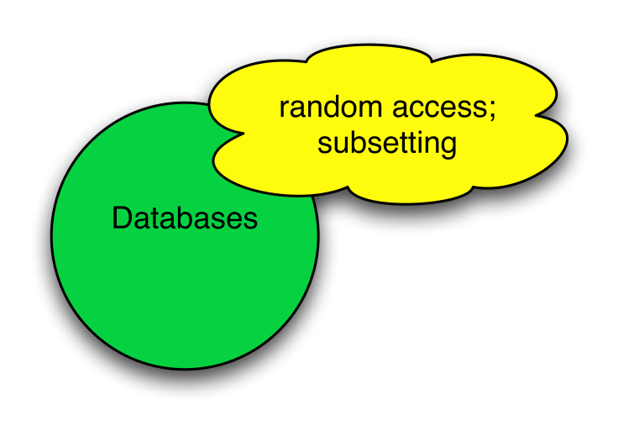
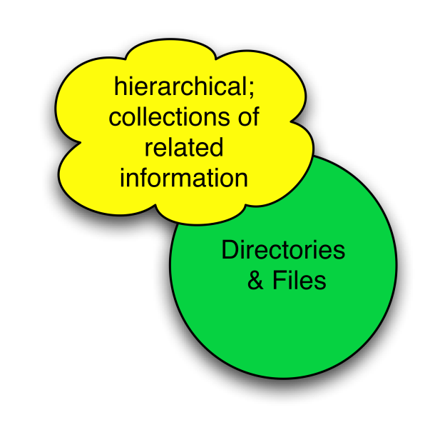
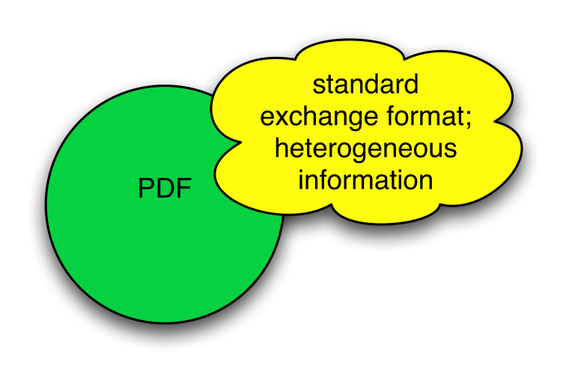
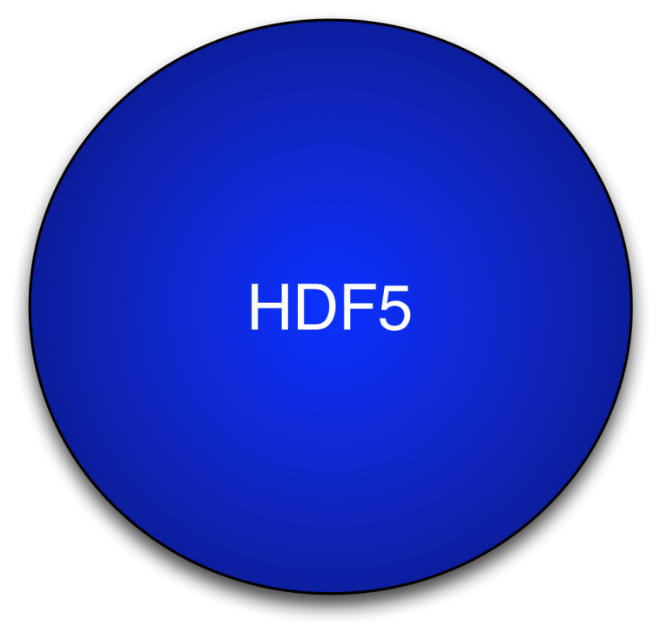
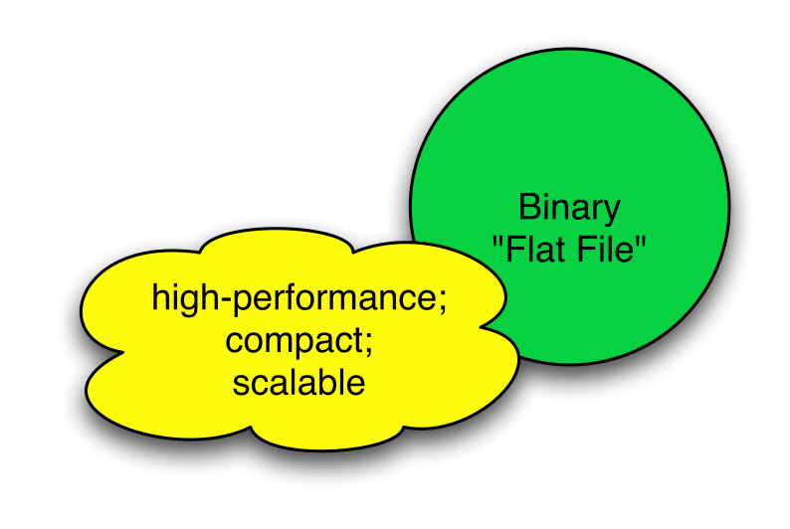
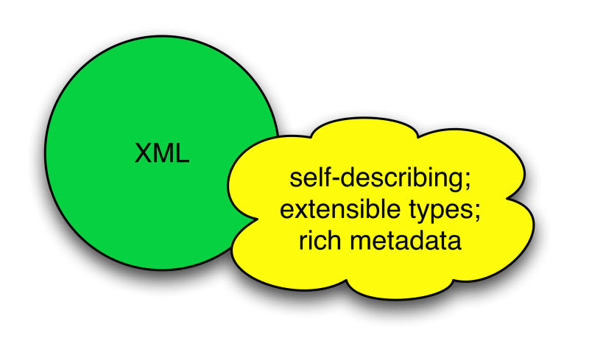
HDF5 is like …
Notes:
Xml –
Binary component
Pdf of science data, portable
Like a grouping, links between object,
Not exactly like any of these things, fast, runs everywhere,

Slide 7
HDF5 is designed …
for high volume and/or complex data
for every size and type of system (portable)
for flexible, efficient storage and I/O
to enable applications to evolve in their use of HDF5 and to accommodate new models
to support long-term data preservation
Notes:
Get data back in 50 years, simulation data available for future comparison, NASA satellite data available for 50 plus years, archive the data.

Slide 8
HDF5 Data model
Notes:
Ab

Slide 9
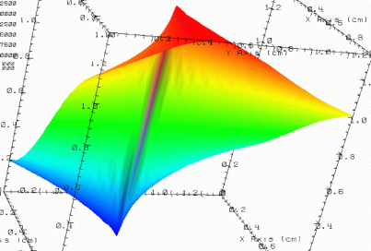


HDF5 File
lat | lon | temp
----|-----|-----
12 | 23 | 3.1
15 | 24 | 4.2
17 | 21 | 3.6
An HDF5 file is a container that holds data objects.
Experiment Notes:
Serial Number: 99378920
Date: 3/13/09
Configuration: Standard 3
Notes:
Container to hold objects

Slide 10
HDF5 Data Model
Dataset
Link
Group
HDF5
Objects
Datatype
Attribute
Dataspace
File
Notes:
Componets and building blocks. On the left are the fundemental components and on the right are the supporting componets , these are the compontes when you work with HDF5.

Slide 11
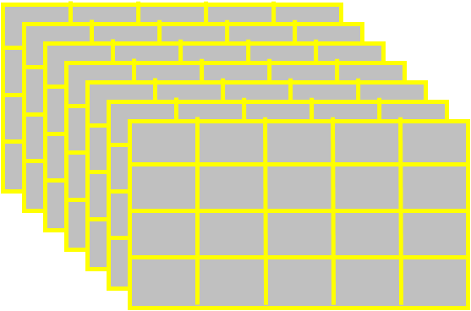
HDF5 Dataset
HDF5 Datatype
Integer: 32-bit, LE
HDF5 Dataspace
Rank
Dimensions
3
Dim[0] = 4
Dim[1] = 5
Dim[2] = 7
Specifications for single data
element and array dimensions
Multi-dimensional array of
identically typed data elements
HDF5 datasets organize and contain data elements.
  HDF5 datatype describes individual data elements.
  HDF5 dataspace describes the logical layout of the data elements.
Notes:
Beginning with HDF, multi dimensional, they are extensiable.
½ of dataset, the other ½ in the metadata, the data is self describing so you have to tell what type of data it is, the rank of the data and the dimension in each direction.

Slide 12
HDF5 Dataspace
Describes the logical layout of the elements in an HDF5 dataset
  NULL
    no elements
  Scalar
    single element
  Simple array (most common)
    multiple elements organized in a
    rectangular array
      rank = number of dimensions
      dimension sizes = number of elements in each dimension
      maximum number of elements in each dimension
        may be fixed or unlimited
Extreme Scale Computing Argonne
Notes:
Scalar (attributes), maxium so that can extent.

Slide 13
HDF5 Dataspace
Two roles:
  Dataspace contains spatial information
  Rank and dimensions
  Permanent part of dataset
  definition
  Partial I/0: Dataspace describes application’s data buffer and data elements participating in I/O
Rank = 2
Dimensions = 4x6
Rank = 1
Dimension = 10
Notes:
To roles: the i
Talk more about selection later

Slide 14
HDF5 Datatypes
Describe individual data elements in an HDF5 dataset
Wide range of datatypes supported
  Integer
  Float
  Enum
  Array
  User-defined (e.g., 13-bit integer)
  Variable-length types (e.g., strings, vectors)
  Compound (similar to C structs)
  More …
Extreme Scale Computing HDF5
Notes:
The other ½ of a dataset it datatypes, 13 bit (satalite sensors etc). Can be as

Slide 15
HDF5 Dataset
3
5
12
Datatype: 32-bit Integer
Dataspace: Rank = 2
Dimensions = 5 x 3
Notes:
And the value is 12.

Slide 16
HDF5 Dataset with Compound Datatype
3
5
V
V
V
V V V
V V V
uint16
char
int32
2x3x2 array of float32
Compound
Datatype:
Dataspace: Rank = 2
Dimensions = 5 x 3
Notes:
Similarly, compound data type. 32 bit int, whole array is templated out with these compound data types.

Slide 17
How are data elements stored?
Buffer in memory
Data in the file
Data elements stored physically adjacent to each other
Contiguous
(default)
Better access time for subsets; extendible
Chunked
Chunked & Compressed
Improves storage efficiency, transmission speed
Notes:
3 most popular one
Very fast, simple, underlinig IO find it.
Break up dataset into chunks, to IO then you can read in just that simple part, otherwise you have to read and seek. So if you have a IO pattern that allows for chunking then you should do it, it also allows the data set to extendable. Sub set, with contiguous the extension is eventually going to bump into something else piece of it are stored around and they are indexed to find them.

Slide 18
HDF5 Attributes
Typically contain user metadata
Have a name and a value
Attributes “decorate” HDF5 objects
Value is described by a datatype and a dataspace
Analogous to a dataset, but do not support partial I/O operations; nor can they be compressed or extended
Notes:
Can to groups or datasets,
Designed to be small, metadata that you add to things.

Slide 19
HDF5 File
lat | lon | temp
----|-----|-----
12 | 23 | 3.1
15 | 24 | 4.2
17 | 21 | 3.6
An HDF5 file is a smart container that holds data objects.
Experiment Notes:
Serial Number: 99378920
Date: 3/13/09
Configuration: Standard 3

Slide 20



HDF5 Groups and Links
HDF5 groups
and links
organize
data objects.
Every HDF5 file
has a root group
/
Experiment Notes:
Serial Number: 99378920
Date: 3/13/09
Configuration: Standard 3
Parameters
10;100;1000
Viz
SimOut
lat | lon | temp
----|-----|-----
12 | 23 | 3.1
15 | 24 | 4.2
17 | 21 | 3.6
Timestep
36,000
Notes:
Want to have structure,
Can create grouping structures, links, refer to objects in other containers.
A lot like a file system, all has a root group.

Slide 21
HDF5 software

Slide 22
HDF5 Home Page
HDF5 home page: http://hdfgroup.org/HDF5/
  Latest release: HDF5 1.10.0 (1.10.1 coming May 2017)
HDF5 source code:
  Written in C, and includes optional C++, Fortran APIs, and High Level APIs
  Contains command-line utilities (h5dump, h5repack, h5diff, ..) and compile scripts
HDF5 pre-built binaries:
  When possible, include C, C++, Fortran, and High Level libraries. Check ./lib/libhdf5.settings file.
  Built with and require the SZIP and ZLIB external libraries

Slide 23
Useful Tools For New Users
h5dump:
Tool to “dump” or display contents of HDF5 files
h5cc, h5c++, h5fc:
Scripts to compile applications
HDFView:
Java browser to view HDF5 files
http://www.hdfgroup.org/hdf-java-html/hdfview/
HDF5 Examples (C, Fortran, Java, Python, Matlab, …)
https://www.hdfgroup.org/HDF5/examples/
Notes:
Groups, datasets,
Building complicated, not expected to use these wrappers., java browers,

Slide 24
HDF5 Programming model and Api

Slide 25
HDF5 Software Layers & Storage
Apps
H5Part
High Level
APIs
API
netCDF-4
h5dump
HDFview
Java Interface
HDF5 Library
Language
Interfaces
HDF5 Data Model Objects
Groups, Datasets, Attributes, …
Tunable Properties
Chunk Size, I/O Driver, …
C, Fortran, C++
Internals
Memory Mgmt
Datatype Conversion
Filters
Chunked Storage
Version Compatibility
and so on…
Virtual File Layer
Posix I/O
Split Files
Custom
MPI I/O
I/O Drivers
Storage
HDF5 File Format
File on Parallel Filesystem
?
File
Split
Files
Other
Notes:
Influence properties, 300k lines of code.

Slide 26
The General HDF5 API
C, Fortran, Java, C++, and .NET bindings
IDL, MATLAB, Python (H5Py, PyTables)
C routines begin with prefix: H5?
  ? is a character corresponding to the type of object the function acts on
Example Functions:
H5D : Dataset interface e.g., H5Dread
H5F : File interface e.g., H5Fopen
H5S : dataSpace interface e.g., H5Sclose
Notes:
.net for
Steer to H5Py. PyTables is a bit more rigid, H5Py is really for wrappers.
Can’t have 2 D,

Slide 27

The HDF5 API
For flexibility, the API is extensive
  300+ functions
This can be daunting… but there is hope
  A few functions can do a lot
  Start simple
  Build up knowledge as more features are needed
Victorinox Swiss Army Cybertool 34

Slide 28
General Programming Paradigm
Object is opened or created
Object is accessed, possibly many times
Object is closed
Properties of object are optionally defined
  Creation properties (e.g., use chunking storage)
  Access properties
Notes:
Properites

Slide 29
Basic Functions
H5Fcreate (H5Fopen) create (open) File
H5Screate_simple/H5Screate create dataSpace
H5Dcreate (H5Dopen) create (open) Dataset
H5Dread, H5Dwrite access Dataset
H5Dclose close Dataset
H5Sclose close dataSpace
H5Fclose close File
Notes:
Abstact program. 7-8 calls make the core of an HDF5 program

Slide 30
Other Common Functions
DataSpaces: H5Sselect_hyperslab (Partial I/O)
H5Sselect_elements (Partial I/O)
H5Dget_space
DataTypes: H5Tcreate, H5Tcommit, H5Tclose
H5Tequal, H5Tget_native_type
Groups: H5Gcreate, H5Gopen, H5Gclose
Attributes: H5Acreate, H5Aopen_name, H5Aclose, H5Aread, H5Awrite
Property lists: H5Pcreate, H5Pclose
H5Pset_chunk, H5Pset_deflate

Slide 31
C examples

Slide 32
How to compile HDF5 applications
h5cc – HDF5 C compiler command
h5fc – HDF5 F90 compiler command
h5c++ - HDF5 C++ compiler command
To compile:
  % h5cc h5prog.c
  % h5fc h5prog.f90
  % h5c++ h5prog.cpp
Notes:
Any fortran programmers, all are not parallel.

Slide 33
Code: Create a File
hid_t file_id;
herr_t status;
file_id = H5Fcreate("file.h5", H5F_ACC_TRUNC,
H5P_DEFAULT, H5P_DEFAULT);
status = H5Fclose (file_id);
“/” (root)
Note: Return codes not checked for errors in code samples.
Notes:
Blow away the existing things. Create file with root group.

Slide 34
Code: Create a Dataset
1 hid_t file_id, dataset_id, dataspace_id;
2 hsize_t dims[2];
3 herr_t status;
4 file_id = H5Fcreate ("file.h5", H5F_ACC_TRUNC,
H5P_DEFAULT, H5P_DEFAULT);
5 dims[0] = 4;
6 dims[1] = 6;
dataspace_id = H5Screate_simple (2, dims, NULL);
8 dataset_id = H5Dcreate (file_id, "A", H5T_STD_I32BE,
dataspace_id, H5P_DEFAULT, H5P_DEFAULT,
H5P_DEFAULT);
9 status = H5Dclose (dataset_id);
10 status = H5Sclose (dataspace_id);
11 status = H5Fclose (file_id);
“/” (root)
A
Notes:
Little more complicated, NULL maxdims is the same. Predifined data type. Creates array off the root group.

Slide 35
Code: Create a Group
hid_t file_id, group_id;
...
/* Open "file.h5" */
file_id = H5Fopen ("file.h5", H5F_ACC_RDWR, H5P_DEFAULT);
/* Create group "/B" in file. */
group_id = H5Gcreate (file_id,"B", H5P_DEFAULT, H5P_DEFAULT, H5P_DEFAULT);
/* Close group and file. */
status = H5Gclose (group_id);
status = H5Fclose (file_id);

Slide 36
Example: Create Dataset & Group
“/” (root)
A
B
4x6 array of integers
file.h5
Notes:
This is what the file would look like

Slide 37
Output of h5dump
$ h5dump file.h5
HDF5 "file.h5" {
GROUP "/" {
DATASET "A" {
DATATYPE H5T_STD_I32BE
DATASPACE SIMPLE { ( 4, 6 ) / ( 4, 6 ) }
DATA {
(0,0): 0, 0, 0, 0, 0, 0,
(1,0): 0, 0, 0, 0, 0, 0,
(2,0): 0, 0, 0, 0, 0, 0,
(3,0): 0, 0, 0, 0, 0, 0
}
}
GROUP "B" {
}
}
}
Notes:
No data, all zeros

Slide 38
Example Code - H5Dwrite
int wdata[4][6];
/* Initialize the dataset. */
for (i = 0; i < 4; i++)
for (j = 0; j < 6; j++)
wdata[i][j] = i * 6 + j + 1;
…..
status = H5Dwrite (dataset_id, H5T_NATIVE_INT, H5S_ALL,H5S_ALL, H5P_DEFAULT, wdata);
Notes:
Want to add data. In memory my data it native interger, going to over, type conversion from memory to disk.

Slide 39
Output of h5dump after writing
$ h5dump file.h5
HDF5 "file.h5" {
GROUP "/" {
DATASET "A" {
DATATYPE H5T_STD_I32BE
DATASPACE SIMPLE { ( 4, 6 ) / ( 4, 6 ) }
DATA {
(0,0): 1, 2, 3, 4, 5, 6,
(1,0): 7, 8, 9, 10, 11, 12,
(2,0): 13, 14, 15, 16, 17, 18,
(3,0): 19, 20, 21, 22, 23, 24
}
}
GROUP "B" {
}
}
}
Notes:
All the type conversion worked.

Slide 40
Partial i/o in HDF5

Slide 41
How to write a row?
$ h5dump file.h5
HDF5 "file.h5" {
GROUP "/" {
DATASET "A" {
DATATYPE H5T_STD_I32BE
DATASPACE SIMPLE { ( 4, 6 ) / ( 4, 6 ) }
DATA {
(0,0): 0, 0, 0, 0, 0, 0,
(1,0): 1, 2, 3, 4, 5, 6,
(2,0): 0, 0, 0, 0, 0, 0,
(3,0): 0, 0, 0, 0, 0, 0
}
}
GROUP "B" {
}
}
}

Slide 42
How to Describe a Subset in HDF5?
Before writing and reading a subset of data one has to describe it to the HDF5 Library.
HDF5 APIs and documentation refer to a subset as a “selection” or “hyperslab selection”.
If specified, HDF5 Library will perform I/O on a selection only and not on all elements of a dataset.
Notes:
Mostly use hyperslab selection. Point selection not a scalabale

Slide 43
Types of Selections in HDF5
Two types of selections
  Hyperslab selection
    Regular hyperslab
    Simple hyperslab
    Result of set operations on hyperslabs (union, difference, …)
  Point selection
Hyperslab selection is especially important for doing parallel I/O in HDF5 (See Parallel HDF5 Tutorial)
Notes:
Can

Slide 44
Regular Hyperslab
Collection of regularly spaced blocks of equal size

Slide 45
Simple Hyperslab
Contiguous subset or sub-array
Notes:
Single one

Slide 46
Hyperslab Selection
Result of union operation on three simple hyperslabs
Notes:
AMR is irrigular,

Slide 47
HDF5 Hyperslab Description
Everything is “measured” in number of elements
  Uses row-major ordering (C order) for coordinates
  Example:
    Start - starting location of a hyperslab (1,1)
    Stride - number of elements that separate each block (3,2)
    Count - number of blocks (2,6)
    Block - block size (2,1)
0
1
2
3
4
5
6
7
8
9
10
11
0
1
2
3
4
5
Notes:
Everthing is done in elements.

Slide 48
Simple Hyperslab Description
Two ways to describe a simple hyperslab
As several blocks
  Stride – (1,1)
  Count – (2,6)
  Block – (2,1)
As one block
  Stride – (1,1)
  Count – (1,1)
  Block – (4,6)
No performance penalty for
one way or another
Notes:
Does not matter how this last section gets created, hdf5 will optimize the hyperslabs for access. Do what is easyiest for you to discribe

Slide 49
Writing a row
Memory space selection is 1-dim array of size 6
File space selection
start = {1,0}, stride = {1,1}, count = {1,6}, block = {1,1}
Number of elements selected in memory must be the same
as selected in the file
Notes:
Return error if not valid

Slide 50
Writing a row
hid_t mspace_id, fspace_id;
hsize_t dims[1] = {6};
hsize_t start[2], count[2];
…..
/* Create memory dataspace */
mspace_id = H5Screate_simple(1, dims, NULL);
/* Get file space identifier from the dataset */
fspace_id = H5Dget_space(dataset_id);
/* Select hyperslab in the dataset to write too */
start[0] = 1;
start[1] = 0;
count[0] = 1;
count[1] = 6;
status = H5Sselect_hyperslab(fspace_id, H5S_SELECT_SET,
start, NULL, count, NULL);
H5Dwrite(dataset_id, H5T_NATIVE_INT, mspace_id, fspace_id,
H5P_DEFAULT, wdata);
Notes:
Code looks like this. Defaults to the whole memory buffer.

Slide 51
HDF5 file format

Slide 52
HDF5 File Format
Defined by the HDF5 File Format Specification.
http://www.hdfgroup.org/HDF5/doc/H5.format.html
Specifies the bit-level organization of an HDF5 file on storage media.
HDF5 library adheres to the File Format, users do not need to know the details of this information.
Extreme Scale Computing HDF5
Notes:
Hi level specs of HDF5, Btrees, heaps

Slide 53
HDF5 Roadmap
Concurrency
  Single-Writer / Multiple-Reader (SWMR)
  Asynchronous I/O
  Internal threading
Virtual Object Layer
Virtual Datasets
Query & Indexing
Native HDF5 client/server
Performance
  Scalable chunk indices
  Metadata aggregation and Page buffering
  Variable-length records
Fault tolerance
Parallel I/O
I/O Autotuning
Extreme Scale Computing HDF5
Notes:
Any number of readers monitor the data, no locking.

Slide 54
Thank You!
Questions?

