Slide 1
Parallel HDF5
Quincey Koziol
Principal Data Architect
NERSC – LBNL
koziol@lbl.gov

Slide 2
Advantage of Parallel HDF5
Recent success story
  Trillion particle simulation on hopper @ NERSC
  120,000 cores
  30TB file
  23GB/sec average speed with 35GB/sec peaks (out of 40GB/sec max for system)
Parallel HDF5 rocks! (when used properly ☺)
Notes:
Little data, can get good performance I/O bandwitch, little tuning (some with Lustre).

Slide 3
Outline
Overview of Parallel HDF5 design
Parallel Environment Requirements
PHDF5 Programming Model
Examples
Performance Analysis
Parallel Tools
Upcoming features of HDF5 (if time permits)

Slide 4
MPI-I/O vs. HDF5

Slide 5
MPI-IO vs. HDF5
MPI-IO is an Input/Output API
It treats the data file as a “linear byte stream” and each MPI application needs to provide its own file view and data representations to interpret those bytes
Notes:
Mpi io really low-level, no metadata, leaves a lot up to you. Exteranal32, everything is not portiable.

Slide 6
MPI-IO vs. HDF5
All data stored are machine dependent except the “external32” representation
External32 is defined in Big Endianness
  Little-endian machines have to do the data conversion in both read or write operations
  64-bit sized data types may lose information

Slide 7
MPI-IO vs. HDF5
HDF5 is data management software
It stores data and metadata according to the HDF5 data format definition
HDF5 file is self-describing
  Each machine can store the data in its own native representation for efficient I/O without loss of data precision
  Any necessary data representation conversion is done by the HDF5 library automatically

Slide 8
Overview of parallel HDf5 design

Slide 9
PHDF5 Requirements
PHDF5 should allow multiple processes to perform I/O to an HDF5 file at the same time
  Single file image to all processes
  Compare with one file per process design:
    Expensive post processing
    Not usable by different number of processes
    Too many files produced for file system
PHDF5 should use a standard parallel I/O interface
Must be portable to different platforms
Notes:
Support Message Passing Interface (MPI) programming
PHDF5 files compatible with serial HDF5 files
Shareable between different serial or parallel platforms
Single file image to all processes
One file per process design is undesirable
Expensive post processing
Not usable by different number of processes

Slide 10
PHDF5 requirements
Support Message Passing Interface (MPI) programming
PHDF5 files compatible with serial HDF5 files
  Shareable between different serial or parallel platforms

Slide 11
Parallel environment requirements
MPI with MPI-IO
  MPICH, OpenMPI w/ROMIO
  Vendor’s MPI-IO
Parallel file system
  IBM GPFS
  Lustre
  PVFS

Slide 12
PHDF5 implementation layers
HDF5 Application
Compute node
Compute node
Compute node
HDF5 Library
MPI Library
HDF5 file on Parallel File System
Switch network + I/O servers
Disk architecture and layout of data on disk
Notes:
PHDF5 is built on top of MPI I/O APIs

Slide 13
PHDF5 consistency semantics

Slide 14
Consistency Semantics
Consistency semantics: Rules that define the outcome of multiple, possibly concurrent, accesses to an object or data structure by one or more processes in a computer system.

Slide 15
PHDF5 Consistency Semantics
PHDF5 library defines a set of consistency semantics to let users know what to expect when processes access data managed by the library.
  When the changes a process makes are actually visible to itself (if it tries to read back that data) or to other processes that access the same file with independent or collective I/O operations
Notes:
Alinged eith mpi io.

Slide 16
HDF5 MPI-I/O consistency semantics
Same as MPI-I/O semantics
Default MPI-I/O semantics doesn’t guarantee atomicity or sequence of calls!
Problems may occur (although we haven’t seen any) when writing/reading HDF5 metadata or raw data
Process 0 | Process 1
MPI_File_write_at()
MPI_Barrier() | MPI_Barrier()
 | MPI_File_read_at()
Notes:
Once can close the file and then open for reading no gurettended to work,
Process 0 can be cache, process 1 gets stall data

Slide 17
HDF5 MPI-I/O consistency semantics
MPI I/O provides atomicity and sync-barrier-sync features to address the issue
PHDF5 follows MPI I/O
  H5Fset_mpio_atomicity function to turn on MPI atomicity
  H5Fsync function to transfer written data to storage device (in implementation now)
Alternatively: We are currently working on reimplementation of metadata caching for PHDF5 (using a metadata server)
Notes:
HDF5 synic barrier sync,

Slide 18
HDF5 MPI-I/O consistency semantics
For more information see “Enabling a strict consistency semantics model in parallel HDF5” linked from H5Fset_mpi_atomicity RM page¹
¹ http://www.hdfgroup.org/HDF5/doc/RM/Advanced/PHDF5FileConsistencySemantics/PHDF5FileConsistencySemantics.pdf

Slide 19
HDF5 parallel programming model

Slide 20
How to compile PHDF5 applications
h5pcc – HDF5 C compiler command
  Similar to mpicc
h5pfc – HDF5 Fortran compiler command
  Similar to mpif90
To compile:
  % h5pcc h5prog.c
  % h5pfc h5prog.f90

Slide 21
Programming restrictions
PHDF5 opens a parallel file with an MPI communicator
  Returns a file handle
  Future access to the file via the file handle
  All processes must participate in collective PHDF5 APIs
  Different files can be opened via different communicators
Notes:
Collective everyone that is in a communciation has to participate.
Biggest gocha, anything modiying a file (metadata, etc) out of sync, (extending dataset)

Slide 22
Collective HDF5 calls
All HDF5 APIs that modify structural metadata are collective!
  File operations
    H5Fcreate, H5Fopen, H5Fclose, etc
  Object creation
    H5Dcreate, H5Dclose, etc
  Object structure modification (e.g., dataset extent modification)
    H5Dset_extent, etc
http://www.hdfgroup.org/HDF5/doc/RM/CollectiveCalls.html
Notes:
Last give a list fo the collective APIs

Slide 23
Other HDF5 calls
Array data transfer can be collective or independent
  Dataset operations: H5Dwrite, H5Dread
  Collectiveness is indicated by function parameters, not by function names as in MPI API
Notes:
Dataset transfer property. Not like pi with *_all

Slide 24
What does PHDF5 support ?
After a file is opened by the processes of a communicator
  All parts of file are accessible by all processes
  All objects in the file are accessible by all processes
  Multiple processes may write to the same data array
  Each process may write to individual data array

Slide 25
PHDF5 API languages
C and Fortran language interfaces
Most platforms with MPI-IO supported. e.g.,
  IBM AIX
  Linux clusters
  Cray XT
Notes:
Support any where you application will run.

Slide 26
Programming model
HDF5 uses access template object (property list) to control the file access mechanism
General model to access HDF5 file in parallel:
  Set up MPI-IO access template (file access property list)
  Open File
  Access Data
  Close File
Notes:
Use the property lists, optional (parallel io is accesed through proporties).

Slide 27
My first parallel hdf5 program
Moving your sequential application to the HDF5 parallel world

Slide 28
Example of PHDF5 C program
Parallel HDF5 program has extra calls
MPI_Init(&argc, &argv);
fapl_id = H5Pcreate(H5P_FILE_ACCESS);
H5Pset_fapl_mpio(fapl_id, comm, info);
file_id = H5Fcreate(FNAME,…, fapl_id);
space_id = H5Screate_simple(…);
dset_id = H5Dcreate(file_id, DNAME, H5T_NATIVE_INT, space_id,…);
xf_id = H5Pcreate(H5P_DATASET_XFER);
H5Pset_dxpl_mpio(xf_id, H5FD_MPIO_COLLECTIVE);
status = H5Dwrite(dset_id, H5T_NATIVE_INT, …, xf_id…);
MPI_Finalize();
Notes:
Red different from serial program. Was H5P_default. Happens on all the processors. Do collective IO when doing this write.

Slide 29
Example
Writing patterns

Slide 30
Parallel HDF5 tutorial examples
For simple examples how to write different data patterns see
http://www.hdfgroup.org/HDF5/Tutor/parallel.html
Notes:
Have a helpdesk

Slide 31
Programming model
Each process defines memory and file hyperslabs using H5Sselect_hyperslab
Each process executes a write/read call using hyperslabs defined, which can be either collective or independent
The hyperslab parameters define the portion of the dataset to write to
  Contiguous hyperslab
  Regularly spaced data (column or row)
  Pattern
  Blocks
Notes:
I’ll describe a few patterns

Slide 32
Four processes writing by rows
HDF5 "SDS_row.h5" {
GROUP "/" {
DATASET "IntArray" {
DATATYPE H5T_STD_I32BE
DATASPACE SIMPLE { ( 8, 5 ) / ( 8, 5 ) }
DATA {
10, 10, 10, 10, 10,
10, 10, 10, 10, 10,
11, 11, 11, 11, 11,
11, 11, 11, 11, 11,
12, 12, 12, 12, 12,
12, 12, 12, 12, 12,
13, 13, 13, 13, 13,
13, 13, 13, 13, 13

Slide 33
Two processes writing by columns
HDF5 "SDS_col.h5" {
GROUP "/" {
DATASET "IntArray" {
DATATYPE H5T_STD_I32BE
DATASPACE SIMPLE { ( 8, 6 ) / ( 8, 6 ) }
DATA {
1, 2, 10, 20, 100, 200,
1, 2, 10, 20, 100, 200,
1, 2, 10, 20, 100, 200,
1, 2, 10, 20, 100, 200,
1, 2, 10, 20, 100, 200,
1, 2, 10, 20, 100, 200,
1, 2, 10, 20, 100, 200,
1, 2, 10, 20, 100, 200
Notes:
Do columns

Slide 34
Four processes writing by pattern
HDF5 "SDS_pat.h5" {
GROUP "/" {
DATASET "IntArray" {
DATATYPE H5T_STD_I32BE
DATASPACE SIMPLE { ( 8, 4 ) / ( 8, 4 ) }
DATA {
1, 3, 1, 3,
2, 4, 2, 4,
1, 3, 1, 3,
2, 4, 2, 4,
1, 3, 1, 3,
2, 4, 2, 4,
1, 3, 1, 3,
2, 4, 2, 4
Notes:
intleave

Slide 35
Four processes writing by blocks
HDF5 "SDS_blk.h5" {
GROUP "/" {
DATASET "IntArray" {
DATATYPE H5T_STD_I32BE
DATASPACE SIMPLE { ( 8, 4 ) / ( 8, 4 ) }
DATA {
1, 1, 2, 2,
1, 1, 2, 2,
1, 1, 2, 2,
1, 1, 2, 2,
3, 3, 4, 4,
3, 3, 4, 4,
3, 3, 4, 4,
3, 3, 4, 4
Notes:
bloks

Slide 36
Complex data patterns
HDF5 doesn’t have restrictions on data patterns and data balance
1
2
3
4
5
6
7
8
1
2
3
4
5
6
7
8
9
10
11
12
13
14
15
16
9
10
11
12
13
14
15
16
17
18
19
20
21
22
23
24
17
18
19
20
21
22
23
24
25
26
27
28
29
30
31
32
25
26
27
28
29
30
31
32
33
34
35
36
37
38
39
40
33
34
35
36
37
38
39
40
41
42
43
44
45
46
47
48
41
42
43
44
45
46
47
48
49
50
51
52
53
54
55
56
49
50
51
52
53
54
55
56
57
58
59
60
61
62
63
64
57
58
59
60
61
62
63
64
1
2
3
4
5
6
7
8
9
10
11
12
13
14
15
16
17
18
19
20
21
22
23
24
25
26
27
28
29
30
31
32
33
34
35
36
37
38
39
40
41
42
43
44
45
46
47
48
49
50
51
52
53
54
55
56
57
58
59
60
61
62
63
64
Notes:
Build mpi data type,

Slide 37
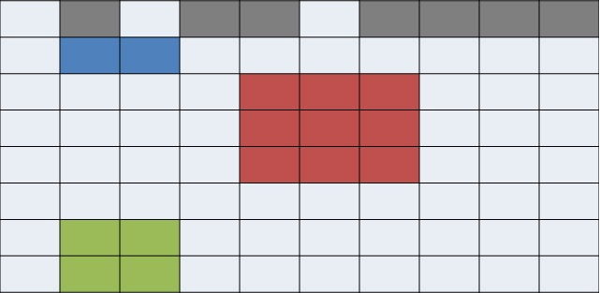
Examples of irregular selection
Internally, the HDF5 library creates an MPI datatype for each lower dimension in the selection and then combines those types into one giant structured MPI datatype

Slide 38
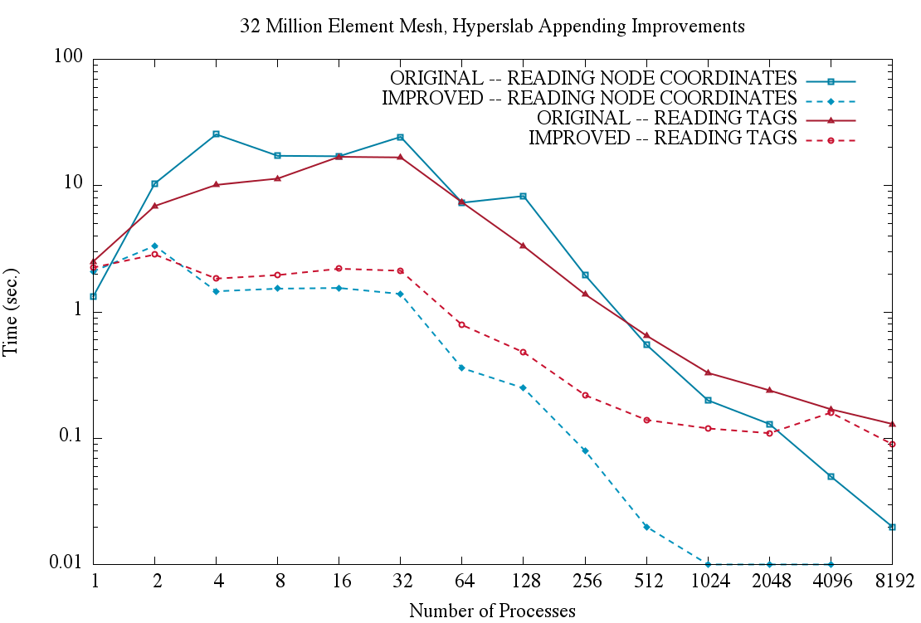
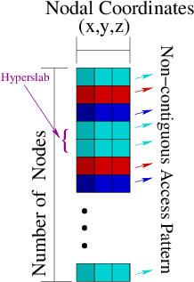
Collective Unstructured Finite Element I/O
Single File Read
¹
¹MOAB — Mira at Argonne National Laboratory

Slide 39
Performance analysis

Slide 40
Performance analysis
Some common causes of poor performance
Possible solutions

Slide 41
My PHDF5 application I/O is slow
  Raw I/O data sizes
  Independent vs. Collective I/O
  “Tuning HDF5 for Lustre File Systems” by Howison, Koziol, Knaak, Mainzer, and Shalf
    Chunking and hyperslab selection
    HDF5 metadata cache
    Specific I/O system hints
Notes:
Good paper for tuning, write framework, manage metadata cache.

Slide 42
Independent vs. collective raw data i/o
Notes:
Collective IO, allows MPI IO to optimize the I/O patterns among the processors. Gather buffer together and do miminumal I/O

Slide 43
Collective vs. independent calls
MPI definition of collective calls:
  All processes of the communicator must participate in calls in the right order. E.g.,
    Process1 Process2
    call A(); call B(); call A(); call B(); **right**
    call A(); call B(); call B(); call A(); **wrong**
Independent means not collective ☺
Collective is not necessarily synchronous, nor must require communication
Notes:
Get order writes.

Slide 44
Independent vs. collective access
User reported independent data transfer mode was much slower than the collective data transfer mode
Data array was tall and thin: 230,000 rows by 6 columns
:
:
:
230,000 rows
:
:
:
Notes:
Small example. 230k individual IO, over million IO,

Slide 45
Debug Slow Parallel I/O Speed(1)
Writing to one dataset
  Using 4 processes == 4 columns
  datatype is 8-byte doubles
  4 processes, 1000 rows == 4x1000x8 = 32,000 bytes
% mpirun -np 4 ./a.out 1000
  Execution time: 1.783798 s.
% mpirun -np 4 ./a.out 2000
  Execution time: 3.838858 s.
Difference of 2 seconds for 1000 more rows = 32,000 bytes.
Speed of 16KB/sec!!! Way too slow.

Slide 46
Debug slow parallel I/O speed(2)
Build a version of PHDF5 with
  ./configure --enable-debug --enable-parallel …
  This allows the tracing of MPIO I/O calls in the HDF5 library.
E.g., to trace
  MPI_File_read_xx and MPI_File_write_xx calls
  % setenv H5FD_mpio_Debug “rw”

Slide 47
Debug slow parallel I/O speed(3)
% setenv H5FD_mpio_Debug ’rw’
% mpirun -np 4 ./a.out 1000 # Indep.; contiguous.
in H5FD_mpio_write mpi_off=0 size_i=96
in H5FD_mpio_write mpi_off=0 size_i=96
in H5FD_mpio_write mpi_off=0 size_i=96
in H5FD_mpio_write mpi_off=0 size_i=96
in H5FD_mpio_write mpi_off=2056 size_i=8
in H5FD_mpio_write mpi_off=2048 size_i=8
in H5FD_mpio_write mpi_off=2072 size_i=8
in H5FD_mpio_write mpi_off=2064 size_i=8
in H5FD_mpio_write mpi_off=2088 size_i=8
in H5FD_mpio_write mpi_off=2080 size_i=8
…
Total of 4000 of these little 8 bytes writes == 32,000 bytes.

Slide 48
Independent calls are many and small
Each process writes one element of one row, skips to next row, write one element, so on.
Each process issues 230,000 writes of 8 bytes each.
:
:
:
230,000 rows
:
:
:

Slide 49
Debug slow parallel I/O speed (4)
% setenv H5FD_mpio_Debug ’rw’
% mpirun -np 4 ./a.out 1000 # Indep., Chunked by column.
in H5FD_mpio_write mpi_off=0 size_i=96
in H5FD_mpio_write mpi_off=0 size_i=96
in H5FD_mpio_write mpi_off=0 size_i=96
in H5FD_mpio_write mpi_off=0 size_i=96
in H5FD_mpio_write mpi_off=3688 size_i=8000
in H5FD_mpio_write mpi_off=11688 size_i=8000
in H5FD_mpio_write mpi_off=27688 size_i=8000
in H5FD_mpio_write mpi_off=19688 size_i=8000
in H5FD_mpio_write mpi_off=96 size_i=40
in H5FD_mpio_write mpi_off=136 size_i=544
in H5FD_mpio_write mpi_off=680 size_i=120
in H5FD_mpio_write mpi_off=800 size_i=272
…
Execution time: 0.011599 s.

Slide 50
Use collective mode or chunked storage
Collective I/O will combine many small independent calls into few but bigger calls
Chunks of columns speeds up too
:
:
:
230,000 rows
:
:
:

Slide 51
Collective vs. independent write
Notes:
Just megabytes.

Slide 52
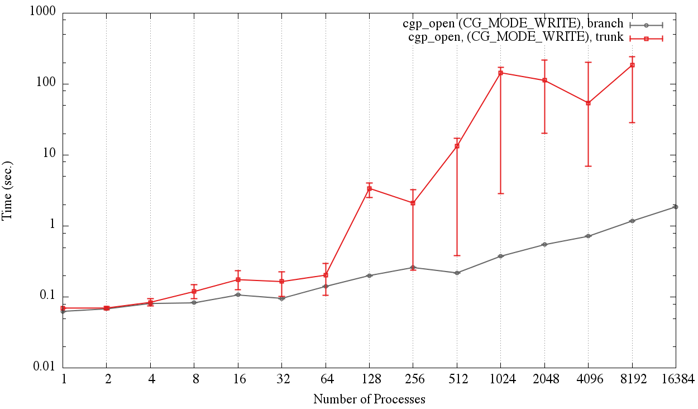
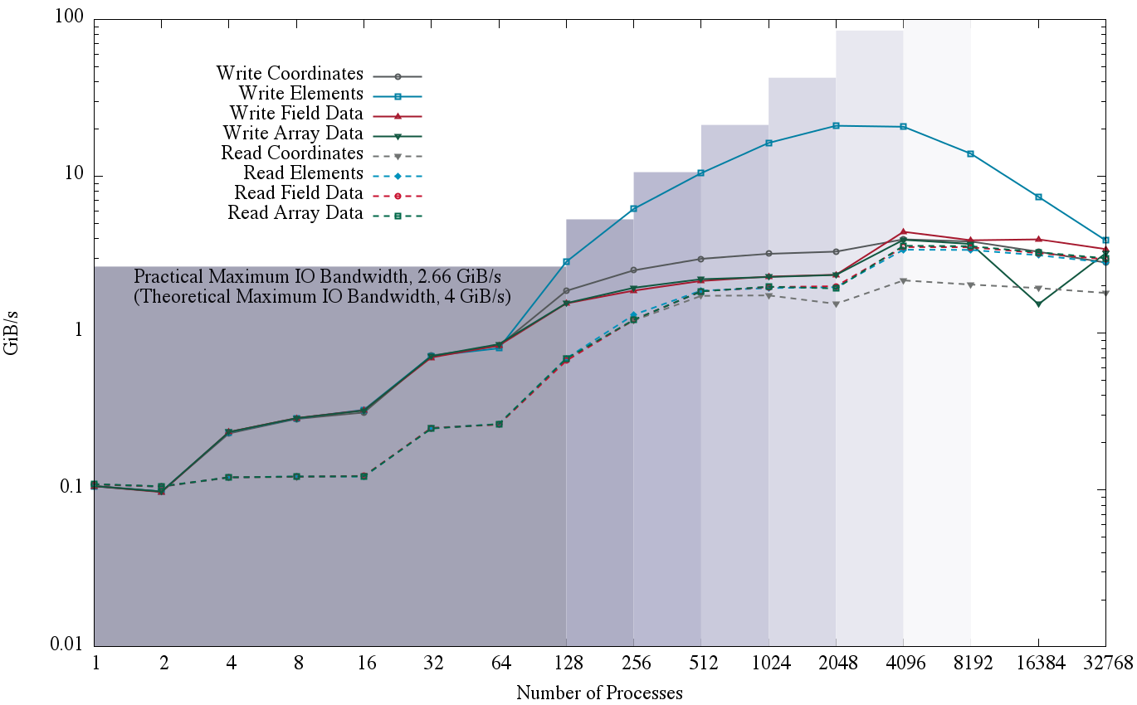
CGNS Collective vs. Independent
Impact
  CGNS was impractical at large scales (i.e. greater then 1024 processors)
  Computational mesh size
    ~33 million elements
    ~200 million nodes
Impractical
Before Improvements
After Improvements
New improvements
  CGNS I/O scales for large simulations
  Efficiently handles large I/O from Exascale CFD simulations

Slide 53
Collective I/O in HDF5
Set up using a Data Transfer Property List (DXPL)
All processes must participate in the I/O call (H5Dread/write) with a selection (which could be a NULL selection)
Some cases where collective I/O is not used even when the use asks for it:
  Data conversion
  Compressed Storage
  Chunking Storage:
    When the chunk is not selected by a certain number of processes
Notes:
Have an int in mermory and writing it to float on disk. Slower , same for compression,

Slide 54
Enabling Collective Parallel I/O with HDF5
/* Set up file access property list w/parallel I/O access */
fa_plist_id = H5Pcreate(H5P_FILE_ACCESS);
H5Pset_fapl_mpio(fa_plist_id, comm, info);
/* Create a new file collectively */
file_id = H5Fcreate(filename, H5F_ACC_TRUNC,
H5P_DEFAULT, fa_plist_id);
/* <omitted data decomposition for brevity> */
/* Set up data transfer property list w/collective MPI-IO */
dx_plist_id = H5Pcreate(H5P_DATASET_XFER);
H5Pset_dxpl_mpio(dx_plist_id, H5FD_MPIO_COLLECTIVE);
/* Write data elements to the dataset */
status = H5Dwrite(dset_id, H5T_NATIVE_INT,
memspace, filespace, dx_plist_id, data);
Notes:
Showed this before,

Slide 55
Collective I/O in HDF5
Can query Data Transfer Property List (DXPL) after I/O for collective I/O status:
  H5Pget_mpio_actual_io_mode
    Retrieves the type of I/O that HDF5 actually performed on the last parallel I/O call
  H5Pget_mpio_no_collective_cause
    Retrieves local and global causes that broke collective I/O on the last parallel I/O call
  H5Pget_mpio_actual_chunk_opt_mode
    Retrieves the type of chunk optimization that HDF5 actually performed on the last parallel I/O call. This is not necessarily the type of optimization requested
Notes:
That was slow, did collective really happen. Was the data set good. for detecting

Slide 56
Effect of HDF5 storage
Notes:
Like IOR

Slide 57
Contiguous storage
Metadata header separate from dataset data
Data stored in one contiguous block in HDF5 file
Application memory
Metadata cache
Dataset header
………….
Dataset data
Datatype
Dataspace
………….
Attributes
…
File
Dataset data

Slide 58
On a parallel file system
File
Dataset data
OST 1
OST 2
OST 3
OST 4
The file is striped over multiple OSTs depending on the stripe size and stripe count that the file was created with.

Slide 59
Chunked storage
Data is stored in chunks of predefined size
  Two-dimensional instance may be referred to as data tiling
HDF5 library writes/reads the whole chunk
Contiguous
Chunked

Slide 60
Chunked storage (cont.)
Dataset data is divided into equally sized blocks (chunks).
Each chunk is stored separately as a contiguous block in HDF5 file.
Application memory
Metadata cache
Dataset data
Dataset header
A
B
C
D
………….
Datatype
Dataspace
………….
Chunk
index
Attributes
…
File
header
Chunk
index
A
C
D
B

Slide 61
On a parallel file system
File
header
Chunk
index
A
C
D
B
OST 1
OST 2
OST 3
OST 4
The file is striped over multiple OSTs depending on the stripe size and stripe count that the file was created with

Slide 62
Which is better for performance?
It depends!!
Consider these selections:
If contiguous: 2 seeks
If chunked: 10 seeks
If contiguous: 16 seeks
If chunked: 4 seeks
Add to that striping over a Parallel File System, which makes this problem very hard to solve!

Slide 63
Chunking and hyperslab selection
P1
P2
P3
When writing or reading, try to use hyperslab selections that coincide with chunk boundaries.
If not possible, HDF5 provides some options

Slide 64
Parallel I/O on chunked datasets
Multiple options for performing I/O when collective:
  Operate on all chunks in one collective I/O operation: “Linked chunk I/O”
  Operate on each chunk collectively: “Multi-chunk I/O”
  Break collective I/O and perform I/O on each chunk independently (also in “Multi-chunk I/O” algorithm)

Slide 65
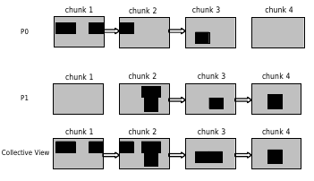
Linked chunk I/O
One MPI Collective I/O Call

Slide 66
Multi-chunk I/O
Collective I/O per chunk
Determine for each chunk if enough processes have a selection inside to do collective I/O
If not enough, use independent I/O

Slide 67
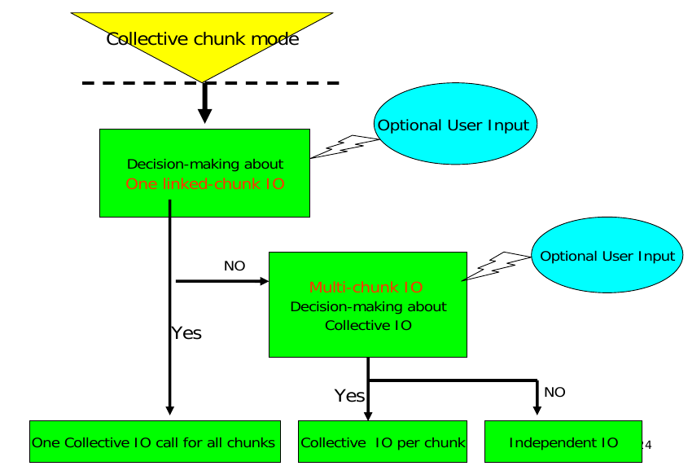
Decision making

Slide 68
Effect of HDF5 metadata cache

Slide 69
PHDF5 and Metadata
Metadata operations:
  Creating/removing a dataset, group, attribute, etc…
  Extending a dataset’s dimensions
  Modifying group hierarchy
  etc …
All operations that modify metadata are collective, i.e., all processes have to call that operation:
  If you have 10,000 processes running your application, and one process needs to create a dataset, ALL processes must call H5Dcreate to create 1 dataset.

Slide 70
Space allocation
Allocating space at the file’s EOA is very simple in serial HDF5 applications:
  the EOA value begins at offset 0 in the file
  when space is required, the EOA value is incremented by the size of the block requested.
Space allocation using the EOA value in parallel HDF5 applications can result in a race condition if processes do not synchronize with each other:
  multiple processes believe that they are the sole owner of a range of bytes within the HDF5 file.
Solution: Make it Collective

Slide 71
Example
Consider this case, where 2 processes want to create a dataset each.
P1
P2
H5Dcreate(D1)
H5Dcreate(D2)
Each call has to allocate space in file to store the dataset header.
Bytes 4 to 10 in the file are free
Bytes 4 to 10 in the file are free
Conflict!

Slide 72
Example
P1
P2
H5Dcreate(D1)
H5Dcreate(D1)
Allocate space in file to store the dataset header.
Bytes 4 to 10 in the file are free.
Create the dataset.
H5Dcreate(D2)
H5Dcreate(D2)
Allocate space in file to store the dataset header.
Bytes 11 to 17 in the file are free.
Create the dataset.

Slide 73
Metadata cache
To handle synchronization issues, all HDF5 operations that could potentially modify the metadata in an HDF5 file are required to be collective
  A list of those routines is available in the HDF5 reference manual (http://www.hdfgroup.org/HDF5/doc/RM/CollectiveCalls.html)
If those operations are not collective, how can each process manage its Metadata Cache?
  Do not have one, i.e. always access metadata directly from disk
  Disastrous for performance as metadata is usually very small

Slide 74
Managing the metadata cache
All operations that modify metadata in the HDF5 file are collective:
  All processes will have the same dirty metadata entries in their cache (i.e., metadata that is inconsistent with what is on disk).
  Processes are not required to have the same clean metadata entries (i.e., metadata that is in sync with what is on disk).
Internally, the metadata cache running on process 0 is responsible for managing changes to the metadata in the HDF5 file.
  All the other caches must retain dirty metadata until the process 0 cache tells them that the metadata is clean (i.e., on disk).

Slide 75
Example
Metadata Cache is clean for all processes:
P0
P1
P2
P3
E1
E2
E3
E4
E1
E7
E8
E2
E4
E6
E1
E5
E12
E32
E1
E4

Slide 76
Example
All processes call H5Gcreate that modifies metadata entry E3 in the file:
P0
P1
P2
P3
E3
E1
E2
E4
E3
E1
E7
E8
E3
E4
E6
E1
E3
E12
E32
E1

Slide 77
Example
All processes call H5Dcreate that modifies metadata entry E2 in the file:
P0
P1
P2
P3
E3
E2
E1
E4
E3
E2
E1
E7
E3
E2
E4
E6
E3
E2
E12
E32

Slide 78
Example
Process 0 calls H5Dopen on a dataset accessing entry E5
P0
P1
P2
P3
E5
E3
E2
E1
E3
E2
E1
E7
E3
E2
E4
E6
E3
E2
E12
E32

Slide 79
Flushing the cache
Initiated when:
  The size of dirty entries in cache exceeds a certain threshold
  The user calls a flush
The actual flush of metadata entries to disk is currently implemented in two ways:
  Single Process (Process 0) write
  Distributed write

Slide 80
Single Process (Process 0) write
All processes enter a synchronization point.
Process 0 writes all the dirty entries to disk while other processes wait and do nothing
Process 0 marks all the dirty entries as clean
Process 0 broadcasts the cleaned entries to all processes that marks them as clean too

Slide 81
Distributed write
All processes enter a synchronization point.
Process 0 broadcasts the metadata that needs to be flushed to all processes
Using a distributed algorithm each determines what part of the metadata cache entries it needs to write, and writes them to disk independently
All processes mark the flushed metadata as clean

Slide 82
Parallel tools

Slide 83
Parallel tools
h5perf
  Performance measuring tool showing I/O performance for different I/O APIs

Slide 84
h5perf
An I/O performance measurement tool
Tests 3 File I/O APIs:
  POSIX I/O (open/write/read/close…)
  MPI-I/O (MPI_File_{open,write,read,close})
  HDF5 (H5Fopen/H5Dwrite/H5Dread/H5Fclose)
An indication of I/O speed upper limits
Notes:
Gives an idea what is going on.

Slide 85
Useful parallel HDF5 links
Parallel HDF information site
  http://www.hdfgroup.org/HDF5/PHDF5/
Parallel HDF5 tutorial available at
  http://www.hdfgroup.org/HDF5/Tutor/
HDF Help email address
  help@hdfgroup.org

Slide 86
Upcoming features in hdf5

Slide 87
PHDF5 Improvements in Progress
Multi-dataset read/write operations
  Allows single collective operation on multiple datasets
    Similar to PnetCDF “write-combining” feature
  H5Dmulti_read/write(<array of datasets, selections, etc>)
  Order of magnitude speedup (see next slides)
Notes:
In 1.10,

Slide 88
H5Dwrite vs. H5Dwrite_multi
Chunked floating-point datasets
Rank = 1
Dims = 200
Chunk size = 20

Slide 89

H5Dwrite vs. H5Dwrite_multi
Contiguous floating-point datasets
Notes:
Order of magnitude.

Slide 90
PHDF5 Improvements in Progress
Avoid file truncation
  File format currently requires call to truncate file, when closing
  Expensive in parallel (MPI_File_set_size)
  Change to file format will eliminate truncate call
Notes:
Really bad is really bad. Want to elimate this truncate call.

Slide 91
PHDF5 Improvements in Progress
Collective Object Open
  Currently, object open is independent
  All processes perform I/O to read metadata from file, resulting in I/O storm at file system
  Change will allow a single process to read, then broadcast metadata to other processes
Virtual Object Layer (VOL)
I/O Autotuning

Slide 92
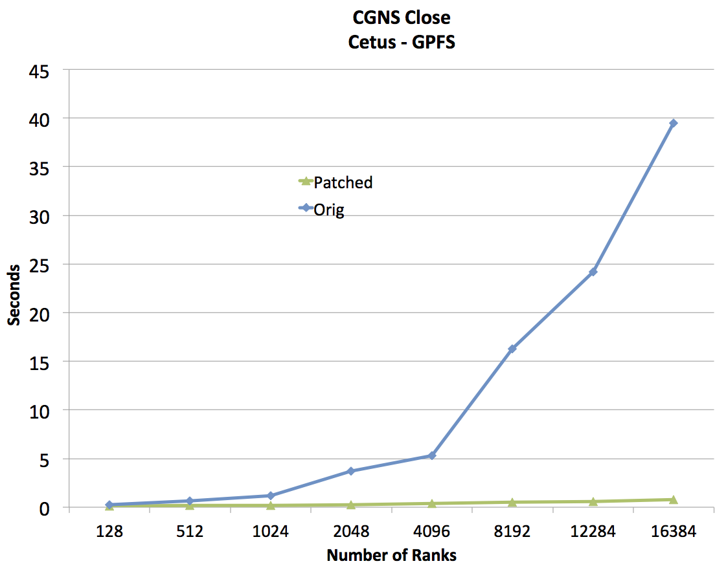
CGNS cgp_close Improvements
Notes:
Made it collective. Improve the write storm.

Slide 93
Virtual object layer (vOL)

Slide 94
Virtual Object Layer (VOL)
Goal
  Provide an application with the HDF5 data model and API, but allow different underlying storage mechanisms
New layer below HDF5 API
  Intercepts all API calls that can touch the data on disk and routes them to a VOL plugin
Potential VOL plugins:
  Native HDF5 driver (writes to HDF5 file)
  Raw driver (maps groups to file system directories and datasets to files in directories)
  Remote driver (the file exists on a remote machine)

Slide 95
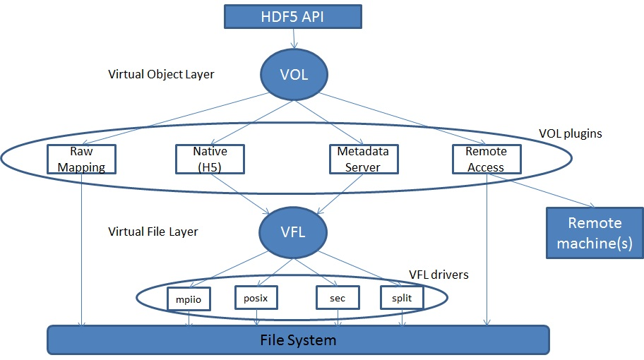
Virtual Object Layer

Slide 96
Why not use the VFL?
VFL is implemented below the HDF5 abstract model
  Deals with blocks of bytes in the storage container
  Does not recognize HDF5 objects nor abstract operations on those objects
VOL is layered right below the API layer to capture the HDF5 model

Slide 97
Sample API Function Implementation
hid_t H5Dcreate2 (hid_t loc_id, const char *name, hid_t type_id, hid_t space_id, hid_t lcpl_id, hid_t dcpl_id, hid_t dapl_id) {
/* Check arguments */
…
/* call corresponding VOL callback for H5Dcreate */
dset_id = H5_VOL_create (TYPE_DATASET, …);
/*
Return result to user (yes the dataset is created,
or no here is the error)
*/
return dset_id;
}

Slide 98
considerations
Work in progress: VOL

Slide 99
VOL Plugin Selection
Use a pre-defined VOL plugin:
  hid_t fapl = H5Pcreate(H5P_FILE_ACCESS);
  H5Pset_fapl_mds_vol(fapl, …);
  hid_t file = H5Fcreate("foo.h5", …, …, fapl);
  H5Pclose(fapl);
Register user defined VOL plugin:
  H5VOLregister (H5VOL_class_t *cls)
  H5VOLunregister (hid_t driver_id)
  H5Pget_plugin_info (hid_t plist_id)

Slide 100
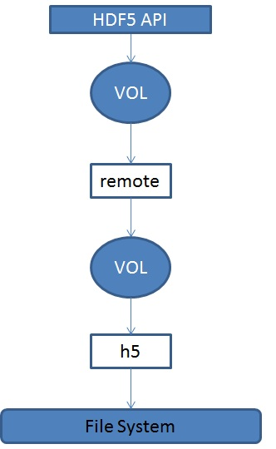
Interchanging and Stacking Plugins
Interchanging VOL plugins
  Should be a valid thing to do
  User’s responsibility to ensure plugins coexist
Stacking plugins
Stacking should make sense.
For example, the first VOL plugin in a stack could be a statistics plugin, that does nothing but gather information on what API calls are made and their corresponding parameters.

Slide 101
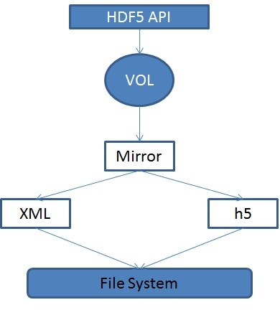
Mirroring
Extension to stacking
HDF5 API calls are forwarded through a mirror plugin to two or more VOL plugins

Slide 102
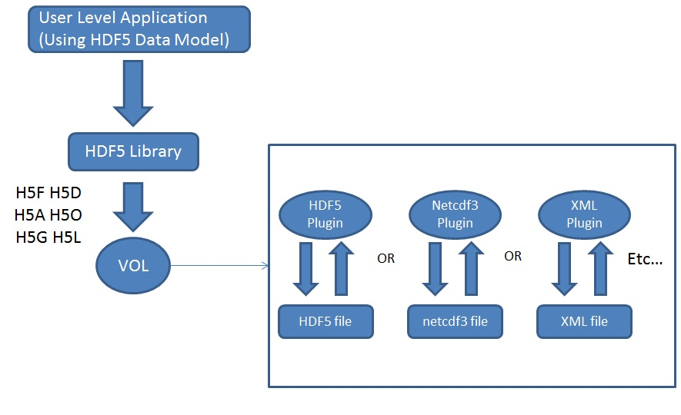
Sample Plugins (I)
Different File Format plugins

Slide 103
Sample Plugins: Metadata Server
Application processes
Set aside process
Compute Nodes
MDS
Metadata
H5F H5D H5A H5O H5G H5L
VOL
HDF5 container
Raw Data File
Metadata File

Slide 104
Raw Plugin
The flexibility of the virtual object layer provides developers with the option to abandon the single file, binary format like the native HDF5 implementation.
A “raw” file format could map HDF5 objects (groups, datasets, etc …) to file system objects (directories, files, etc …).
The entire set of raw file system objects created would represent one HDF5 container.
Useful to the PLFS package (http://institute.lanl.gov/plfs/)

Slide 105
Remote Plugin
A remote VOL plugin would allow access to files located remotely.
The plugin could have an HDF5 server module located where the HDF5 file resides and listens to incoming requests from a remote process.
Use case: Remote visualization
  Large, remote datasets are very expensive to migrate to the local visualization system.
  It would be faster to just enable in situ visualization to remotely access the data using the HDF5 API.

Slide 106
Implementation
VOL Class
  Data structure containing general variables and a collection of function pointers for HDF5 API calls
Function Callbacks
  API routines that potentially touch data on disk
  H5F, H5D, H5A, H5O, H5G, H5L, and H5T

Slide 107
Implementation
We will end up with a large set of function callbacks:
  Lump all the functions together into one data structure OR
  Have a general class that contains all common functions, and then children of that class that contain functions specific to certain HDF5 objects OR
  For each object have a set of callbacks that are specific to that object (This is design choice that has been taken).

Slide 108
Filters
Need to keep HDF5 filters in mind
Where is the filter applied, before or after the VOL plugin?
  Logical guess now would be before, to avoid having all plugins deal with filters

Slide 109
Current status of VOL
?

Slide 110
autotuning
Research Focus -

Slide 111
Autotuning Background
Software Autotuning:
  Employ empirical techniques to evaluate a set of alternative mappings of computation kernels to an architecture and select the mapping that obtains the best performance.
Autotuning Categories:
  Self-tuning library generators such as ATLAS, PhiPAC and OSKI for linear algebra, etc.
  Compiler-based autotuners that automatically generate and search a set of alternative implementations of a computation
  Application-level autotuners that automate empirical search across a set of parameter values proposed by the application programmer

Slide 112
HDF5 Autotuning
Why?
  Because the dominant I/O support request at NERSC is poor I/O performance, many/most of which can be solved by enabling Lustre striping, or tuning another I/O parameter
  Scientists shouldn’t have to figure this stuff out!
Two Areas of Focus:
  Evaluate techniques for autotuning HPC application I/O
    File system, MPI, HDF5
  Record and Replay HDF5 I/O operations

Slide 113
Autotuning HPC I/O
Goal: Avoid tuning each application to each machine and file system
  Create I/O autotuner library that can inject “optimal” parameters for I/O operations on a given system
Using Darshan* tool to create wrappers for HDF5 calls
  Application can be dynamically linked with I/O autotuning library
  No changes to application or HDF5 library
Using several HPC applications currently:
  VPIC, GCRM, Vorpal
* - http://www.mcs.anl.gov/research/projects/darshan/

Slide 114
Autotuning HPC I/O
Initial parameters of interest
  File System (Lustre): stripe count, stripe unit
  MPI-I/O: Collective buffer size, coll. buffer nodes
  HDF5: Alignment, sieve buffer size

Slide 115
Autotuning HPC I/O

Slide 116
Autotuning HPC I/O
Autotuning Exploration/Generation Process:
  Iterate over running application many times:
    Intercept application’s I/O calls
    Inject autotuning parameters
    Measure resulting performance
Analyze performance information from many application runs to create configuration file, with best parameters found for application/machine/file system

Slide 117
Autotuning HPC I/O
Using the I/O Autotuning Library:
  Dynamically link with I/O autotuner library
  I/O autotuner library automatically reads parameters from config file created during exploration process
  I/O autotuner automatically injects autotuning parameters as application operates

Slide 118
Autotuning HPC I/O

Slide 119
Autotuning HPC I/O

Slide 120
Autotuning HPC I/O

Slide 121
Autotuning in HDF5
“Auto-Tuning of Parallel IO Parameters for HDF5 Applications”, Babak Behzad, et al, poster @ SC12
"Taming Parallel I/O Complexity with Auto-Tuning”, Babak Behzad, et al, SC13

Slide 122
Autotuning HPC I/O
Remaining research:
  Determine “speed of light” for I/O on system and use that to define “good enough” performance
  Entire space is too large to fully explore, we are now evaluating genetic algorithm techniques to help find “good enough” parameters
  How to factor out “unlucky” exploration runs
  Methods for avoiding overriding application parameters with autotuned parameters

Slide 123
Thank You!
Questions?

