Slide 1
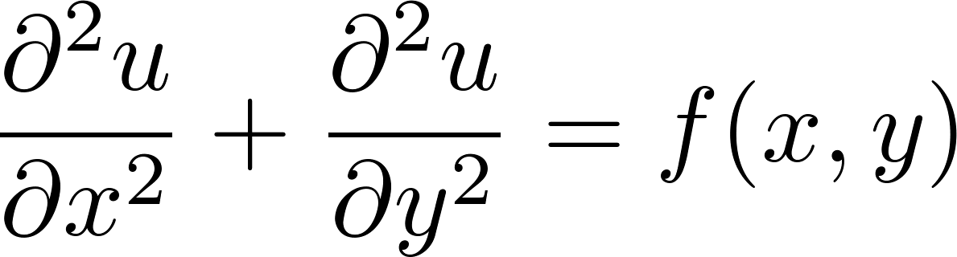
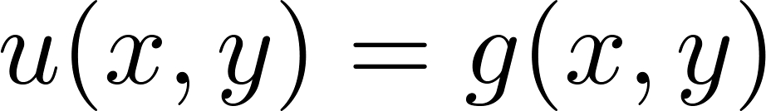
The Poisson Problem
The Poisson Problem is a simple PDE
given on the boundary
Solve the Poisson equation numerically over a region by discretizing it in the x and y directions to obtain a grid of points
Compute the approximate solution values at these points
http://bit.ly/PH5-Example-LRC-2015

Slide 2
The Poisson Problem
We may replace the partial derivatives by numerical approximations involving first-order finite difference
We can write a Jacobi iteration as
http://bit.ly/PH5-Example-LRC-2015

Slide 3
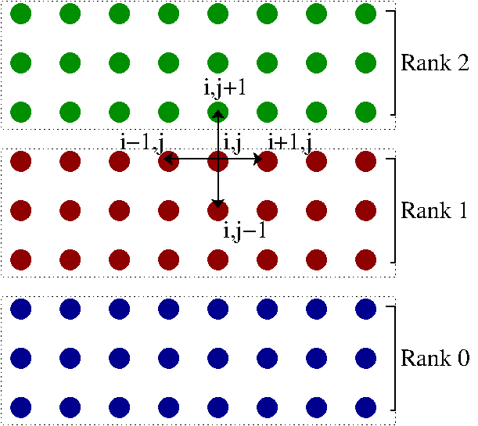
One-dimension Decomposition of Domain
Algorithm
… Figure out communication and decomposition of the domain
DO WHILE ( diffnorm > tolerance )
…..Actually do the computation
END DO
… After our ground breaking solution we need to save the solution
http://bit.ly/PH5-Example-LRC-2015
Notes:
Metis, Zoltan

Slide 4
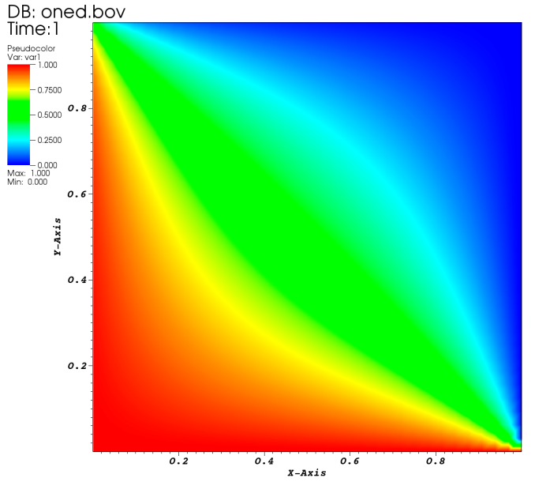
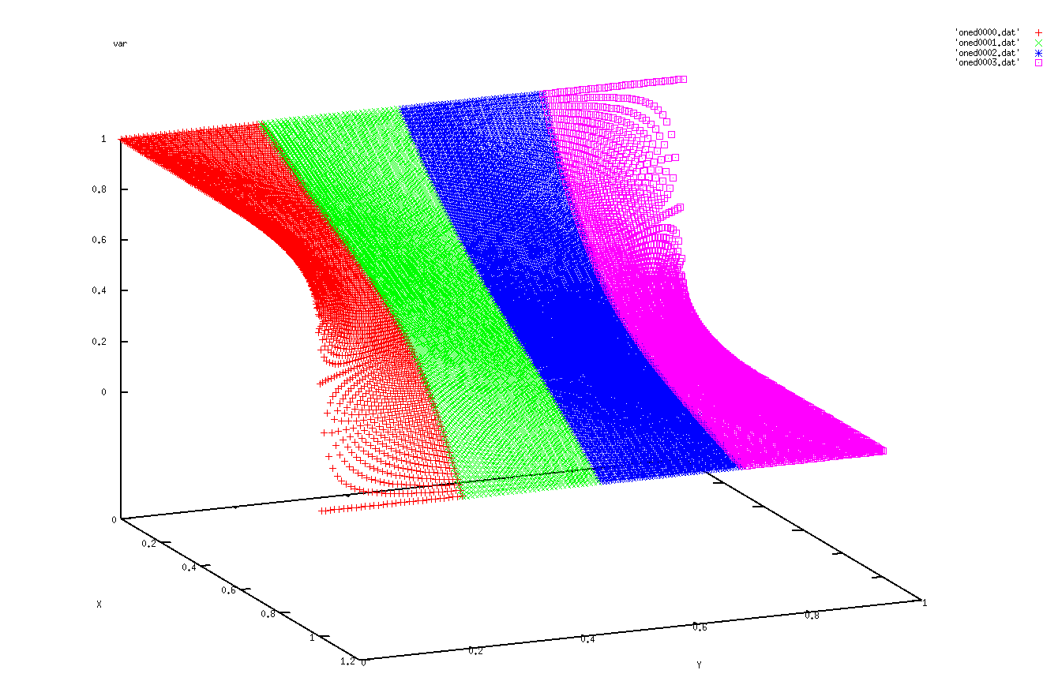
Method I: One File per Process
OPEN(10,file='oned'//ichr4//'.dat', ACCESS='STREAM')
dx = 1.0_dp/REAL(nx, KIND=dp)
x = 0.0_dp
DO i = 0, nx+1
y = (sy-1)*dx
DO j = sy, ey+1
WRITE(10) b(i,j)
y = y + dx
ENDDO
x = x + dx
ENDDO
close(10)
VisIT
Gnuplot

Slide 5
Method II: Write to a Single HDF File
SUBROUTINE WRITE_HDF(b, nx, sy, ey, my_id, nprocs, MPI_COMM_WORLD)
INTEGER :: nx, sy, ey, my_id, nprocs
REAL (KIND=dp), DIMENSION (0:nx+1,sy-1:ey+1), TARGET :: b
CHARACTER(LEN=7), PARAMETER :: filename = "oned.h5" ! File name
CHARACTER(LEN=3), PARAMETER :: dsetname = "Var" ! Dataset name
INTEGER(HID_T) :: file_id ! File identifier
INTEGER(HID_T) :: dset_id ! Dataset identifier
INTEGER(HID_T) :: filespace ! Dataspace identifier in file
INTEGER(HID_T) :: memspace ! Dataspace identifier in memory
INTEGER(HID_T) :: plist_id ! Property list identifier
INTEGER(HSIZE_T), DIMENSION(2) :: dimsf ! Dataset dimensions.
INTEGER(HSIZE_T), DIMENSION(2) :: count
INTEGER(HSSIZE_T), DIMENSION(2) :: offset
INTEGER :: rank = 2 ! Dataset rank
TYPE(c_ptr) :: f_ptr
INTEGER :: error, error_n ! Error flags
INTEGER :: MPI_COMM_WORLD

Slide 6
Method II: Write to a Single HDF File
dimsf = (/nx+2,nx+2/)
! Initialize FORTRAN predefined datatypes
CALL h5open_f(error)
! Setup file access property list with parallel I/O access.
CALL h5pcreate_f(H5P_FILE_ACCESS_F, plist_id, error)
CALL h5pset_fapl_mpio_f(plist_id, MPI_COMM_WORLD, MPI_INFO_NULL, error)
! Create the file collectively.
CALL h5fcreate_f(filename, H5F_ACC_TRUNC_F, file_id, error, access_prp = plist_id)
CALL h5pclose_f(plist_id, error)
! Create the data space for the dataset.
CALL h5screate_simple_f(rank, dimsf, filespace, error)
! Create the dataset with default properties.
CALL h5dcreate_f(file_id, dsetname, H5T_NATIVE_DOUBLE, filespace, dset_id, error)
CALL h5sclose_f(filespace, error)

Slide 7
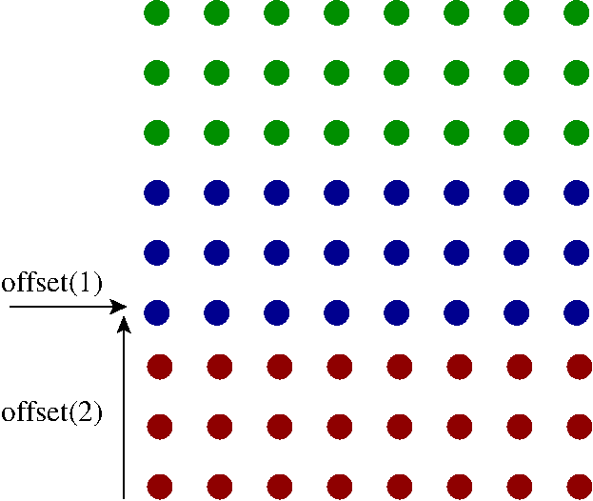
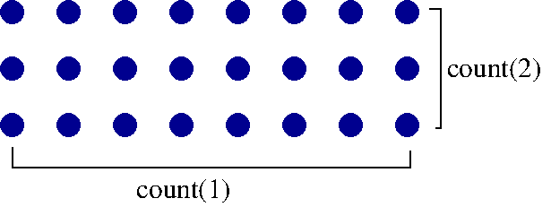
Method II: Write to a Single HDF File
! Each process defines dataset in memory and writes it to the hyperslab
! in the file.
COUNT(1) = nx+2
COUNT(2) = ey-sy + 1
offset(1) = 0
offset(2) = my_id * COUNT(2)
CALL h5screate_simple_f(rank, count, memspace, error)
File
Proc 1 (memory space)

Slide 8
Method II: Write to a Single HDF File
! Select hyperslab in the file.
CALL h5dget_space_f(dset_id, filespace, error)
CALL h5sselect_hyperslab_f (filespace, H5S_SELECT_SET_F, offset, &
count, error)
! Create property list for collective dataset write
CALL h5pcreate_f(H5P_DATASET_XFER_F, plist_id, error)
CALL h5pset_dxpl_mpio_f(plist_id, H5FD_MPIO_COLLECTIVE_F, error)
! Write the dataset collectively.
f_ptr = C_LOC(b(0,sy))
CALL h5dwrite_f(dset_id, H5T_NATIVE_DOUBLE, f_ptr, error, &
file_space_id = filespace, mem_space_id = memspace, &
xfer_prp = plist_id)
! Write the dataset independently.
! CALL h5dwrite_f(dset_id, H5T_NATIVE_DOUBLE, f_ptr, error, &
! file_space_id = filespace, mem_space_id = memspace)

Slide 9
Method II: Write to a Single HDF File
! Close dataspaces.
CALL h5sclose_f(filespace, error)
CALL h5sclose_f(memspace, error)
! Close the dataset and property list.
CALL h5dclose_f(dset_id, error)
CALL h5pclose_f(plist_id, error)
! Close the file.
CALL h5fclose_f(file_id, error)
! Close FORTRAN predefined datatypes.
CALL h5close_f(error)

Slide 10
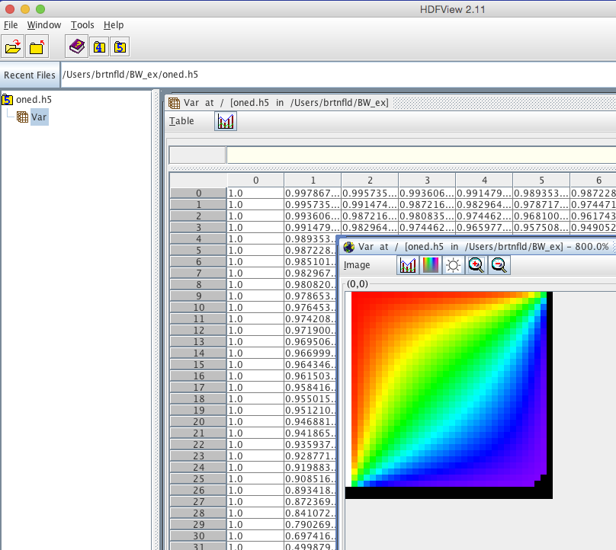
Method II: Write to a Single HDF File
All the processes create one HDF5 file
View data with HDFView

Slide 11
Don’t Reinvent the wheel…
Use libraries that utilize HDF, but represent the scientific data using a set of conventions, i.e.
  How to represent meshes
  Variable definitions
  Multiple datasets
  Component definitions
Some parallel formats using HDF
  CFD: CGNS
  Meshless Methods: H5Part
  FEM: MOAB
  General: NetCDF
Hides the complexity of HDF

Slide 12

CGNS example
/* ====================================== */
/* == **WRITE THE CGNS FILE ** == */
/* ====================================== */
cgp_open(fname, CG_MODE_WRITE, &fn);
cg_base_write(fn, "Base 1", cell_dim, phys_dim, &B);
cg_zone_write(fn, B, "Zone 1", nijk, Unstructured, &Z);

Slide 13
CGNS example
/* ====================================== */
/* == (A) WRITE THE NODAL COORDINATES == */
/* ====================================== */
count = nijk[0]/comm_size;
min = count*comm_rank+1;
max = count*(comm_rank+1);
cgp_coord_write(fn,B,Z,CGNS_ENUMV(RealDouble),"CoordinateX",&Cx);
cgp_coord_write(fn,B,Z,CGNS_ENUMV(RealDouble),"CoordinateY",&Cy);
cgp_coord_write(fn,B,Z,CGNS_ENUMV(RealDouble),"CoordinateZ",&Cz);
Cvec[0] = Cx;
Cvec[1] = Cy;
Cvec[2] = Cz;
cgp_coord_multi_write_data(fn, B, Z, Cvec, &min,&max, Coor_x, Coor_y, Coor_z);

Slide 14
CGNS example
/* ====================================== */
/* == (B) WRITE THE CONNECTIVITY TABLE == */
/* ====================================== */
start = 1;
end = nijk[1];
cgp_section_write(fn,B,Z,"Elements",PENTA_6,start,end,0,&S);
count = nijk[1]/comm_size;
emin = count*comm_rank+1;
emax = count*(comm_rank+1);
cgp_elements_write_data(fn, B, Z, S, emin, emax, elements);

Slide 15
CGNS example
/* ====================================== */
/* == (C) WRITE THE FIELD DATA == */
/* ====================================== */
count = nijk[0]/comm_size;
cg_sol_write(fn, B, Z, "Solution", Vertex, &S);
cgp_field_write(fn,B,Z,S,CGNS_ENUMV(RealDouble),"MomentumX",&Fx) ;
cgp_field_write(fn,B,Z,S,CGNS_ENUMV(RealDouble),"MomentumY",&Fy);
cgp_field_write(fn,B,Z,S,CGNS_ENUMV(RealDouble),"MomentumZ",&Fz);
Fvec[0] = Fx;
Fvec[1] = Fy;
Fvec[2] = Fz;
cgp_field_multi_write_data(fn,B,Z,S,Fvec,&min,&max,
3,Data_Fx,Data_Fy,Data_Fz);
Reading the file is just as easy…

Slide 16
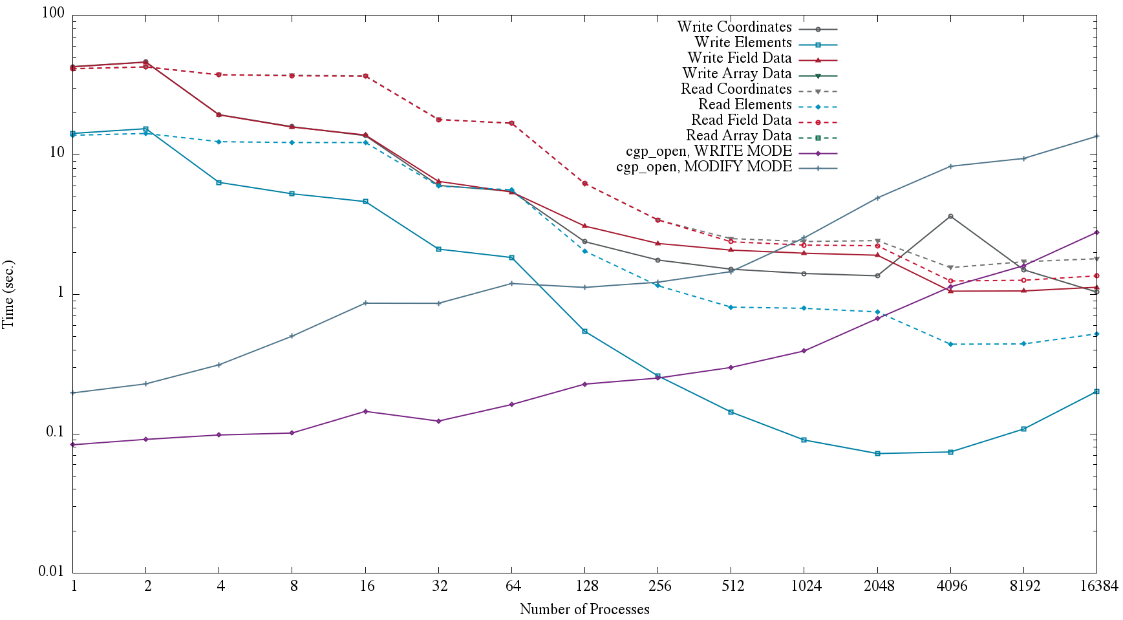
CGNS example

