Slide 1
Shane Canon
NERSC Data and Analytics Services
An Introduction to Docker and Shifter

Slide 2
Goals
Brief Intro to Docker and Shifter
Motivations for using Docker and Shifter
Examples of how Shifter is already being used
Quick walk through of:
  Creating a Docker image
  Running an container locally
  Pushing an image to a registry
  Pulling an image to NERSC
  Running an image with Shifter
Roadmap and Conclusions

Slide 3
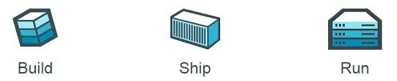
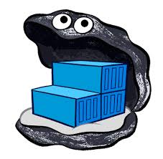

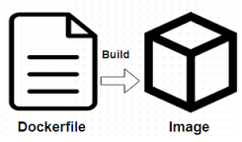
Docker Basic’s
Build images that captures applications requirements.
Manually commit or use a recipe file.
Push an image to DockerHub, a hosted registry, or a private Docker Registry.
Share Images
Use Docker Engine to pull images down and execute a container from the image.

Slide 4
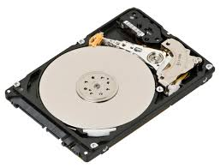


Why not just run Docker
System Architecture: Docker assumes local disk
Security: Docker currently uses an all or nothing security model. Users would effectively have system privileges
Integration: Docker doesn’t play nice with batch systems.
System Requirements: Docker typically requires a very modern kernel
Complexity: Running real Docker would add new layers of complexity
Notes:
So that model worked for a small cluster but what about the Cray’s. Well the approach has a number of draw backs and some architectural aspects of the Cray make it challenging.

Slide 5
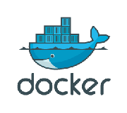
Shifter: Bringing Containers to HPC
Docker: open source, automated container deployment service
  Docker containers wrap up a piece of software in
  a complete filesystem that contains everything it
  needs to run (code, runtime, system tools and libraries)
  Guaranteed to operate the same, regardless of the environment in which it is running
NERSC has partnered with Cray to deliver Docker-like container technology through a new software package known as Shifter

Slide 6
Shifter at NERSC
Secure and scalable way to deliver containers to HPC
Implemented on Cori and Edison
Supports Docker images and other image formats (ext4, squashfs)
Basic Idea
  Users create custom images in desired OS
  Upload image to docker hub and pull down on HPC system
  Hooked into the batch system
http://www.nersc.gov/users/software/using-shifter-and-docker/

Slide 7
Why Use Shifter?
Shifter allows you to fully customize your operating environment
  Want SL 6.X with 32 bit libraries? Use Shifter
  Have a very complicated software stack with lots of dependencies? Use Shifter
Portability
  Can volume mount directories into shifter images
    Have an /input and /output that are linked to directories in your scratch directory
  Images are NERSC-independent, can be run anywhere

Slide 8
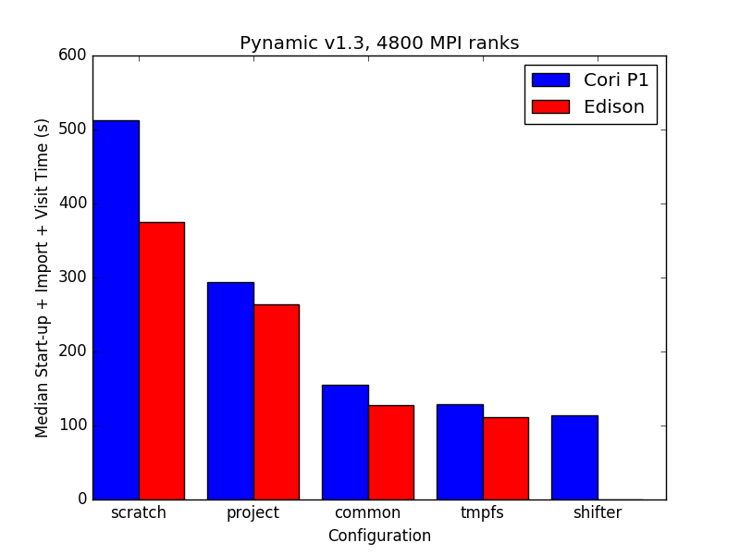
Shifter is Fast
Another benefit: Improved shared library loading times compared to other file system
Notes:
Python must walk through the python libraries to construct the namespace
• Python must load up (read) any dynamic libraries that are required
• The loader must traverse the LD_LIBRARY_PATH to find the libraries to load
• Result: Lots of metadata accesses which put a load on the file system Metadata server

Slide 9
Per-Node Write Cache (IOPS)
Results of an IOR File per-process, 2 tasks per node, 512B transfer size, 2GB write. 100x faster than Lustre at the same scale.

Slide 10
Shifter and MPI
Shifter can be used to run MPI jobs
MPI communication over Aries network is available by default for Shifter on Cori
In the image, build and link against standard MPICH libraries
Cray libraries swapped in at run time by front loading LD_LIBRARY_PATH
Shifter in some cases is faster than a natively compiled application

Slide 11
Hands-On Walk Through

Slide 12
Basic Workflow
Install Docker on your laptop or workstation
Create a Dockerfile that installs and builds your application and any dependencies
Test this Docker Image locally
Push the image to a registry (DockerHub)
Pull the image to NERSC
Run the Image
https://github.com/NERSC/2016-11-14-sc16-Container-Tutorial

Slide 13
Example Dockerfile
# This example makes use of an Ubuntu-based NERSC base image
# that already has MPI built and installed.
#
# This means the you just need to add your app code in and compile it.
#
# To build this example do:
# docker build -t <dockerhubid>/hellompi:latest .
#
FROM nersc/ubuntu-mpi:14.04
ADD helloworld.c /app/
RUN cd /app && mpicc helloworld.c -o /app/hello
ENV PATH=/usr/bin:/bin:/app:/usr/local/bin

Slide 14
Building and running image
DOE6903508:tutorial canon$ ls -l
total 16
-rw-r--r-- 1 canon canon 407 Feb 23 17:14 Dockerfile
-rw-r--r-- 1 canon canon 418 Feb 23 17:15 helloworld.c
DOE6903508:tutorial canon$ docker build -t scanon/tutorial1 .
Sending build context to Docker daemon 3.072 kB
Step 1/4 : FROM nersc/ubuntu-mpi:14.04
---> a71176e6ce4e
Step 2/4 : ADD helloworld.c /app/
---> Using cache
---> a06d0f662b73
Step 3/4 : RUN cd /app && mpicc helloworld.c -o /app/hello
---> Using cache
---> 84f264e93c70
Step 4/4 : ENV PATH /usr/bin:/bin:/app:/usr/local/bin
---> Using cache
---> b13860cb4c19
Successfully built b13860cb4c19

Slide 15
Running and pushing the image
DOE6903508:tutorial canon$ docker images|grep tutorial
scanon/tutorial1 latest b13860cb4c19 3 months ago 376 MB
DOE6903508:tutorial canon$ docker run -it --rm scanon/tutorial1 /app/hello
hello from 0 of 1 on f127729fdb84
DOE6903508:tutorial canon$ docker push scanon/tutorial1
The push refers to a repository [docker.io/scanon/tutorial1]
e3bf3b7a50cc: Mounted from scanon/hellompi
caa1179b31a8: Mounted from scanon/hellompi
2a291a08dc8c: Mounted from scanon/hellompi
04cb0f3619cf: Mounted from scanon/hellompi
c410e650f359: Mounted from scanon/hellompi
bab10a362750: Mounted from scanon/hellompi
787a9151f9ae: Mounted from scanon/hellompi
470641744213: Mounted from scanon/hellompi

Slide 16
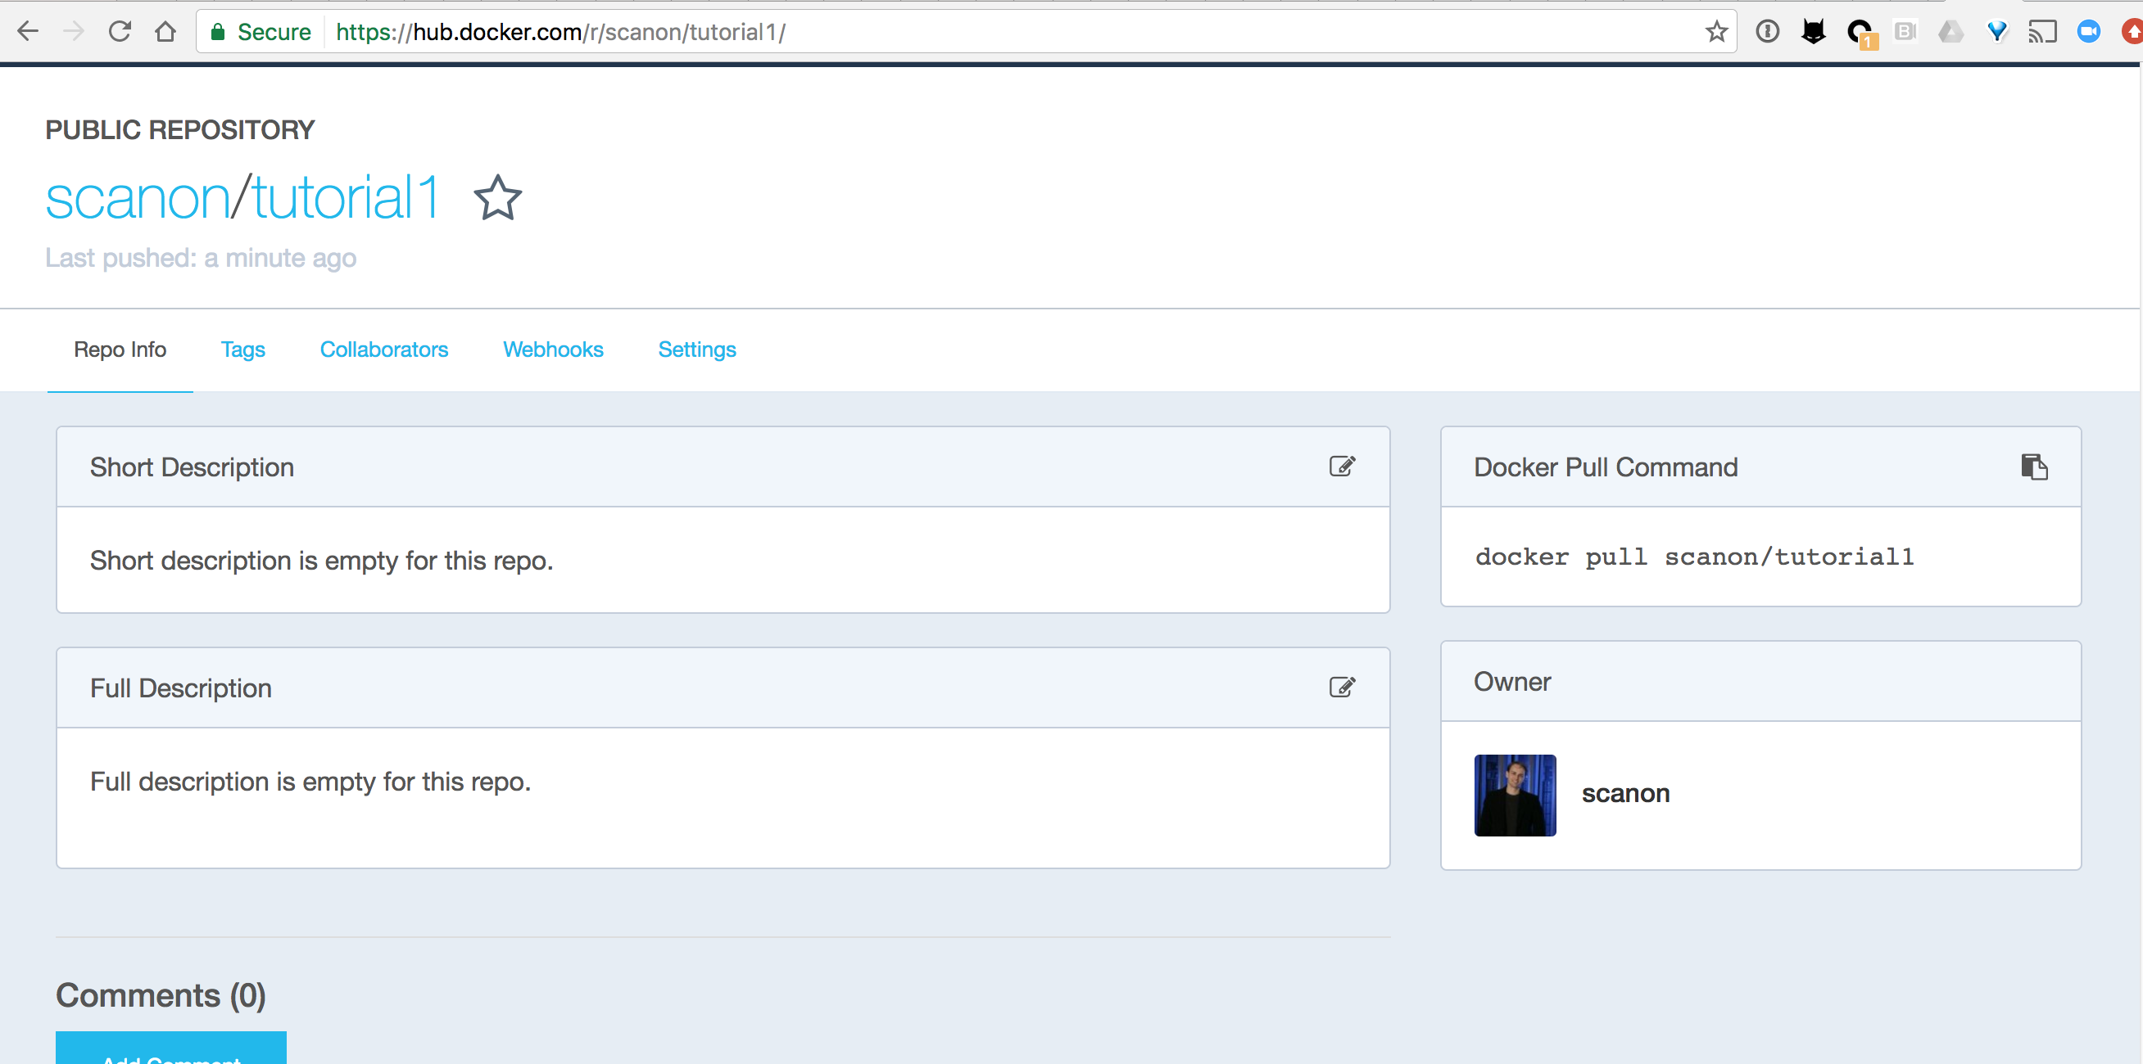
Image on Dockerhub

Slide 17
Pull the image to NERSC and run
canon@cori11:~> shifterimg pull scanon/tutorial1
2017-02-23T17:22:38 Pulling Image: docker:scanon/tutorial1, status: READY
canon@cori11:~> shifterimg images|grep scanon/tut
cori docker READY 2ab93f3c45 2017-02-23T17:22:46 scanon/tutorial1:latest

Slide 18
Pull the image to NERSC and run
canon@cori11:~> salloc -N 1 --image scanon/tutorial1 -C haswell
salloc: Pending job allocation 3844683
salloc: job 3844683 queued and waiting for resources
salloc: job 3844683 has been allocated resources
salloc: Granted job allocation 3844683
salloc: Waiting for resource configuration
salloc: Nodes nid00121 are ready for job
canon@nid00121:~> srun shifter /app/hello
hello from 0 of 1 on nid00121
canon@nid00121:~> srun -n 8 shifter /app/hello
hello from 0 of 8 on nid00121
hello from 1 of 8 on nid00121
hello from 2 of 8 on nid00121
hello from 3 of 8 on nid00121
hello from 4 of 8 on nid00121
hello from 5 of 8 on nid00121
hello from 6 of 8 on nid00121
hello from 7 of 8 on nid00121

Slide 19
Volume Mounts
Volume Mounts provide a way to map external paths into container paths.
This allows paths in the container to be abstracted so it can be portable across different systems.
Basic syntax is: –volume <external path>:<container path>
Shifter places some constraints on what paths can be mapped and where they can be mapped for added security.

Slide 20
Using Volume Mounts
canon@nid00275:~> ls $SCRATCH
MyQuota spark spark_conf_files
canon@nid00275:~> shifter --image ubuntu --volume $SCRATCH:/data bash
canon@nid00275:~$ ls /data
MyQuota spark spark_conf_files
canon@nid00275:~$ exit

Slide 21
PerNode Write Cache
PerNodeWrite extends the volume concept to create temporary writeable space that aren’t shared across nodes.
These spaces are ephemeral (removed on exit)
These are node local and the size can be adjusted
Performs like a local disk but is more flexible
Basic syntax is --volume <external path>:<container path>:perNodeCache=size=XXG

Slide 22
Using Volume Mounts
canon@nid00172:~> shifter --image=ubuntu \
--volume=$SCRATCH:/scratch:perNodeCache=size=100G bash
canon@nid00172:~$ df -h /scratch
Filesystem Size Used Avail Use% Mounted on
/dev/loop1 100G 33M 100G 1% /scratch
canon@nid00172:~$ dd if=/dev/zero bs=1k count=10M of=/scratch/output
10485760+0 records in
10485760+0 records out
10737418240 bytes (11 GB, 10 GiB) copied, 14.1891 s, 757 MB/s
canon@nid00172:~$ ls -lh /scratch/output
-rw-r--r-- 1 canon canon 10G Mar 3 04:01 /scratch/output
canon@nid00172:~$ exit
Exit
canon@nid00172:~> shifter --image=ubuntu \
--volume=$SCRATCH:/scratch:perNodeCache=size=100G bash
canon@nid00172:~$ ls -l /scratch
total 0

Slide 23
Shifter Gotchas
Containers run as the user, not root
Images are mounted read-only
Some volume mount locations are disallowed
Volumes currently can’t be mounted over each other

Slide 24
Shifter Gotchas Examples
canon@nid00173:~> shifter --image=ubuntu bash
canon@nid00173:~$ ls -ld /var/tmp/
drwxrwxrwt 2 root 0 3 Feb 14 23:29 /var/tmp/
canon@nid00173:~$ touch /var/tmp/blah
touch: cannot touch '/var/tmp/blah': Read-only file system
canon@nid00173:~> shifter --image=ubuntu --volume=$SCRATCH:/opt bash|head -2
Invalid Volume Map: /scratch1/scratchdirs/canon:/opt, aborting! 1
Failed to parse volume map options
canon@nid00173:~> shifter --image=ubuntu --volume=$SCRATCH:/data --volume=$SCRATCH/spark:/data/spark2 bash
Mount request path /var/udiMount/data/spark2 not on an approved device for volume mounts.
FAILED to setup user-requested mounts.
FAILED to setup image.

Slide 25
Work Arounds
Make sure critical paths and files are world-readable
Rsync image contents to a volume mount, then volume mount the copy over the original to work around read-only limitation

Slide 26
Dockerfile Best Practices
Bad:
RUN wget http://hostname.com/mycode.tgz
RUN tar xzf mycode.tgz
RUN cd mycode ; make; make install
RUN rm -rf mycode.tgz mycode
Good:
RUN wget http://hostname.com/mycode.tgz && \
tar xzf mycode.tgz && \
cd mycode && make && make install && \
rm -rf mycode.tgz mycode

Slide 27
Dockerfile Best Practices
Bad:
RUN wget http://hostname.com/mycode.tgz ; \
tar xzf mycode.tgz ; \
cd mycode ; make ; make install ; \
rm -rf mycode.tgz mycode
Good:
RUN wget http://hostname.com/mycode.tgz && \
tar xzf mycode.tgz && \
cd mycode && make && make install && \
rm -rf mycode.tgz mycode

Slide 28
Dockerfile Best Practices
Bad:
ADD . /src
RUN apt-get update –y && atp-get install gcc
RUN cd /src && make && make install
Good:
RUN apt-get update –y && apt-get install gcc
ADD . /src
RUN cd /src && make && make install

Slide 29
Other Considerations
Avoid very large images (> ~5 GB)
Keep data in $SCRATCH and volume mount into the container if data is large
Use volume mounts for rapid prototyping and testing, then add that into the image after code stabalizes

Slide 30
Coming Soon
Private Repos and Image ACLs
Allow users to pull from private Docker repos (username and password

Slide 31
Roadmap
17.03 Release
  ACL support (private and authenticated images)
  Image expiry and removal
  Basic Image usage statistics and metrics
17.0X Release
  Integrated Image Import Support
  OverlayFS support (write-able images)
  Simplified Installation
  Singularity Image Format Support

Slide 32
Conclusion
Combination of Docker and Shifter addresses many challenges:
  Usability – Porting applications is easier and quicker
  Flexibility – Users aren’t tethered to the native OS
  Reproducibility – Users can easily save and re-run the same code
  Sharing – Users can easily share their tools with collaborators
  Scientific Process – Images can be published so others can reproduce work
Performance
  Shifter also provides a number of performance benefits especially for Python or codes with many dynamic libraries
  Shifter integrates with the batch system, scales well, and provides special features like perNodeCaches

Slide 33
National Energy Research Scientific Computing Center

Slide 34
Hello World
DOE6903508:shifter canon$ cat helloworld.c
// Hello World MPI app
#include <mpi.h>
#include <stdio.h>
int main(int argc, char** argv) {
int size, rank;
char buffer[1024];
MPI_Init(&argc, &argv);
MPI_Comm_size(MPI_COMM_WORLD, &size);
MPI_Comm_rank(MPI_COMM_WORLD, &rank);
gethostname(buffer, 1024);
printf("hello from %d of %d on %s\n", rank, size, buffer);
MPI_Barrier(MPI_COMM_WORLD);
MPI_Finalize();
return 0;
}

Slide 35
Screen Shots for Backup

Slide 36
Dockerfile
DOE6903508:shifter canon$ cat Dockerfile
# This example makes use of an Ubuntu-based NERSC base image
# that already has MPI built and installed.
#
# This means the you just need to add your app code in and compile it.
#
# To build this example do:
# docker build -t <dockerhubid>/hellompi:latest .
#
# And to test:
# docker run -it --rm <dockerhubid>/hellompi:latest /app/hello
FROM nersc/ubuntu-mpi:14.04
ADD helloworld.c /app/
RUN cd /app && mpicc helloworld.c -o /app/hello
ENV PATH=/usr/bin:/bin:/app:/usr/local/bin

Slide 37
Building and Pushing
DOE6903508:shifter canon$ docker build -t scanon/hellompi .
Sending build context to Docker daemon 4.096 kB
Step 1 : FROM nersc/ubuntu-mpi:14.04
---> a71176e6ce4e
Step 2 : ADD helloworld.c /app/
---> 3ebe2000ff1b
Removing intermediate container c88799e39fa2
Step 3 : RUN cd /app && mpicc helloworld.c -o /app/hello
---> Running in f3ec8a1c55f3
---> 68491ca5b944
Removing intermediate container f3ec8a1c55f3
Step 4 : ENV PATH /usr/bin:/bin:/app:/usr/local/bin
---> Running in eef831fe8c61
---> 132ba04bff6d
Removing intermediate container eef831fe8c61
Successfully built 132ba04bff6d
DOE6903508:shifter canon$ docker push scanon/hellompi
The push refers to a repository [docker.io/scanon/hellompi]
2c96e3a94e72: Pushed
b0da9b74490f: Pushed
2a291a08dc8c: Mounted from scanon/hello
04cb0f3619cf: Mounted from scanon/hello
c410e650f359: Mounted from scanon/hello
bab10a362750: Mounted from scanon/hello
787a9151f9ae: Mounted from scanon/hello
470641744213: Mounted from scanon/hello
latest: digest: sha256:9225f1ce3fc3f6a644306899019df55e7632bc9a2e2f5a0a46e933b810a32805 size: 1990

Slide 38
Approach 1 – In the image
FROM centos:6
## update packages and install dependencies
RUN yum upgrade -y && \
yum –y install csh tar numpy scipy matplotlib gcc
WORKDIR /
## replace mpi4py with cray-tuned one
ADD optcray_cori.tar /
ADD mpi4py-1.3.1.tar.gz /usr/src
ADD mpi.cfg /usr/src/mpi4py-1.3.1/
RUN cd /usr/src/mpi4py-1.3.1 && \
chmod -R a+rX /opt/cray && chown -R root:root /opt/cray && \
python setup.py build && \
export MPI4PY_LIB=$( rpm -ql $(rpm -qa | grep mpi4py | head -1) | egrep "lib$" ) && \
export MPI4PY_DIR="${MPI4PY_LIB}/.." && \
python setup.py install && \
cd / && rm -rf /usr/src/mpi4py-1.3.1 && \
echo "/opt/cray/wlm_detect/default/lib64/libwlm_detect.so.0" >>/etc/ld.so.preload && \
(echo "/opt/cray/mpt/default/gni/mpich2-gnu/48/lib\n/opt/cray/pmi/default/lib64”;\
echo “/opt/cray/ugni/default/lib64\n/opt/cray/udreg/default/lib64”;\
echo “/opt/cray/xpmem/default/lib64\n/opt/cray/alps/default/lib64”) \
>> /etc/ld.so.conf && \
ldconfig
Dockerfile
> docker build –t scanon/myapp:1.1 .
> docker push scanon/myapp:1.1

Slide 39
Approach 2 - Golden Image
FROM registry.services.nersc.gov/cori:latest
ADD . /app
RUN cd /app && \
mpicc –o hello helloworld.c
Dockerfile
> docker build –t scanon/myapp:1.1 .
> docker push scanon/myapp:1.1

Slide 40
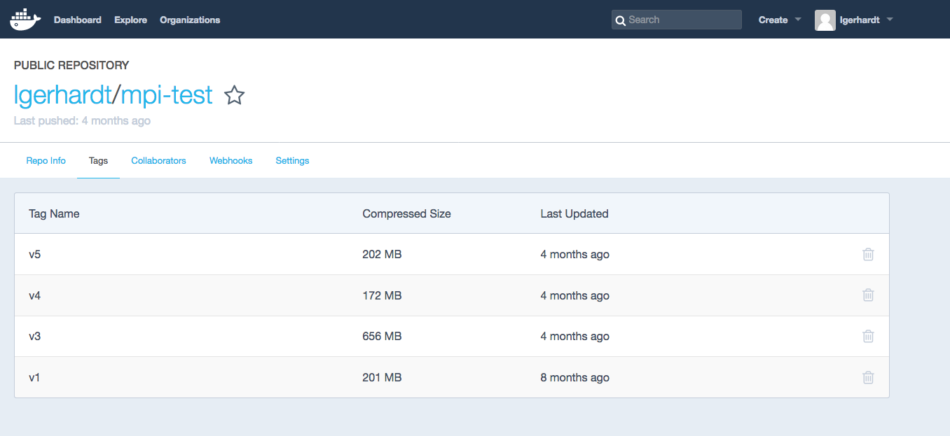
Pulling Down an Image from Dockerhub
On Cori or Edison
shifterimg pull docker:lgerhardt/mpi-test:v5
Format is source:image_name: tag

Slide 41
Running A Job in A Shifter Image
#!/bin/bash
#SBATCH --image=docker:image_name:latest
  #SBATCH --volume="/global/cscratch1/sd/lgerhard:/output”
  #SBATCH --volume=“/global/cscratch1/sd/lgerhard/shifter_tmp:/tmp
  :perNodeCache=size=200G”
#SBATCH --nodes=1
#SBATCH --partition=regular
#SBATCH -C haswell
srun -n 32 shifter python myPythonScript.py args
Many more commands at
http://www.nersc.gov/users/software/using-shifter-and-docker/using-shifter-at-nersc/

Slide 42
File System flow – Traditional vs Shifter
Process
Process
Local
ext4 or squashfs
Lustre Client
Lustre Client
Lustre MDS
Lustre OST
Lustre OST
Remote
/udi/image1
/udi/image1/usr
/udi/image1/etc
…
/udi/image1.ext4
Notes:
Here is a graphical representation of the layout options all layered on Lustre. The important thing to consider is how these models differ when the contained process is doing heavy metadata operations inside the image (i.e. loading up python libraries). In the pure lustre model, everything falls back to the Lustre MDS (even with DNE this is a major bottle neck). With the others, the client only has to interact with the OSTs which is much more scalable.

Slide 43
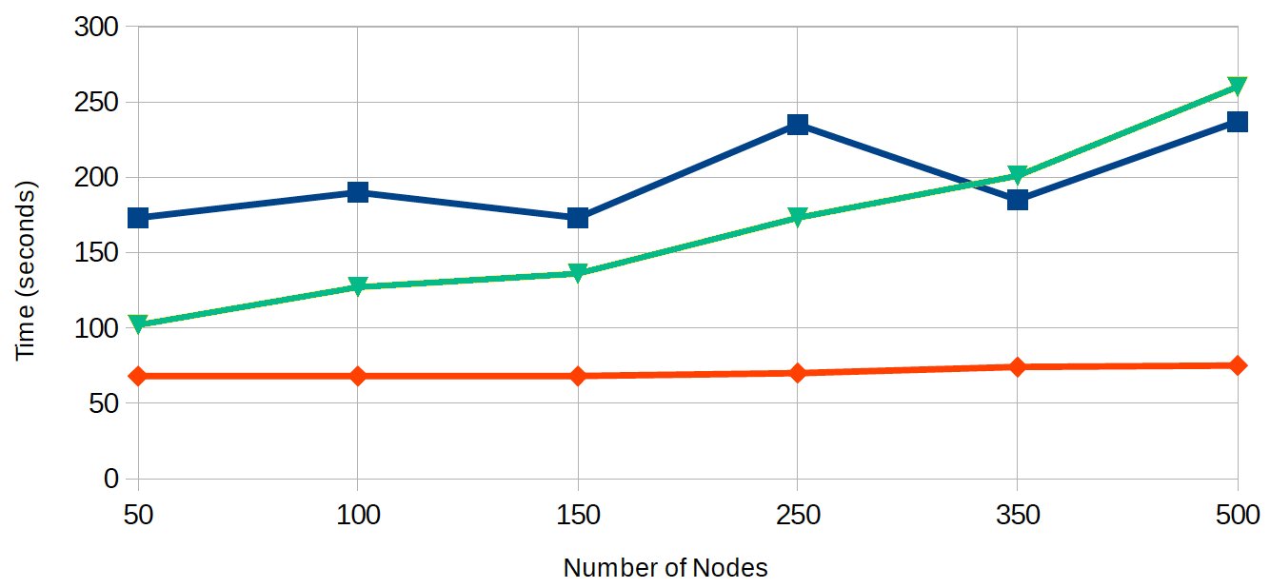
Even Big Images Load Quickly
As proof of concept created “Mega” CVMFS shifter image
  Full CVMFS stack pulled down and deduped with uncvmfs software stack. 1 – 3 TB ext4 file uncompressed, 300 GB compressed w/squashfs
Use Shifter to load job
  Add a single flag to batch script “--image=<image name>”
  ATLAS cvmfs repository is found at /cvmfs/atlas.cern.ch like normal
Burst Buffer
Lustre
Shifter

Slide 44
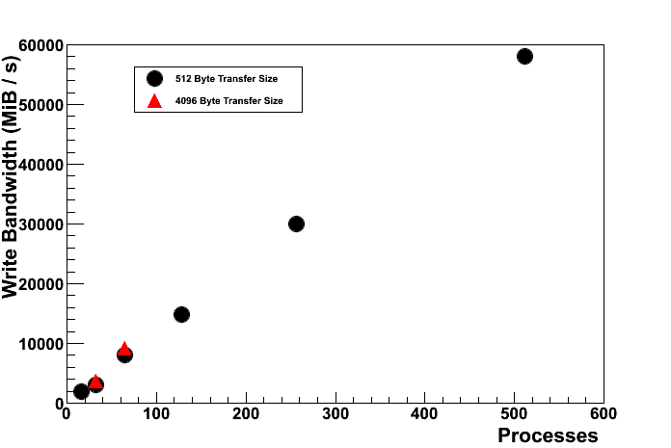
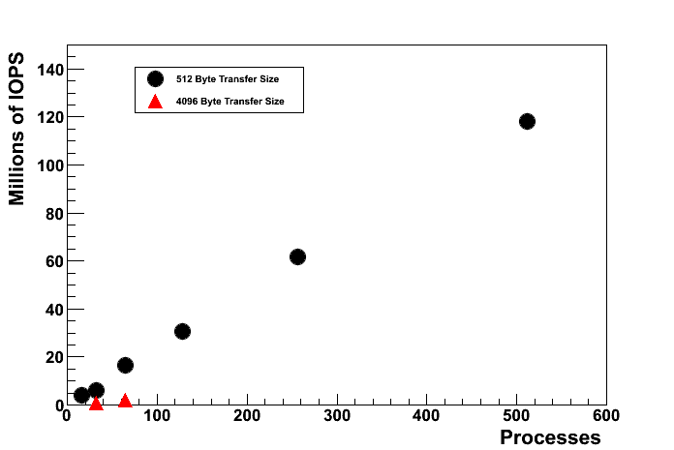
Loop Mounted FS for Super Fast I/O
Shifter can mount an xfs file system on each node
  Created when job starts and destroyed when job ends
  Compute node “local disk”
  Excellent I/O rates:
    Small databases
    Also good for “bad IO”
57 GiB/s!

