Slide 1
March, 2016
Cori Application Readiness Strategy and Early Experiences

Slide 2
What is different about Cori?
Edison (Ivy-Bridge):
12 Cores Per CPU
24 Virtual Cores Per CPU
2.4-3.2 GHz
Can do 4 Double Precision Operations per Cycle (+ multiply/add)
2.5 GB of Memory Per Core
~100 GB/s Memory Bandwidth
Cori (Knights-Landing):
Up to 72 Physical Cores Per CPU
Up to 288 Virtual Cores Per CPU
Much slower GHz
Can do 8 Double Precision Operations per Cycle (+ multiply/add)
< 0.3 GB of Fast Memory Per Core
< 2 GB of Slow Memory Per Core
Fast memory has ~ 5x DDR4 bandwidth

Slide 3
Basic Optimization Concepts

Slide 4
MPI + X?
Need to explicitly consider both inter and on-node parallelism in application.
Existing applications may suffer from:
Memory overhead due to duplicated data in traditional MPI tasks
Lack of SIMD/Vectorization expressiveness in app.
Potential MPI latency in all-to-all communication patterns
Possible Solutions:
MPI+MPI, MPI+OpenMP, PGAS (MPI+PGAS), Task Based Programming

Slide 5
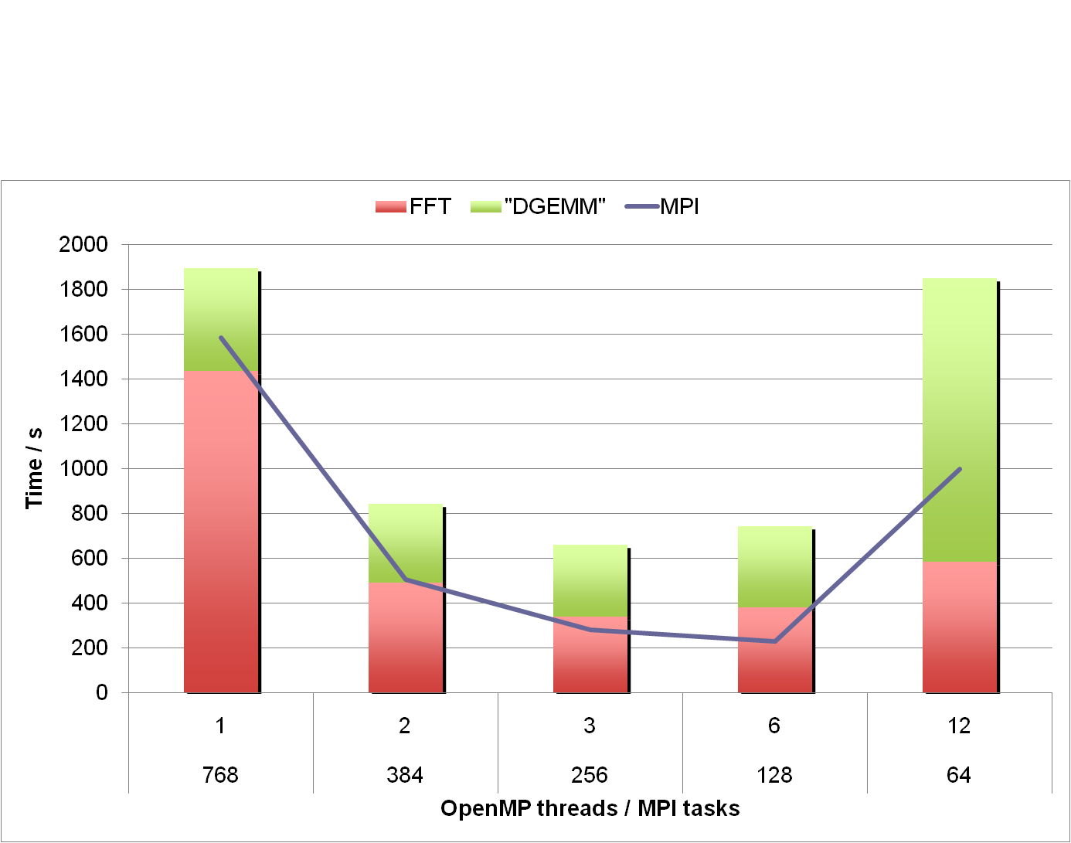
PARATEC Use Case For OpenMP
PARATEC computes parallel FFTs across all processors.
Involves MPI all-to-all communication (small messages, latency bound).
Reducing the number of MPI tasks in favor OpenMP threads makes large improvement in overall runtime.
Figure Courtesy of Andrew Canning

Slide 6
Nested OpenMP
#include <omp.h>
#include <stdio.h>
void report_num_threads(int level)
{
#pragma omp single {
printf("Level %d: number of threads in the team: %d\n", level, omp_get_num_threads());
}
}
int main()
{
omp_set_dynamic(0);
#pragma omp parallel num_threads(2) {
report_num_threads(1);
#pragma omp parallel num_threads(2) {
report_num_threads(2);
#pragma omp parallel num_threads(2) {
report_num_threads(3);
}
}
}
return(0);
}
% a.out
Level 1: number of threads in the team: 2
Level 2: number of threads in the team: 1
Level 3: number of threads in the team: 1
Level 2: number of threads in the team: 1
Level 3: number of threads in the team: 1
% setenv OMP_NESTED TRUE
% a.out
Level 1: number of threads in the team: 2
Level 2: number of threads in the team: 2
Level 2: number of threads in the team: 2
Level 3: number of threads in the team: 2
Level 3: number of threads in the team: 2
Level 3: number of threads in the team: 2
Level 3: number of threads in the team: 2
Level 0: P0
Level 1: P0 P1
Level 2: P0 P2; P1 P3
Level 3: P0 P4; P2 P5; P1 P6; P3 P7

Slide 7
Nested OpenMP
Beneficial to use nested OpenMP to allow more fine-grained thread parallelism.
Achieving best process and thread affinity is crucial in getting good performance with nested OpenMP, yet it is not straightforward to do so.
Combinations of OpenMP environment variables and run time flags are needed for different compilers and different batch schedulers on different NERSC systems.
Refer to NERSC “Nested OpenMP” web page for detailed instructions illustrated with sample hybrid MPI/OpenMP programs - Advanced OpenMP Talk Wednesday:
  https://www.nersc.gov/users/computational-systems/edison/running-jobs/using-openmp-with-mpi/nested-openmp/
Example usage with Intel compiler with Torque/Moab on Edison:
setenv OMP_NESTED true
setenv OMP_NUM_THREADS 4,3
setenv OMP_PROC_BIND spread,close
setenv KMP_HOT_TEAMS 1
setenv KMP_HOT_TEAMS_MAX_LEVELS 2
aprun -n 2 -S 1 -d 12 –cc numa_node ./nested.intel.edison
- ‹#› -

Slide 8
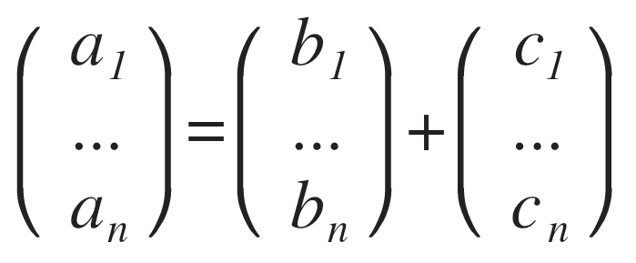
Vectorization
There is a another important form of on-node parallelism
Vectorization: CPU does identical operations on different data; e.g., multiple iterations of the above loop can be done concurrently.
do i = 1, n
a(i) = b(i) + c(i)
enddo

Slide 9
Vectorization
There is a another important form of on-node parallelism
Vectorization: CPU does identical operations on different data; e.g., multiple iterations of the above loop can be done concurrently.
do i = 1, n
a(i) = b(i) + c(i)
enddo
Intel Xeon Sandy-Bridge/Ivy-Bridge: 4 Double Precision Ops Concurrently
Intel Xeon Phi: 8 Double Precision Ops Concurrently

Slide 10
Things that prevent vectorization in your code
Compilers want to “vectorize” your loops whenever possible. But sometimes they get stumped. Here are a few things that prevent your code from vectorizing:
Loop dependency:
Task forking:
do i = 1, n
a(i) = a(i-1) + b(i)
enddo
do i = 1, n
if (a(i) < x) cycle
if (a(i) > x) …
enddo

Slide 11
Things that prevent vectorization in your code
Example From NERSC User Group Hackathon - (Astrophysics Transport Code)
for (many iterations) {
… many flops …
et = exp(outcome1)
tt = pow(outcome2,3)
IN = IN * et +tt
}

Slide 12
Things that prevent vectorization in your code
Example From NERSC User Group Hackathon - (Astrophysics Transport Code)
for (many iterations) {
… many flops …
et(i) = exp(outcome1)
tt(i) = pow(outcome2,3)
}
for (many iterations) {
IN = IN * et(i) + tt(i)
}
for (many iterations) {
… many flops …
et = exp(outcome1)
tt = pow(outcome2,3)
IN = IN * et +tt
}

Slide 13
Things that prevent vectorization in your code
Example From NERSC User Group Hackathon - (Astrophysics Transport Code)
for (many iterations) {
… many flops …
et(i) = exp(outcome1)
tt(i) = pow(outcome2,3)
}
for (many iterations) {
IN = IN * et(i) + tt(i)
}
for (many iterations) {
… many flops …
et = exp(outcome1)
tt = pow(outcome2,3)
IN = IN * et +tt
}
30% speed up for entire application!

Slide 14
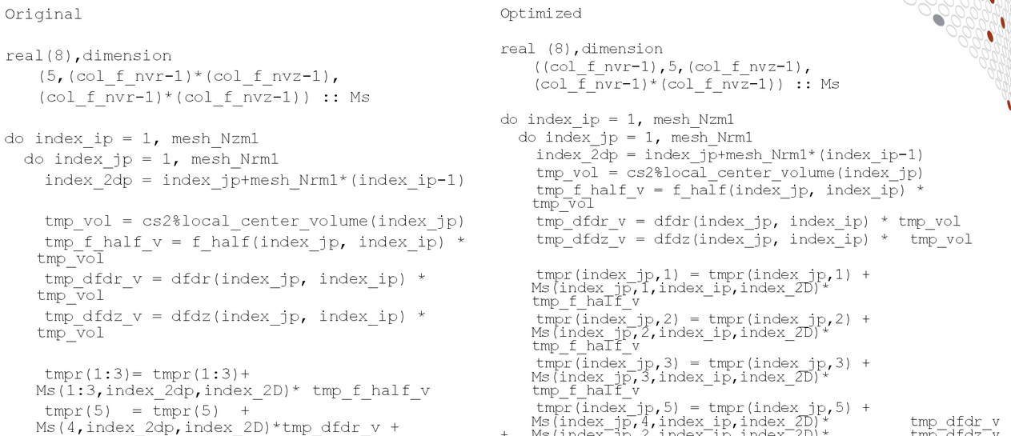
Things that prevent vectorization in your code
Example From Cray COE Work on XGC1

Slide 15
Things that prevent vectorization in your code
Example From Cray COE Work on XGC1
~40% speed up
for kernel

Slide 16
Memory Bandwidth
Consider the following loop:
Assume, n & m are very large such that a & b don’t fit into cache.
Then,
During execution, the number of loads From DRAM is
n*m + n
do i = 1, n
do j = 1, m
c = c + a(i) * b(j)
enddo
enddo

Slide 17
Memory Bandwidth
Consider the following loop:
Assume, n & m are very large such that a & b don’t fit into cache.
Then,
During execution, the number of loads From DRAM is
n*m + n
do i = 1, n
do j = 1, m
c = c + a(i) * b(j)
enddo
enddo
Requires 8 bytes loaded from DRAM per FMA. Assuming 100 GB/s bandwidth on Edison, we can at most achieve 25 GFlops/second (2 Flops per FMA)
Much lower than 460 GFlops/second peak on Edison node. Loop is memory bandwidth bound.

Slide 18
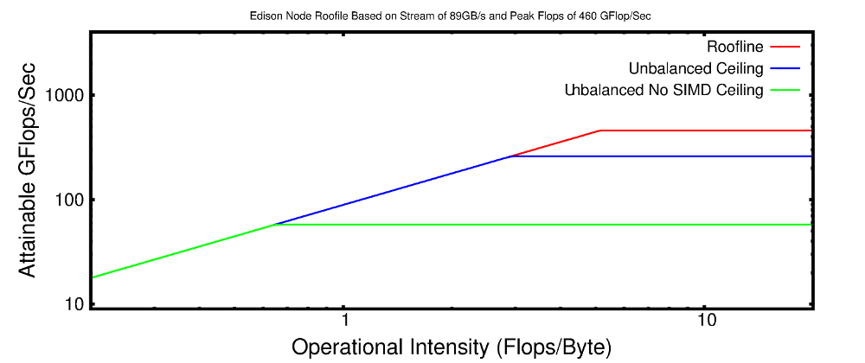
Roofline Model For Edison

Slide 19
Improving Memory Locality
Improving Memory Locality. Reducing bandwidth required.
do jout = 1, m, block
do i = 1, n
do j = jout, jout+block
c = c + a(i) * b(j)
enddo
enddo
enddo
do i = 1, n
do j = 1, m
c = c + a(i) * b(j)
enddo
enddo
Loads From DRAM:
n*m + n
Loads From DRAM:
m/block * (n+block)
= n*m/block + m

Slide 20
Improving Memory Locality Moves you to the Right on the Roofline

Slide 21
Optimization Strategy

Slide 22


The Ant Farm!
OpenMP scales only to 4 Threads
large cache miss rate
Code shows no improvements when turning on vectorization
Communication dominates beyond 100 nodes
50% Walltime is IO
Compute intensive doesn’t vectorize
Memory bandwidth
bound kernel
IO bottlenecks
Increase Memory Locality
MPI/OpenMP
Scaling Issue
Can you use a library?
Utilize High-Level IO-Libraries. Consult with NERSC about use of Burst Buffer.
Use Edison to Test/Add OpenMP Improve Scalability. Help from NERSC/Cray COE Available.
Create micro-kernels or examples to examine thread level performance, vectorization, cache use, locality.
Utilize performant / portable libraries
The Dungeon:
Simulate kernels on KNL. Plan use of on package memory, vector instructions.

Slide 23
Use IPM and Darshan to Measure and Remove Communication and IO Bottlenecks from Code
The Ant Farm Flow Chart
Make Algorithm
Changes
Make Algorithm
Changes
Run Example in “Half Packed” Mode
Run Example at “Half Clock” Speed
Is Performance affected by Half-Packing?
Is Performance affected by Half-Clock Speed?
No
No
Yes
Yes
Likely Partially Memory Latency Bound
(assuming not IO or Communication Bound)
Your Code is at least Partially Memory Bandwidth Bound
You are at least Partially CPU Bound
Can You Increase Flops Per Byte Loaded From Memory in Your Algorithm?
Can You Reduce Memory Requests Per Flop In Algorithm?
Yes
Yes
No
No
Explore Using HBM on Cori For Key Arrays
Make Sure Your Code is Vectorized! Measure Cycles Per Instruction with VTune
Try Running With as Many Virtual Threads as Possible (> 240 Per Node on Cori)

Slide 24
Use IPM and Darshan to Measure and Remove Communication and IO Bottlenecks from Code
Make Algorithm
Changes
Make Algorithm
Changes
Run Example in “Half Packed” Mode
Run Example at “Half Clock” Speed
Is Performance affected by Half-Packing?
Is Performance affected by Half-Clock Speed?
No
No
Likely Partially Memory Latency Bound
(assuming not IO or Communication Bound)
Your Code is at least Partially Memory Bandwidth Bound
You are at least Partially CPU Bound
Can You Increase Flops Per Byte Loaded From Memory in Your Algorithm?
Can You Reduce Memory Requests Per Flop In Algorithm?
Yes
Yes
No
No
Explore Using HBM on Cori For Key Arrays
Make Sure Your Code is Vectorized! Measure Cycles Per Instruction with VTune
Try Running With as Many Virtual Threads as Possible (> 240 Per Node on Cori)

Slide 25
Are you memory or compute bound? Or both?
Run Example in “Half Packed” Mode
If you run on only half of the cores on a node, each core you do run has access to more bandwidth
srun -N 2 -n 24 -c 2 - S 6 ...
VS
srun -N 1 -n 24 -c 1 ...
If your performance changes, you are at least partially memory bandwidth bound

Slide 26
Are you memory or compute bound? Or both?
Run Example at “Half Clock” Speed
Reducing the CPU speed slows down computation, but doesn’t reduce memory bandwidth available.
srun --cpu-freq=2400000 ...
VS
srun --cpu-freq=1900000 ...
If your performance changes, you are at least partially compute bound

Slide 27
So, you are Memory Bandwidth Bound?
What to do?
Try to improve memory locality,
cache reuse
Identify the key arrays leading to high memory bandwidth usage and make sure they are/will-be allocated in HBM on Cori.
Profit by getting ~ 5x more bandwidth GB/s.

Slide 28
So, you are Compute Bound?
What to do?
Make sure you have good OpenMP scalability. Look to see thread activity for major OpenMP regions.
Make sure your code is vectorizing. Look at Cycles per Instruction (CPI) and VPU utilization.
See whether compiler vectorized loop

