Slide 1
The Big Data Revolution in Astrophysics:
A Case Study of the Palomar Transient Factory
Peter Nugent (LBNL/UCB)

Slide 2
Future Concerns for HPC
Power
Data
Programming
All of them hit your wallet - $’s

Slide 3
Which Swim-Lane to Choose
NERSC-9
1 EF Peak
10⁷
10⁶
10⁵
10⁴
10³
10²
10
 | 2006 | 2007 | 2008 | 2009 | 2010 | 2011 | 2012 | 2013 | 2014 | 2015 | 2016 | 2017 | 2018 | 2019 | 2020
Exascale + ???
NERSC-8
100 PF Peak
NERSC-7
10 PF Peak
GPU CUDA/OpenCL
Or Manycore BG/Q, R
Peak Teraflop/s
Hopper (N6)
>1 PF Peak
Top500
Franklin (N5) +QC
36 TF Sustained
352 TF Peak
COTS/MPP + MPI (+ OpenMP)
Franklin (N5)
19 TF Sustained
101 TF Peak
COTS/MPP + MPI
Notes:
NERSC 7: testbed

Slide 4
Key Questions for GPU Testbed
What parts of the NERSC workload will benefit from GPU acceleration
What portions of workload see no benefit
  GPU costs as much as the CPU host
  GPU consumes same power as host (~200-250W)
Is GPU “swim lane” going to supplant the CPU swim lane, or just expand into “different” space
  Are GPU’s the future, or just a feature?
  Should NERSC expand GPU-based systems to serve specific user needs

Slide 5

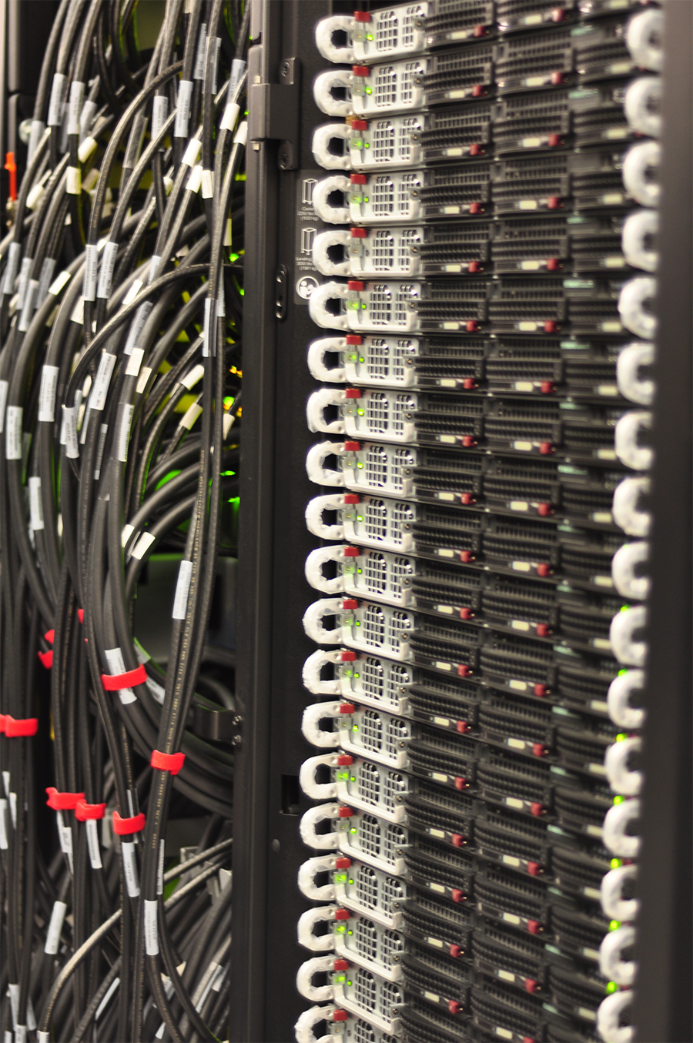
Dirac GPU Testbed Configuration
Hardware
44 nodes w/ 1 GPU per node
  integrated into carver cluster
Host Node
  dual-socket Xeon E5530 (Nehalem)
  76.5GF Peak DP (153 GF SP)
  QDR Infiniband
  24GB GB DDR-1066 memory
  51 GB/s peak mem BW
GPU
  Nvidia Tesla C2050 (Fermi)
  515GF peak DP (1030GF SP) : 6x more than host
  3 GB memory
  144 GB/s peak mem BW (3x)
Software
CUDA 3.1
PGI Compilers
GPU Direct
  OpenMPI
  MVAPICH
Matlab Parallel Computing Toolbox coming soon

Slide 6
A Likely Trajectory - Collision or Convergence?
future
processor
by 2012
CPU
?
multi-threading
multi-core
many-core
fully programmable
programmability
partially programmable
parallelism
fixed function
after Justin Rattner, Intel, ISC 2008
GPU

Slide 7
Cost of Data Movement
~1000-10k simple cores
4-8 wide SIMD or VLIW bundles
Cost of moving long-distances on chip motivates clustering on-chip
  1mm costs ~6pj (today & 2018)
  20mm costs ~120 pj (today & 2018)
  FLOP costs ~100pj today
  FLOP costs ~25pj in 2018
Different Architectural Directions
  GPU: WARPs of hardware threads clustered around shared register file
  Limited area cache-coherence
  Hardware multithreading clusters

Slide 8
Performance Summary
Comparisons of optimized CPU version to optimized GPU version are rare
  3x memory and 6x flop rate advantage for GPU
  Speedups in excess of 50x-100x usually indicate methodological errors
No tests performed on analysis of large data sets.

Slide 9
Early User Observations
“Domain Scientist input is essential. Debugging can be hard”
“Programming on the GPU can be a bit challenging, as many of the resources to learn from are geared towards programmers rather than scientists”
“For advanced programmer GPU and CUDA is good team”
“Most CUDA can be learned from downloading example code. First get it working and then optimizations like cache, memory but application specific. NVIDIA doc is very dense. Mixing MPI and CUDA is straightforward but challenge is in using all cores on node efficiently”

Slide 10
…Not Everyone Was Happy…
“disappointing – the 200GF for DGEMM was not worth the trade off of re-writing code in CUDA”
“CUDA is inadequate for most scientific computation since i) most algorithms are not trivial data-parallel ii) NVIDIA
documentation on performance tuning is not always correct”

Slide 11
Results: Astrophysics
Astrophysics: H. Y. Schive
  Code: GPU-accelerated Adaptive MEsh Refinment (GAMER)
  Method: 2nd order PDEs using adaptive meshes
  Performance: 1GPU 5x faster than 8 CPUs
  Notes: Would be faster, but AMR datastructures must be manipulated on CPU
Astrophysics: Jose Fiestas
  Code: PhiGPU
  Method: N-body application with 4th-8th order Hermite integrators
  Performance: performance improves 60% for C1060 vs. C2050 (don’t know speedup vs. CPU)
  Notes: mixed precision, running on 32 nodes

Slide 12
“Current” Optical Surveys
Photometric:
Palomar Transient Factory
La Silla Supernova Search
SkyMapper
PanSTARRS
Spectroscopic:
SDSS III
All of these surveys span astrophysics from planets to cosmology, from the static to the transient universe.

Slide 13
Competition
The competition were two wide-field multi-color surveys with cadences that were either unpredictable (SkyMapper) or from days to weeks (PanSTARRS) in a given filter.
How could we do something better/different?
- Start quickly - P48” coupled with the CFHT12k camera
- Don’t do multiple colors
- Explore the temporal domains in unique ways
- Take full advantage of the big-iron at Super-Computing Centers
- Get all the science we possibly can out of this program
Thus we need the capability of providing immediate follow-up of unique transients, using 4 to 10-m class telescopes.

Slide 14
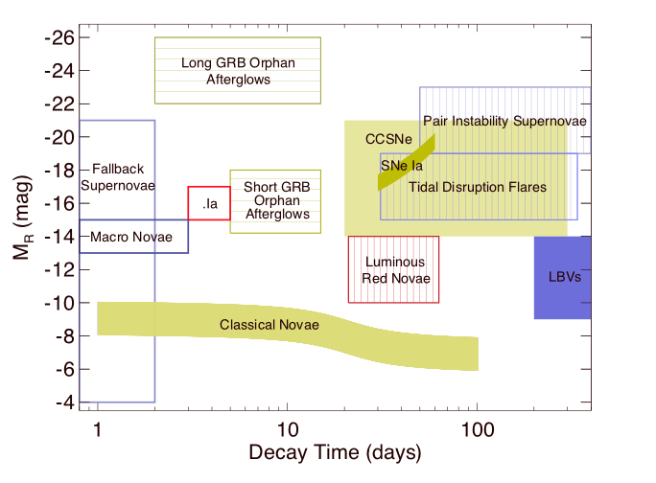
Phase-Space

Slide 15
PTF (2009-2013)
CFH12k camera on the Palomar Oschin Schmidt telescope
  7.8 sq deg field of view, 1” pixels
  60s exposures with 15-20s readout in r, g and H-alpha
  First light Nov. 24, 2008.
  First useful science images on Jan 13th, 2009.
2 Cadences (Mar. - Nov.)
  Nightly (35% of time) on nearby galaxies and clusters (g/r)
  Every 3 nights (65% of time) on mostly SDSS fields with minimum coverage of 2500 sq deg. (r) to 20th mag 10-sigma
  H-alpha during bright time (full +/-2 days)
  Nov-Feb, minute cadences on select fields.

Slide 16
PTF Science
PTF Key Projects
Various SNe | Dwarf novae
Transients in nearby galaxies | Core collapse SNe
RR Lyrae | Solar system objects
CVs | AGN
AM CVn | Blazars
Galactic dynamics | LIGO & Neutrino transients
Flare stars | Hostless transients
Nearby star kinematics | Orphan GRB afterglows
Rotation in clusters | Eclipsing stars and planets
Tidal events | H-alpha sky-survey
The power of PTF resides in its diverse science goals and follow-up.

Slide 17
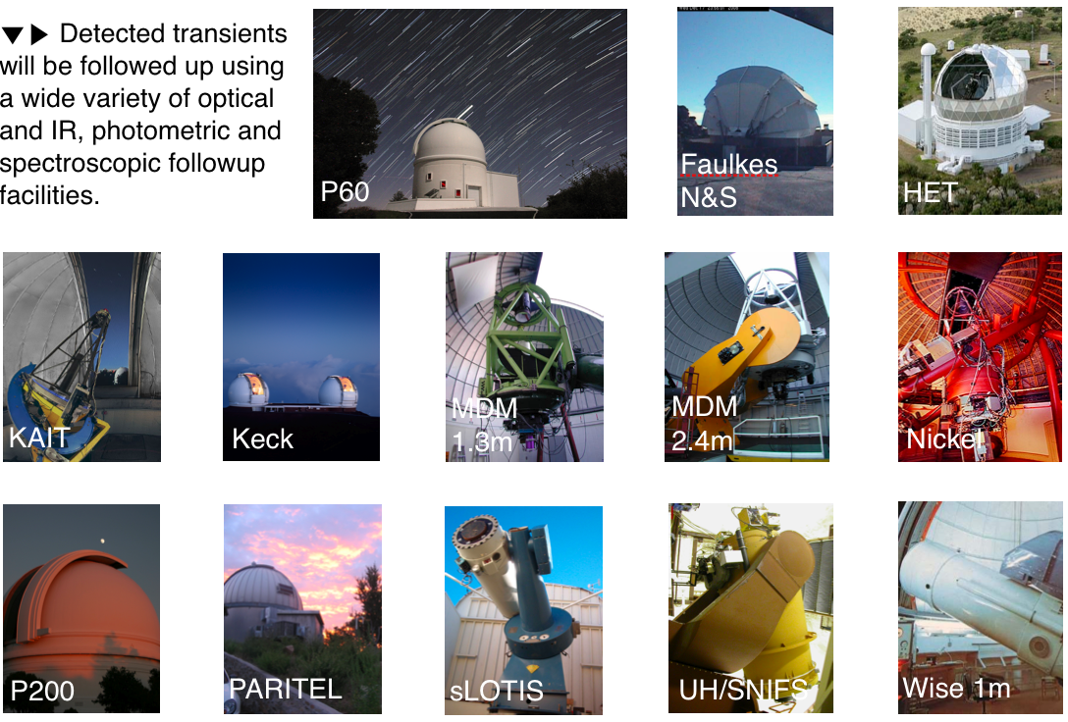
PTF Science
The power of PTF resides in its diverse science goals and follow-up.

Slide 18
PTF Pipeline
128 MB/90s
50 GB/night

Slide 19
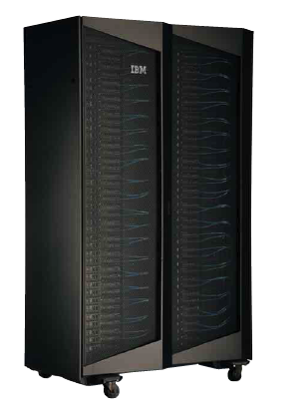
Pipeline
Observatory
PTF
Collaboration
via Web
Subtractions
Processing/db
Data
Transfer
Nodes
Science
Gateway
Node 2
Carver
Science
Gateway
Node 1
NERSC GLOBAL FILESYSTEM
250TB (170TB used)

Slide 20
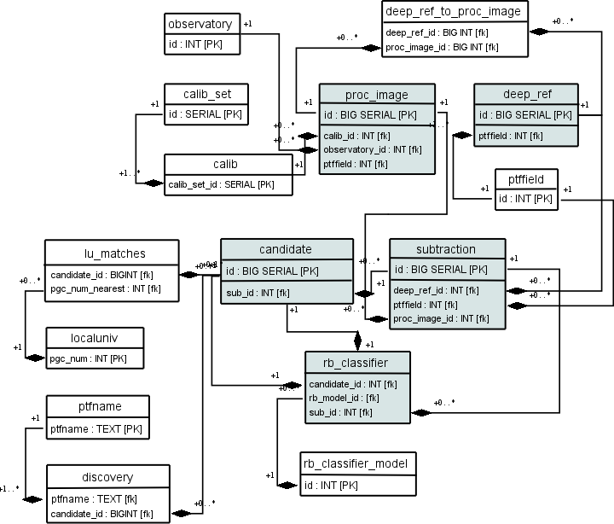
PTF Database
1.66M images
29k references
1.18M subtractions
765M candidates
40k saved transients
(many more unsaved)
All in just ~700 nights.

Slide 21
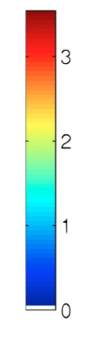
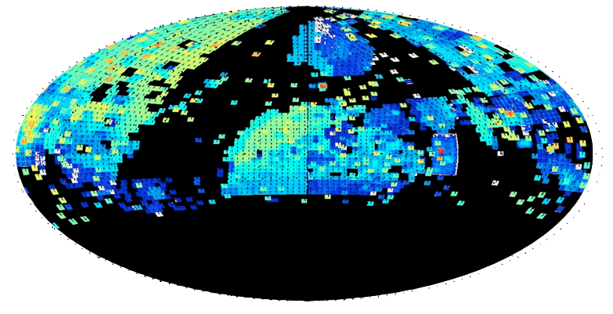
PTF Sky Coverage
1000
100
10
0
To date:
1500 Spectroscopically typed supernovae
10⁵ Galactic Transients
10⁴ Transients in M31
22nd/23rd/24th magnitude total depth (blue/green/orange)

Slide 22
PTF: Real or Bogus
PTF produces 1 million candidates during a typical night:
  Most of these are not real
    Image Artifacts
    Misalignment of images due to poor sky conditions
    Image saturation from bright stars
  50k are asteroids
  1-2k are variable stars
  100 supernovae
  3-4 new, young supernovae or other explosions

Slide 23
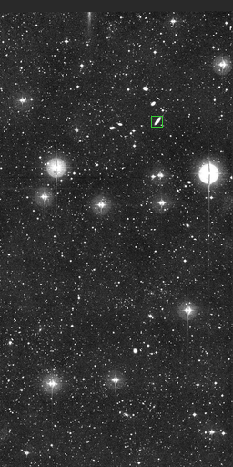
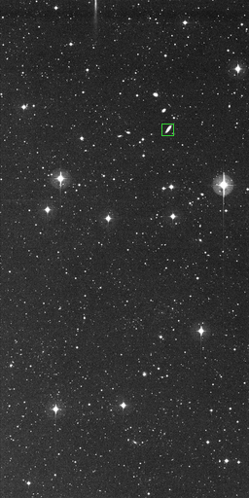
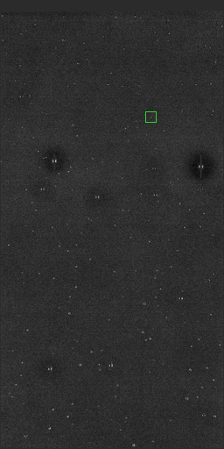
Real or Bogus
moon
4096 X 2048 CCD images - over 3000 per night

Slide 24
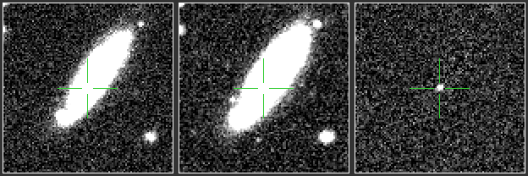
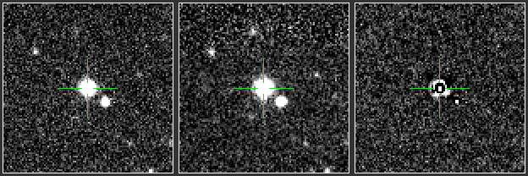
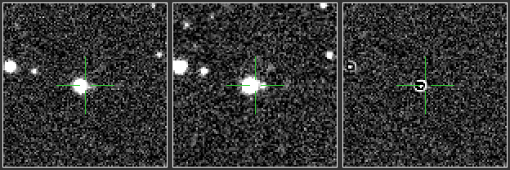
Real or Bogus
PTF10ygu: Caught
2 days after explosion
230 bogus candidates, 2 variable stars, 4 asteroids
and the youngest Type Ia supernovae observed to date.

Slide 25
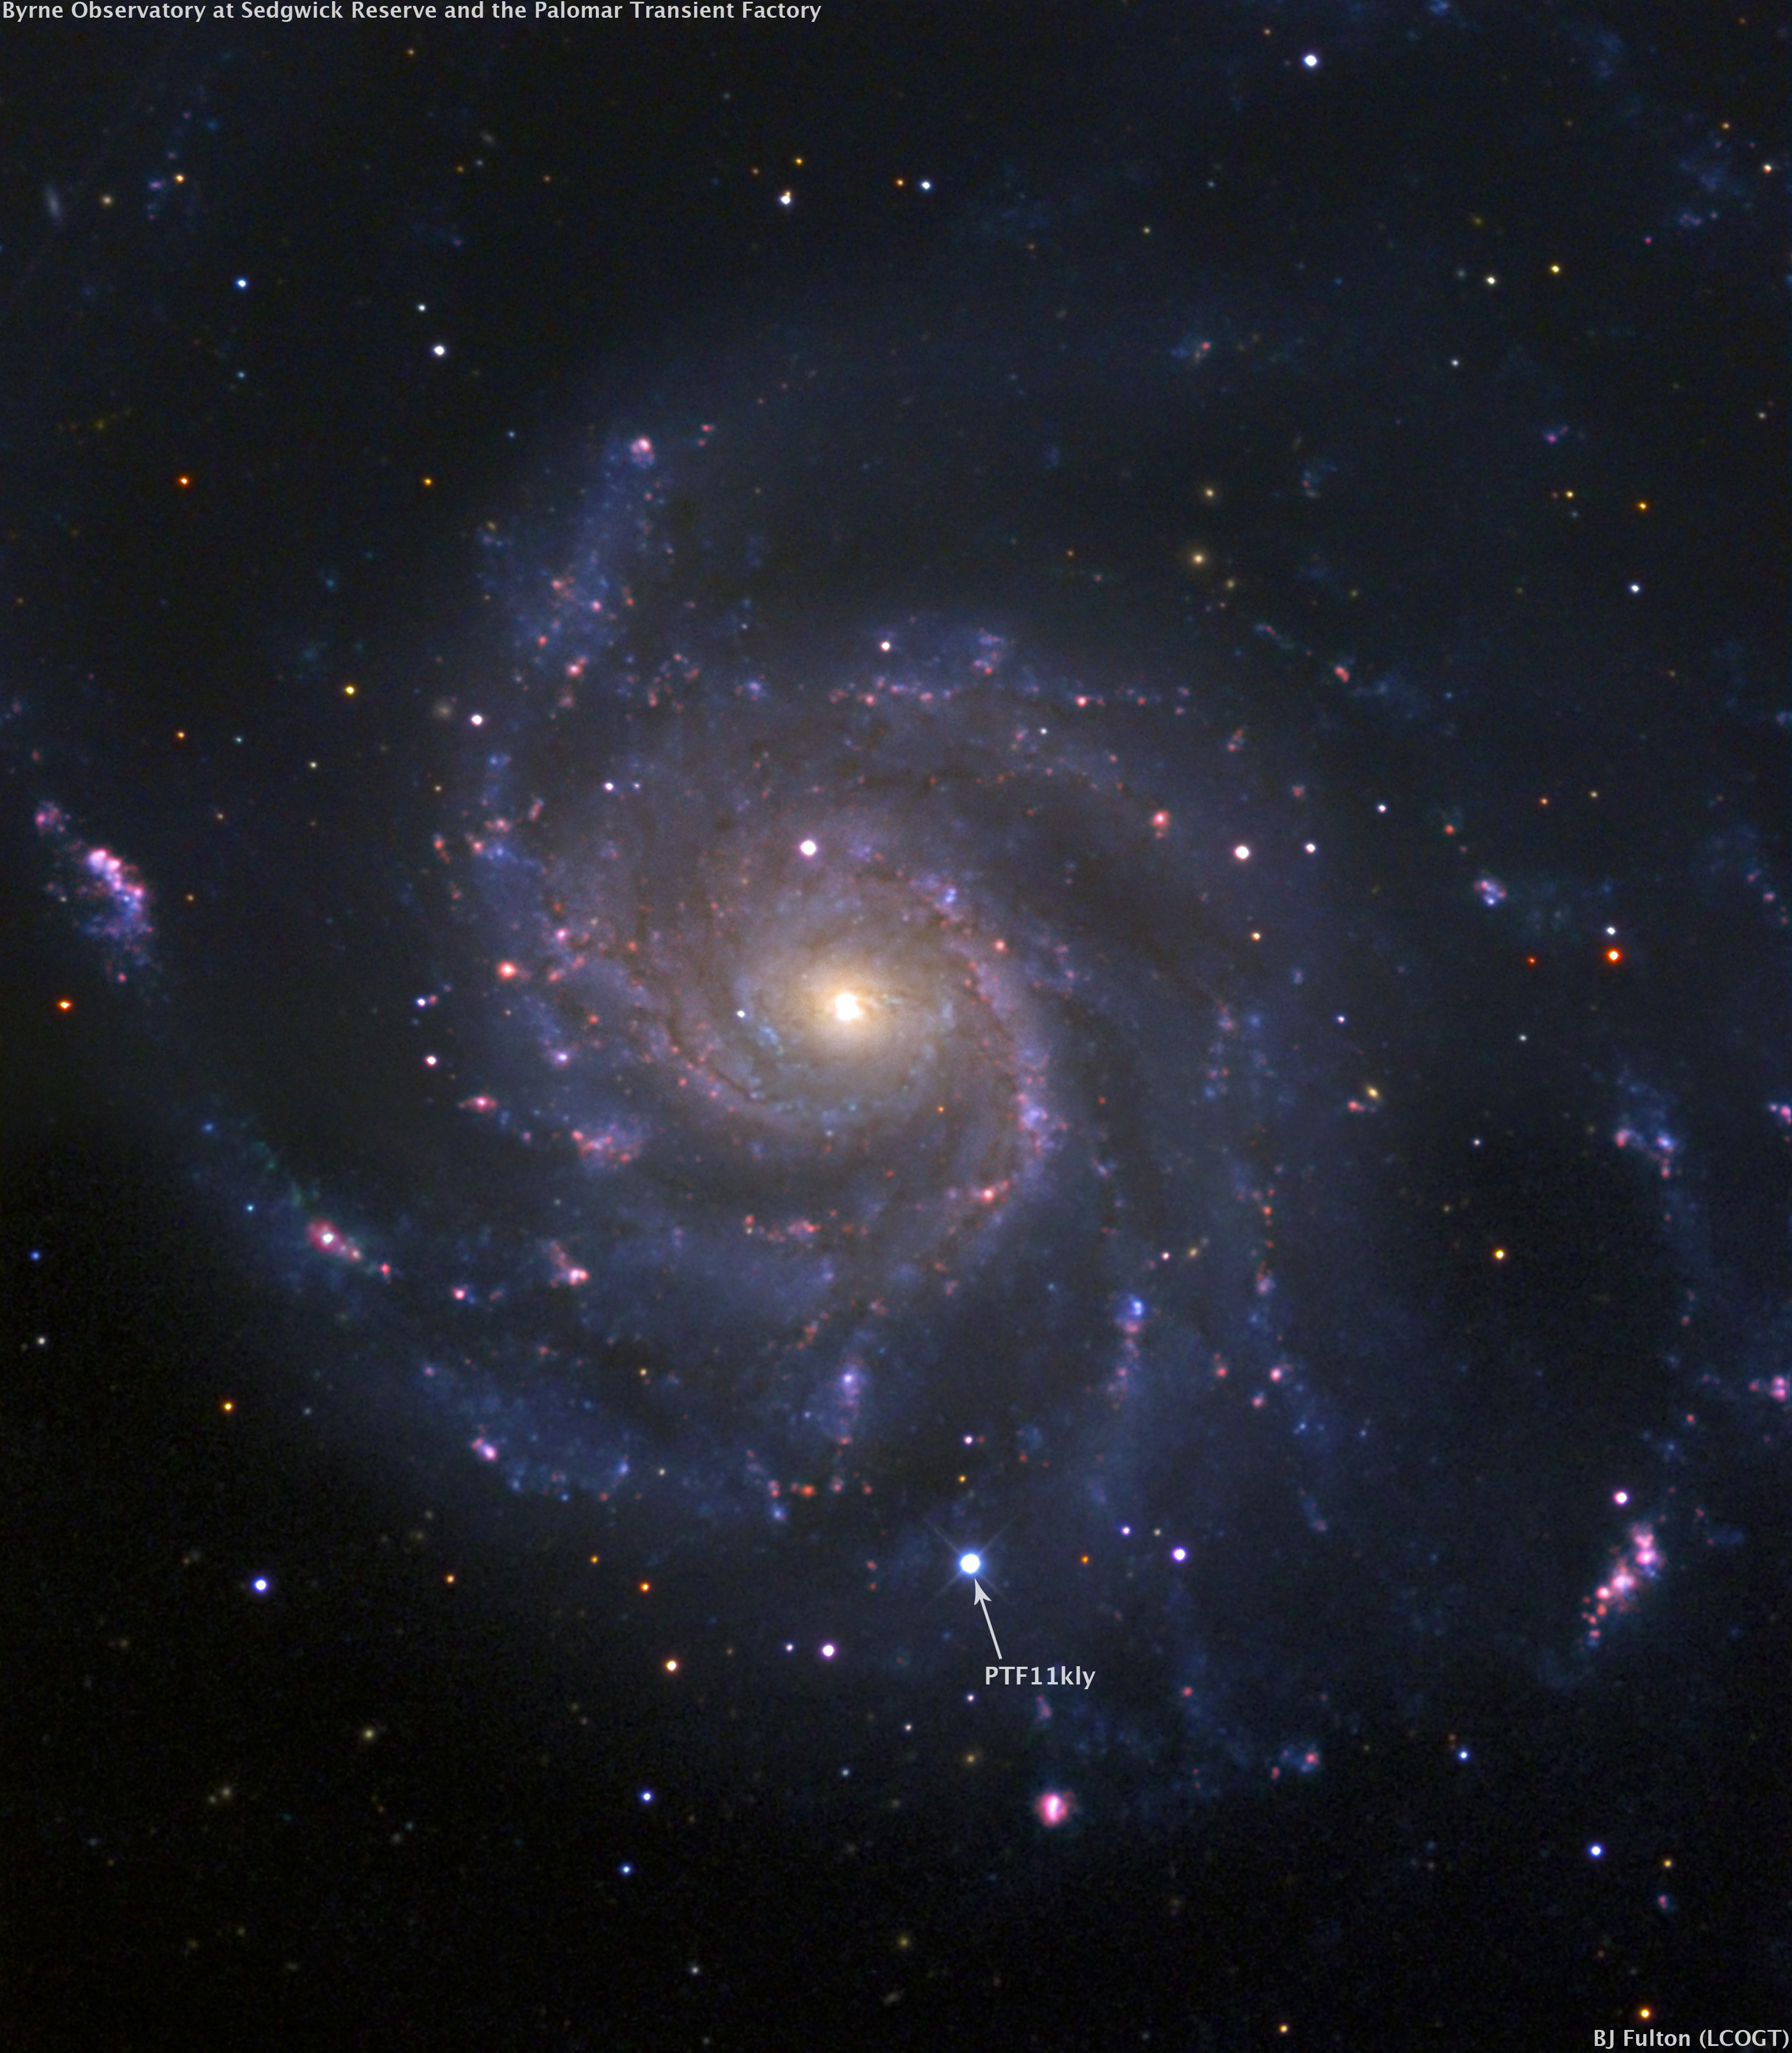
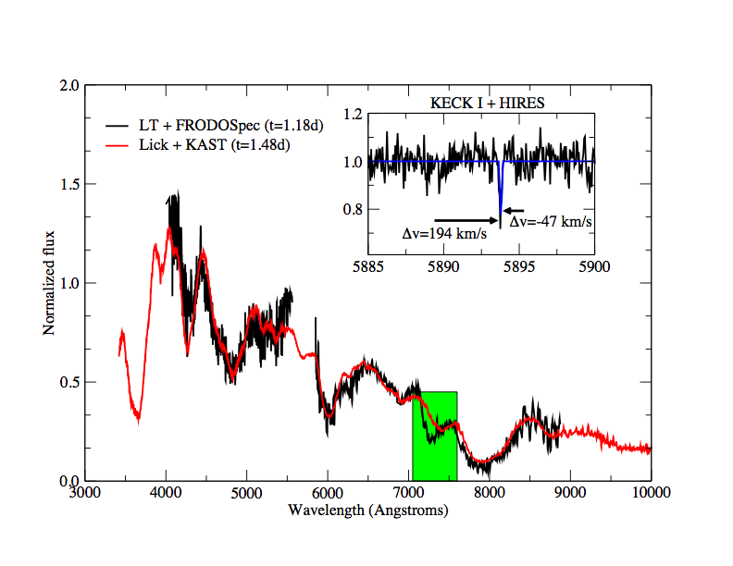
SN in M101
PTF11kly: Caught 11 hours after explosion
Quick query – what’s the best candidate from the previous night…

Slide 26
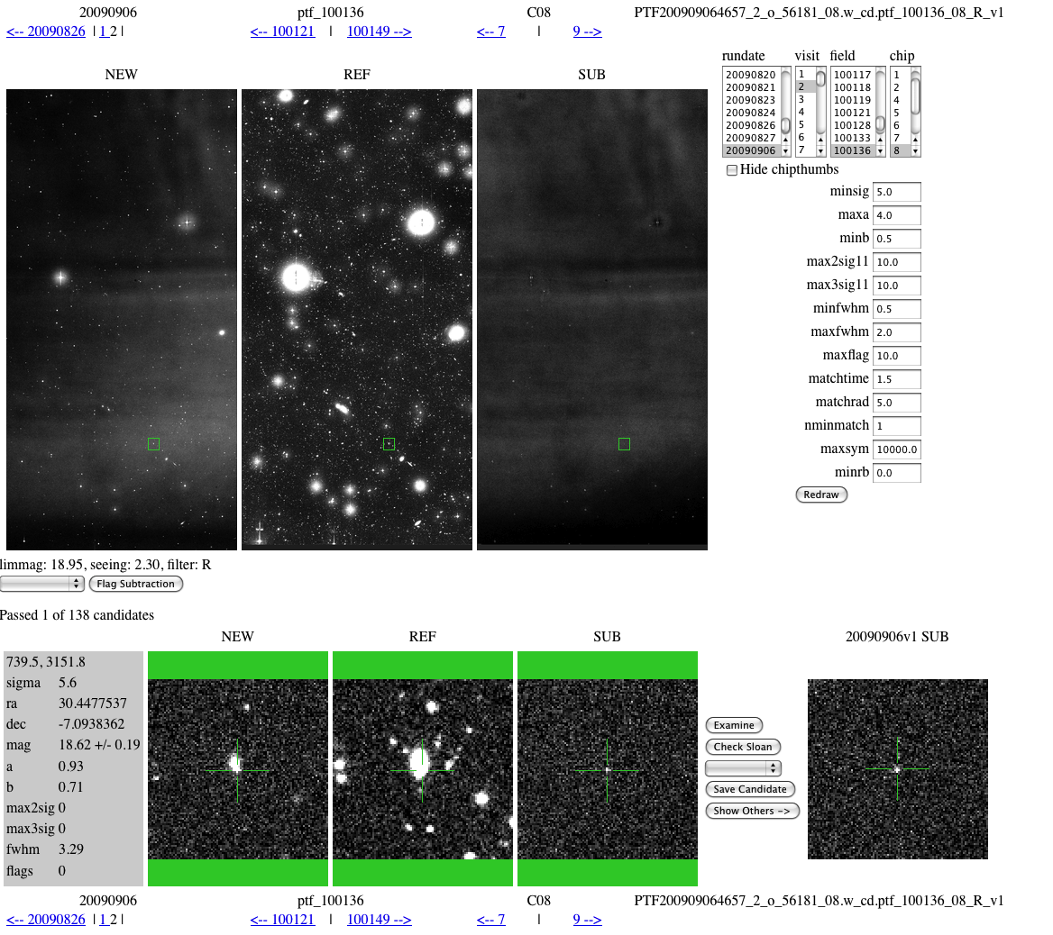
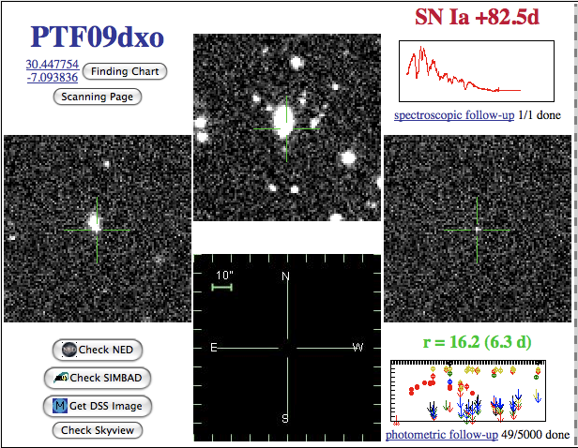
Users…

Slide 27
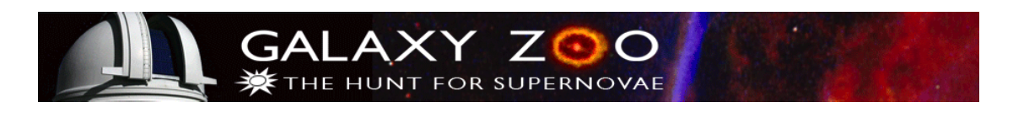
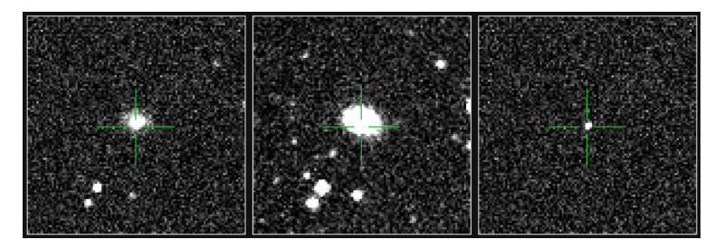

Citizen Scientists…
http:// supernova.galaxyzoo.org is now up and running!
A beta version appeared last year to support the SN Ia program in PTF and a WHT spectroscopy run. I spent a week with the folks at Oxford setting up the db and giving them training sets of good and bad candidates. They did the rest… 1200 members of galaxy zoo screened all the candidates between Aug 1 and Aug 12 in 3 hrs. The top 50 hits were all SNe/variable stars and they found 3 before we did. They scanned ~25,000 objects - 3 objects/min. They now do ~200 nightly and we have 15,000 users.

Slide 28
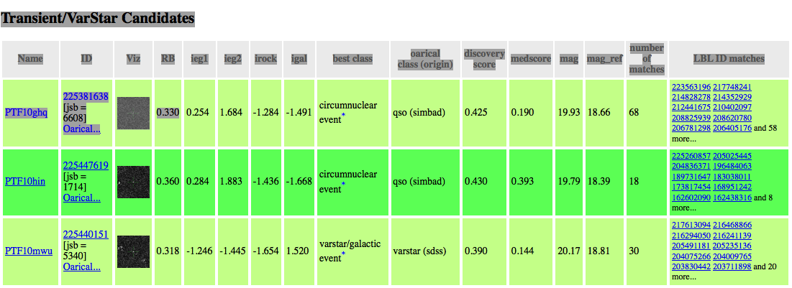
Robot
A robot (built by Josh Bloom at UCB) queries the db every 20 min and compares new transients with archival information to ascertain its likely nature and publishes them to the collaboration - classification.

Slide 29
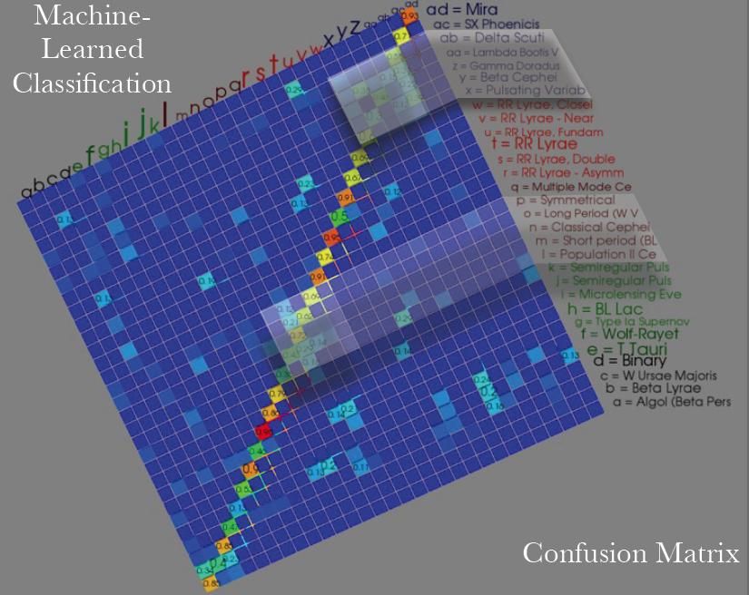
Robot
Complications to traditional methods include varying uncertainties in data, non-structured temporal sequence (bad weather, etc.), differing levels of historical information (in SDSS or not, known host in NED, etc.)
And this is just for stars…we also have ones for SNe, AGN…

Slide 30
Turn-around
The scanning is handled in three ways:
Individuals can look through anything they want and save things to the PTF database
SN Zoo
UCB machine learning algorithm is applied to all candidates and reports are generated on the best targets and what they are likely to be (SN, AGN, varstar) by comparison to extant catalogs as well as the PTF reference catalog. These come out ~15 min after a group of subtractions are loaded into the database.
On June 3, 2010 we were able to photometrically screen 4 SN candidates with the Palomar 60” telescope in g, r and i-band (50% of the time on P60 is devoted to this) within 2.5 hrs of discovery on the Palomar Schmidt and take spectra of them at Keck the same night. Now a nightly occurrence.

Slide 31
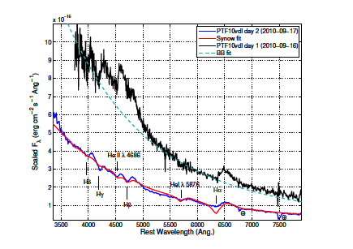
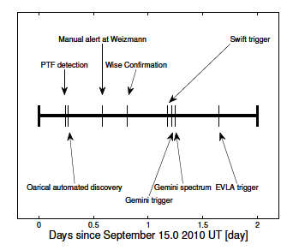
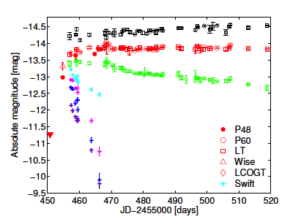
Robot -10vdl
Discovery and follow-up of PTF 10vdl a SN II.

Slide 32
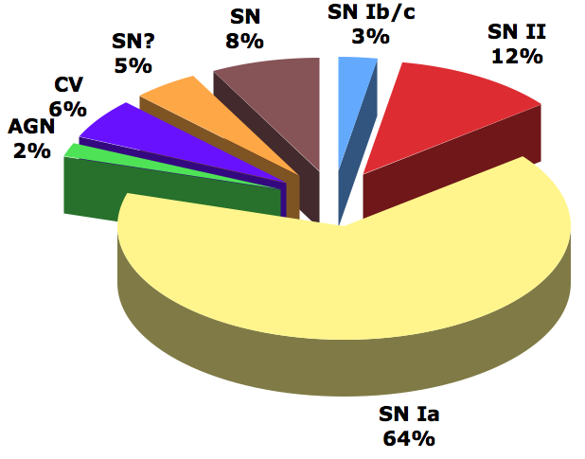
PTF Totals
In addition to these we have followed 2 triggers from IceCube and one from LIGO.
We estimate that at the end of the survey we will have 40B detections in the individual images and 40B detections in the deep co-additions.
Transients = 1500
Papers = 36

Slide 33
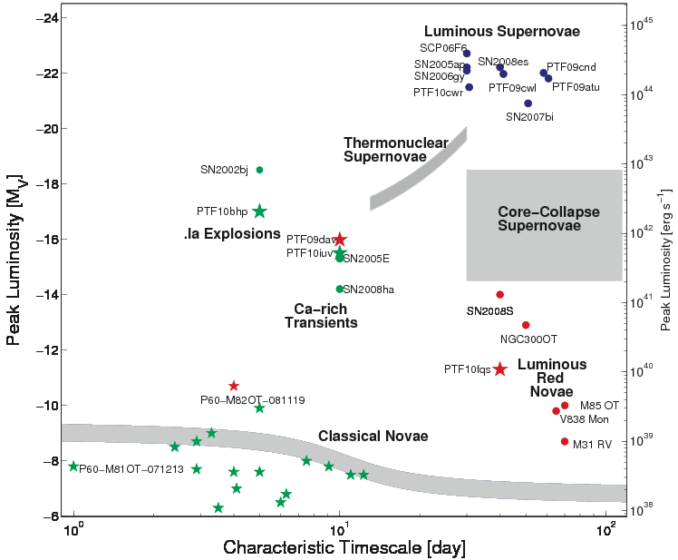
PTF Totals

Slide 34
Near Future
Next Generation Transient Survey (aka PTF-II)
- Upgrade to 5X PTF: 36 sq. deg. (~ 1 billion pixels)
- Would like to explore the sky on 100s timescales
- Turnaround in 10-20 minutes with list of new candidates
- Ingest SDSS, BOSS, NED, etc. catalogs to refine our understanding of these candidates in real-time
- Able to handle Advanced LIGO, neutrino detectors, etc.

Slide 35
Bottlenecks…
Observatory
PTF
Classification
2.5 MB/s
12 MB/s
Subtractions
Processing/db
4 MB/s
(crude)
Data
Transfer
Nodes
Science
Gateway
Node 2
Carver
Science
Gateway
Node 1
1 GB/s
0.5 MB/s
(full)
NERSC GLOBAL FILESYSTEM
250TB (170TB used)

Slide 36
Bottlenecks…crude vs. real
brightness
5-σ data in db
time

Slide 37
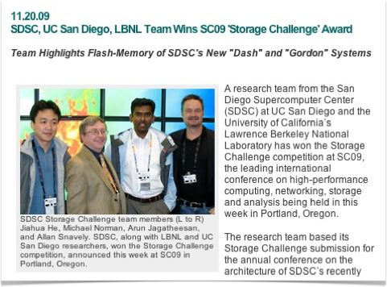
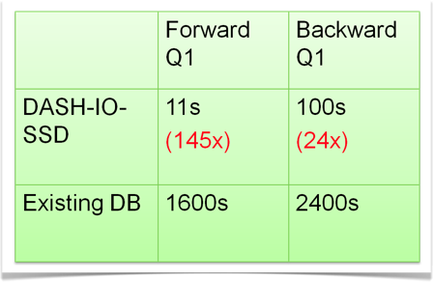
Heavy Random I/O
SC09 Storage challenge allowed us to couple both the SDSS db and the PTF candidate db to ask the question, which objects that we think are qso in the static SDSS data vary like one in the PTF data. PTF db is now 165GB and growing nightly!

Slide 38
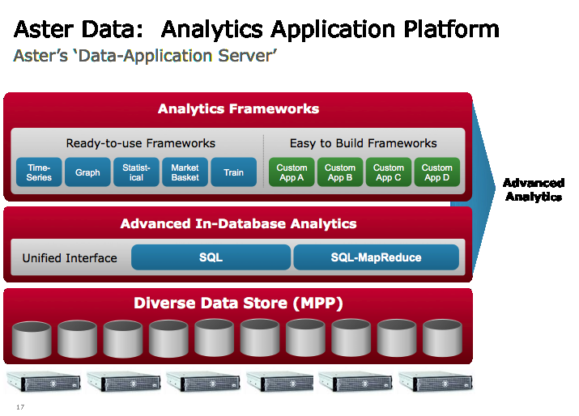
Heavy Random I/O + analytics
Aster Data provides a parallel db solution that also allows us to embed many of our machine learning algorithms. Already handle PB datasets.
Likely will couple both solutions (Aster + SSD).

Slide 39
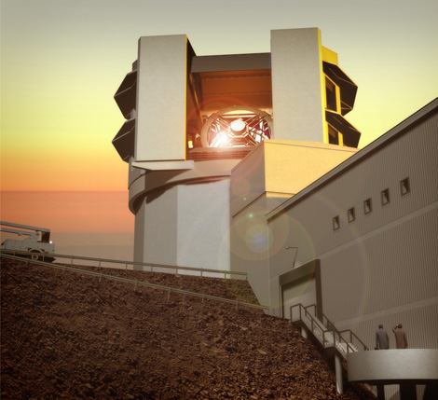
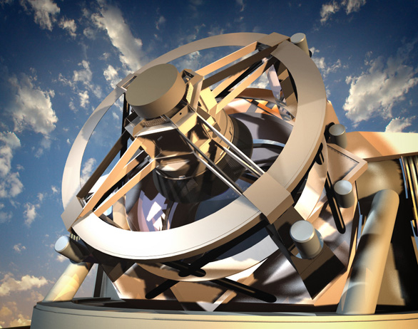
Conclusions - Future
LSST - 15TB data/night
Only one 30-m telescope

Slide 40
Future Concerns
Power – 20MW per facility
Data – PB’s per simulation
Programming – Investment to rewrite?

