Slide 1
The Palomar Transient Factory
Peter Nugent (LBNL/UCB)

Slide 2
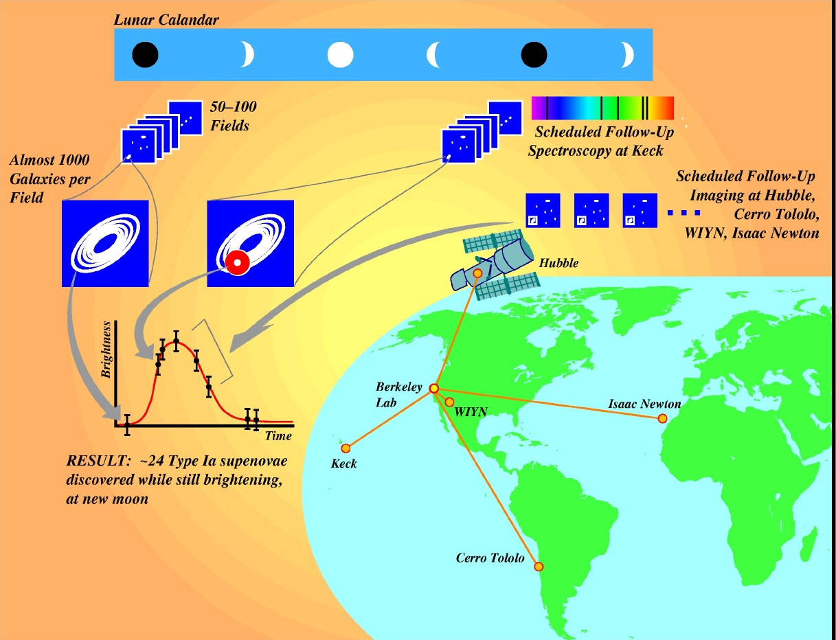
Supernovae circa 1995
50 k-baud connection
200 images/night
4 nights/month
3 month season

Slide 3
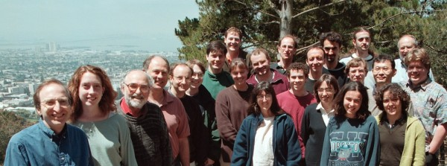
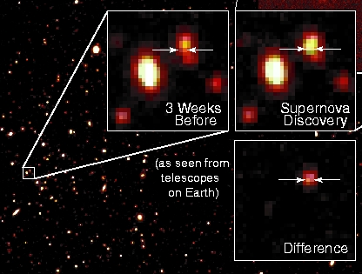
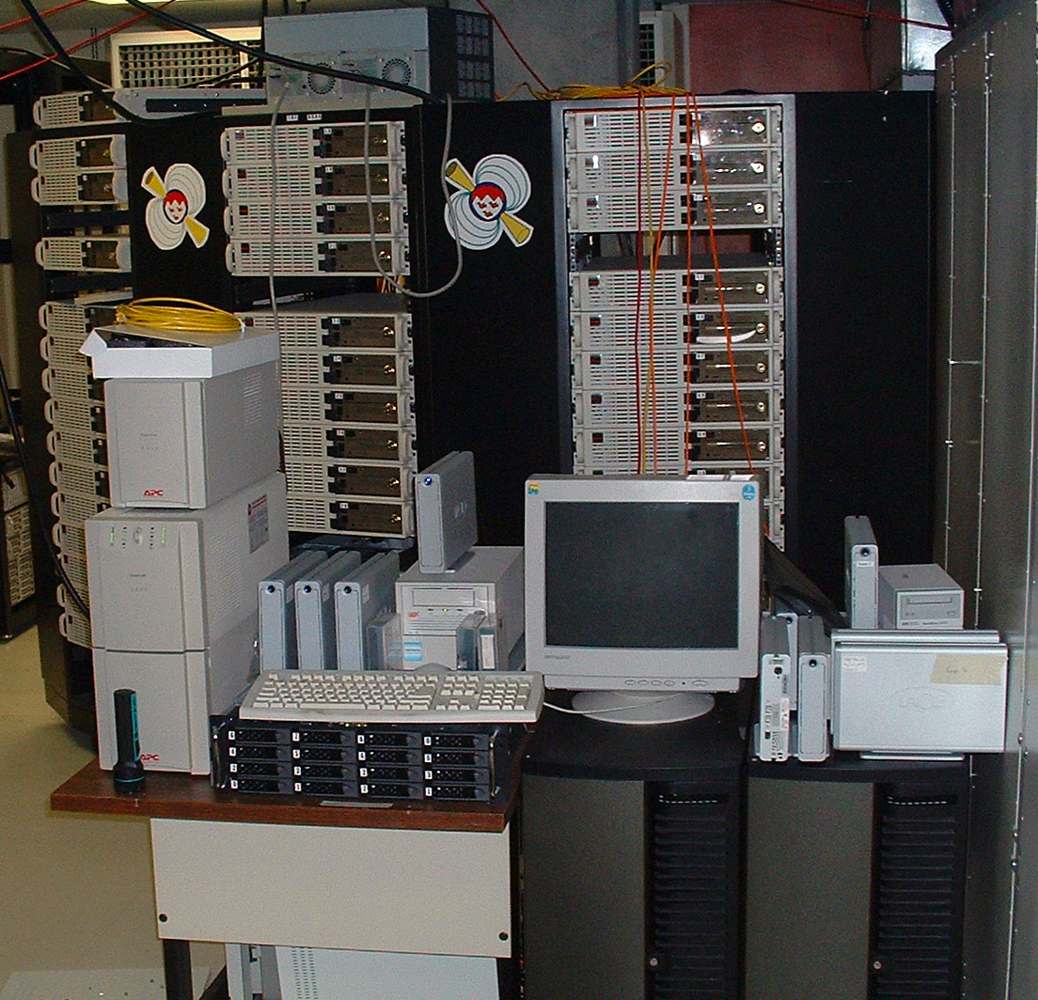
Supernovae circa 1995

Slide 4
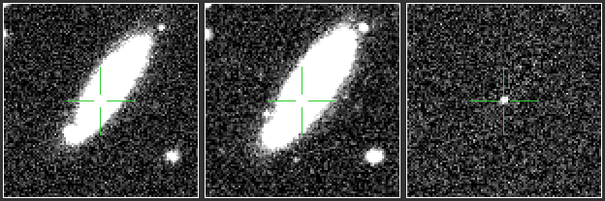
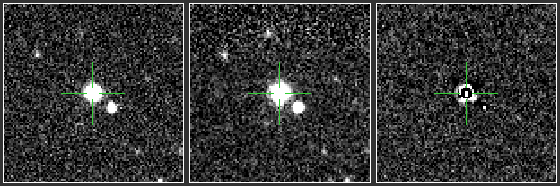
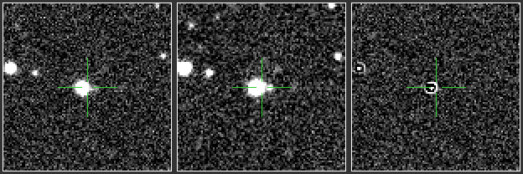
Supernovae circa 1998
Per image we would have ~200 5-σ detections. We would require 2 independent detections.
Typically only 50-200 images taken per night - 4 sq. deg. of sky.
Cuts were made based on shape, motion, etc., and a scanner would have to look at ~5 candidates per image.

Slide 5
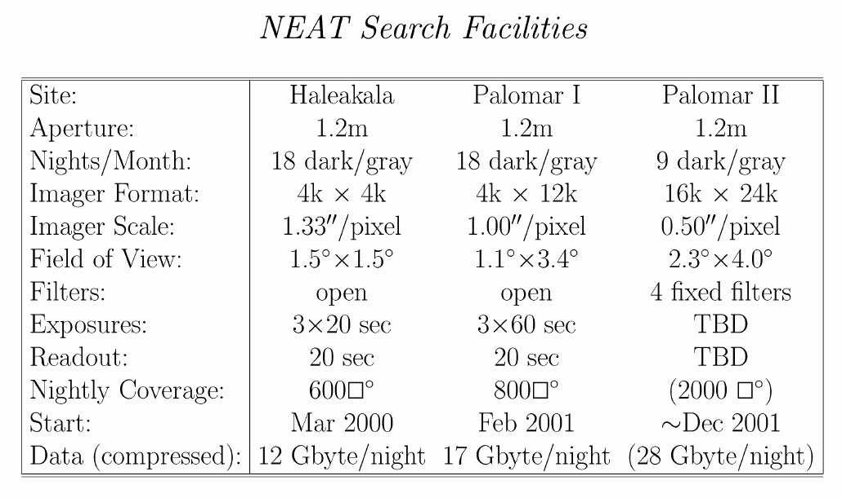
Supernovae circa 2000
Pain begins.....
~1000 sq. deg. – 250 X increase in scale per night EVERY NIGHT !!!

Slide 6
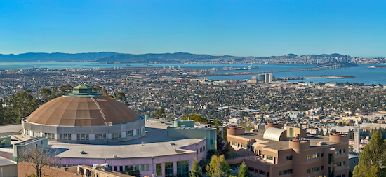
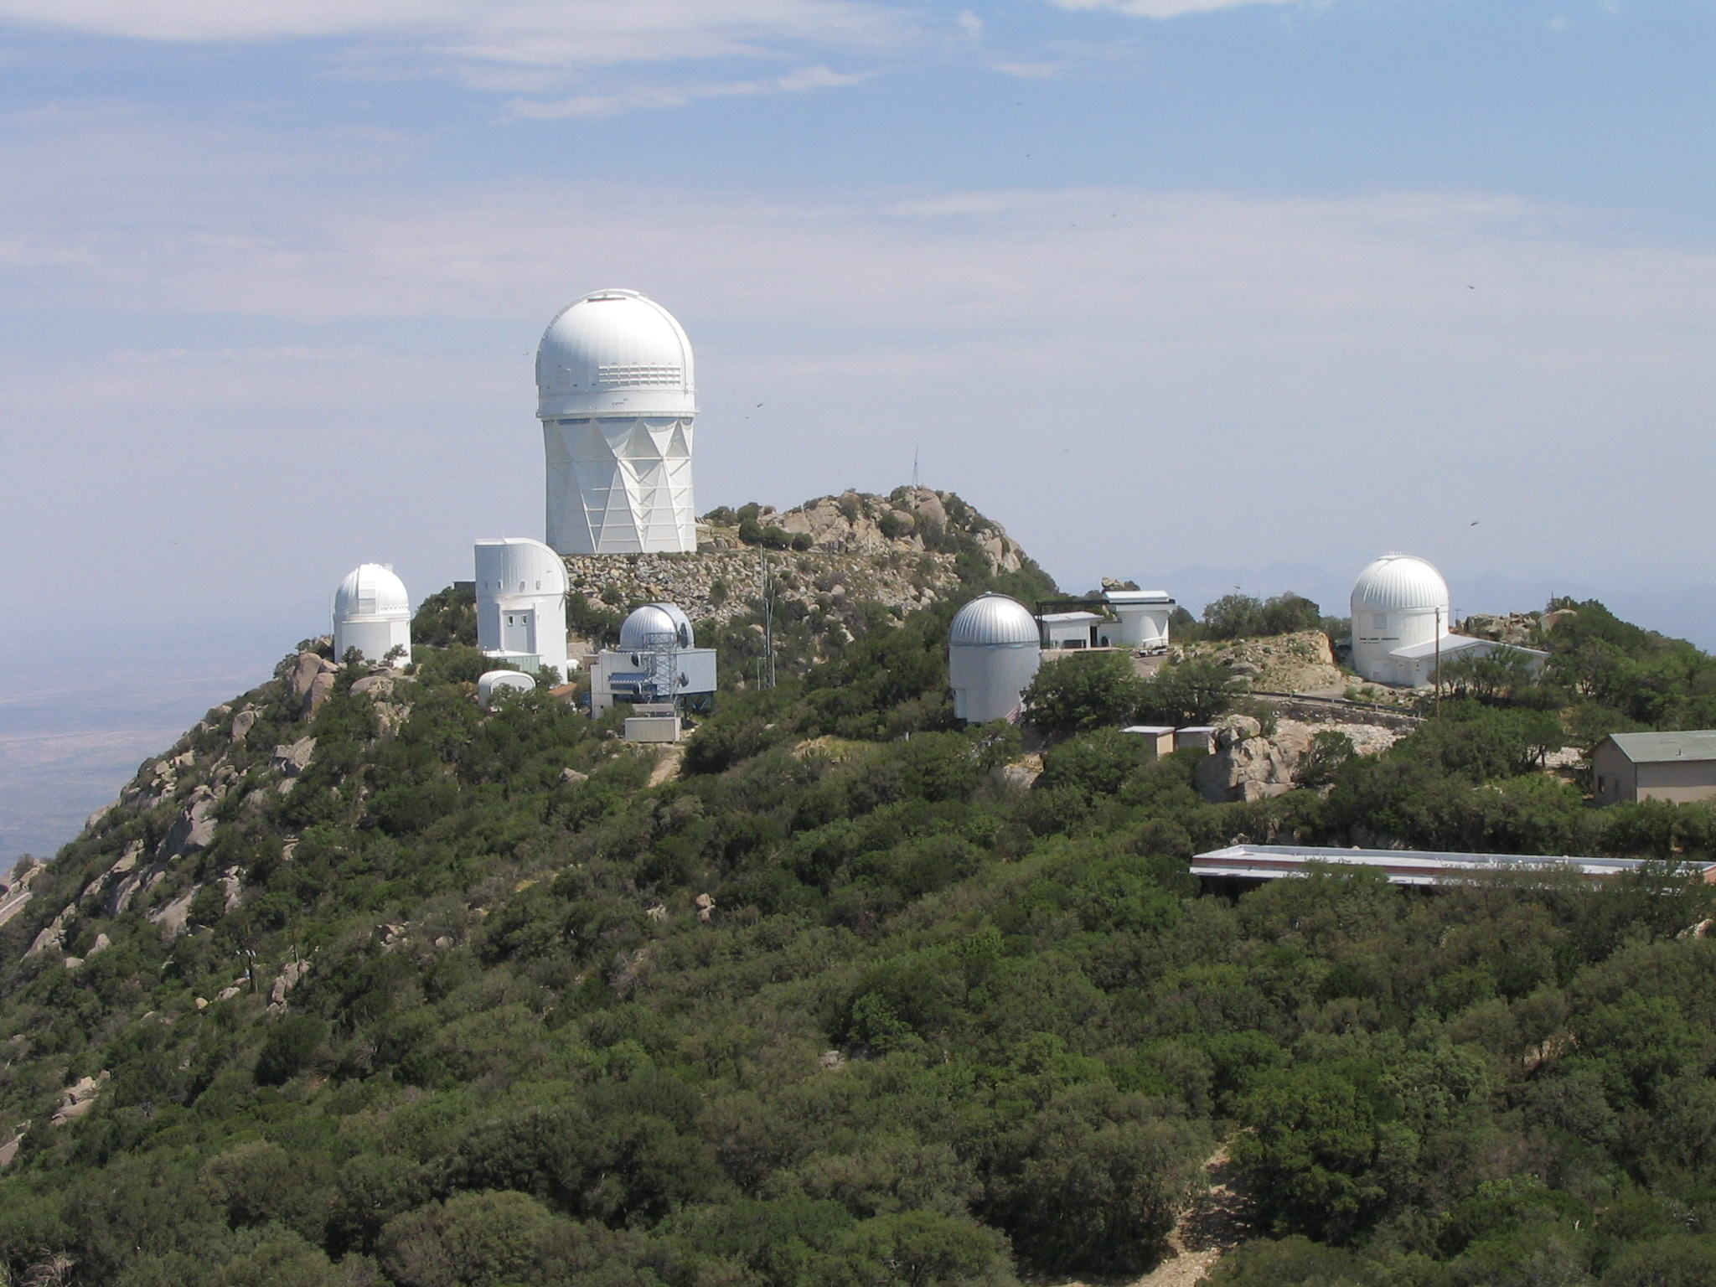
Supernovae circa 2000
FEDEx Networking: Do not underestimate the bandwidth of a station wagon filled with DAT tapes... achieved 200 kB/s

Slide 7
PTF (2009-2012), iPTF(2013-2016)
CFH12k camera on the Palomar Oschin Schmidt telescope
  7.8 sq deg field of view, 1” pixels
  60s exposures with 15-20s readout in r, g and H-alpha
  First light Nov. 24, 2008.
  First useful science images on Jan 13th, 2009.
2 Cadences (Mar. - Nov.) 2009-2011
  Nightly (35% of time) on nearby galaxies and clusters (g/r)
  Every 3 nights (65% of time) on SDSS fields with minimum coverage of 2500 sq deg. (r) to 20th mag 10-sigma
  H-alpha during bright time (full +/-2 days)
  Nov-Feb, minute cadences on select fields.

Slide 8
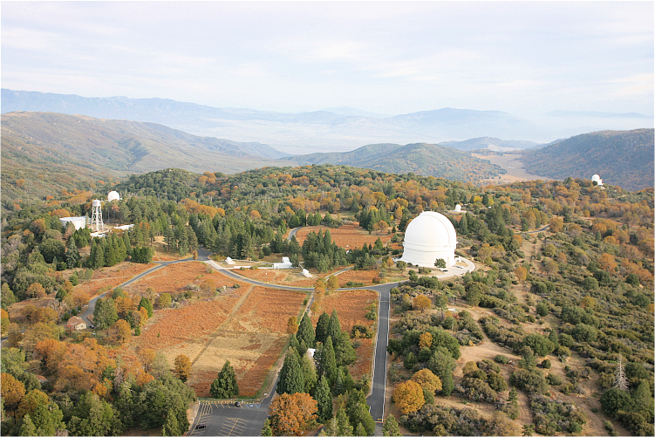


Supernovae circa 2009
Discovery and Follow-up
P60:
Followup
P48:
Discovery Engine
Instrumentation, system design, first results | Law, Kulkarni, Dekany et al. 2009 PASP 121 1395L
Science plans | Rau, Kulkarni, Law et al. 2009 PASP 121 1334R
2010 survey status | Law et al. 2010 SPIE 7735

Slide 9
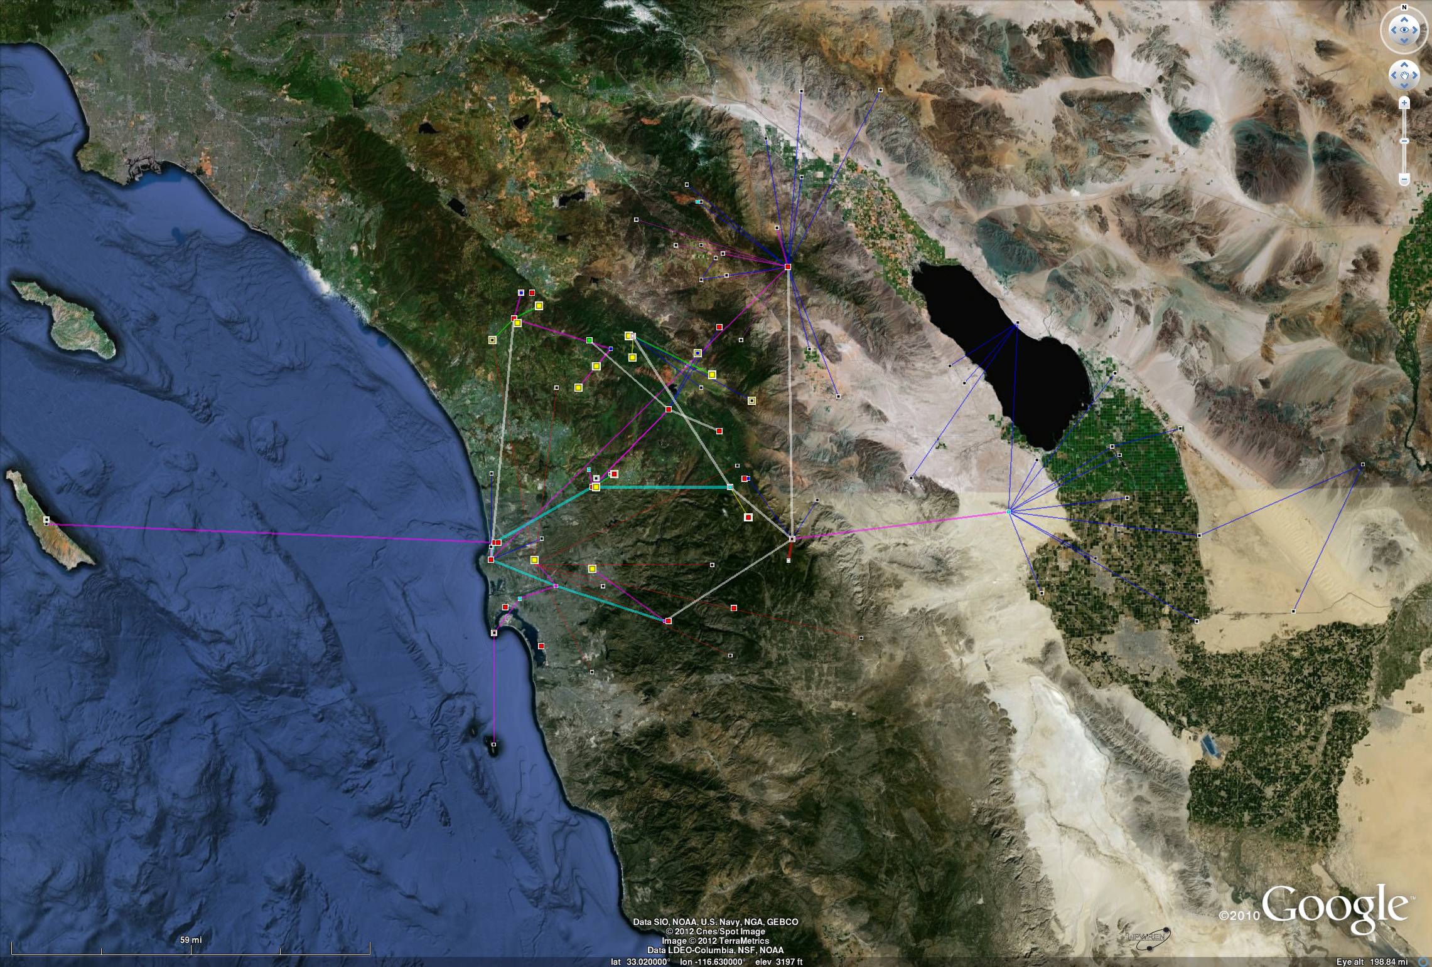
HPWREN Network
Palomar
UCSD
155 Mbps from Palomar to UCSD, then ∞ via ESnet to NERSC ;-)

Slide 10
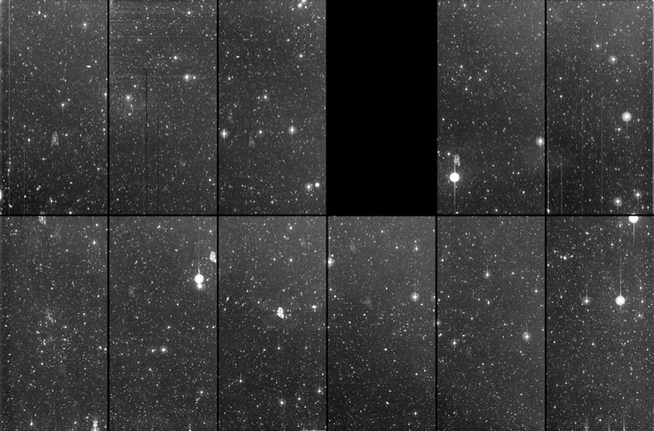
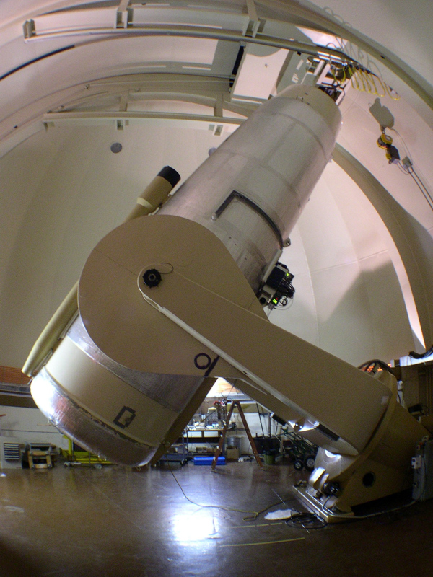
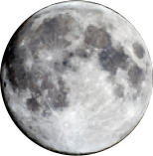
PTF Camera
92 Mpixels, 1” resolution, R=21 in 60s

Slide 11
PTF Science
PTF Key Projects
Various SNe | Dwarf novae
Transients in nearby galaxies | Core collapse SNe
RR Lyrae | Solar system objects
CVs | AGN
AM CVn | Blazars
Galactic dynamics | LIGO & Neutrino transients
Flare stars | Hostless transients
Nearby star kinematics | Orphan GRB afterglows
Type Ia Supernovae | Eclipsing stars and planets
Tidal events | H-alpha ½ sky survey
The power of PTF resides in its diverse science goals and follow-up.

Slide 12
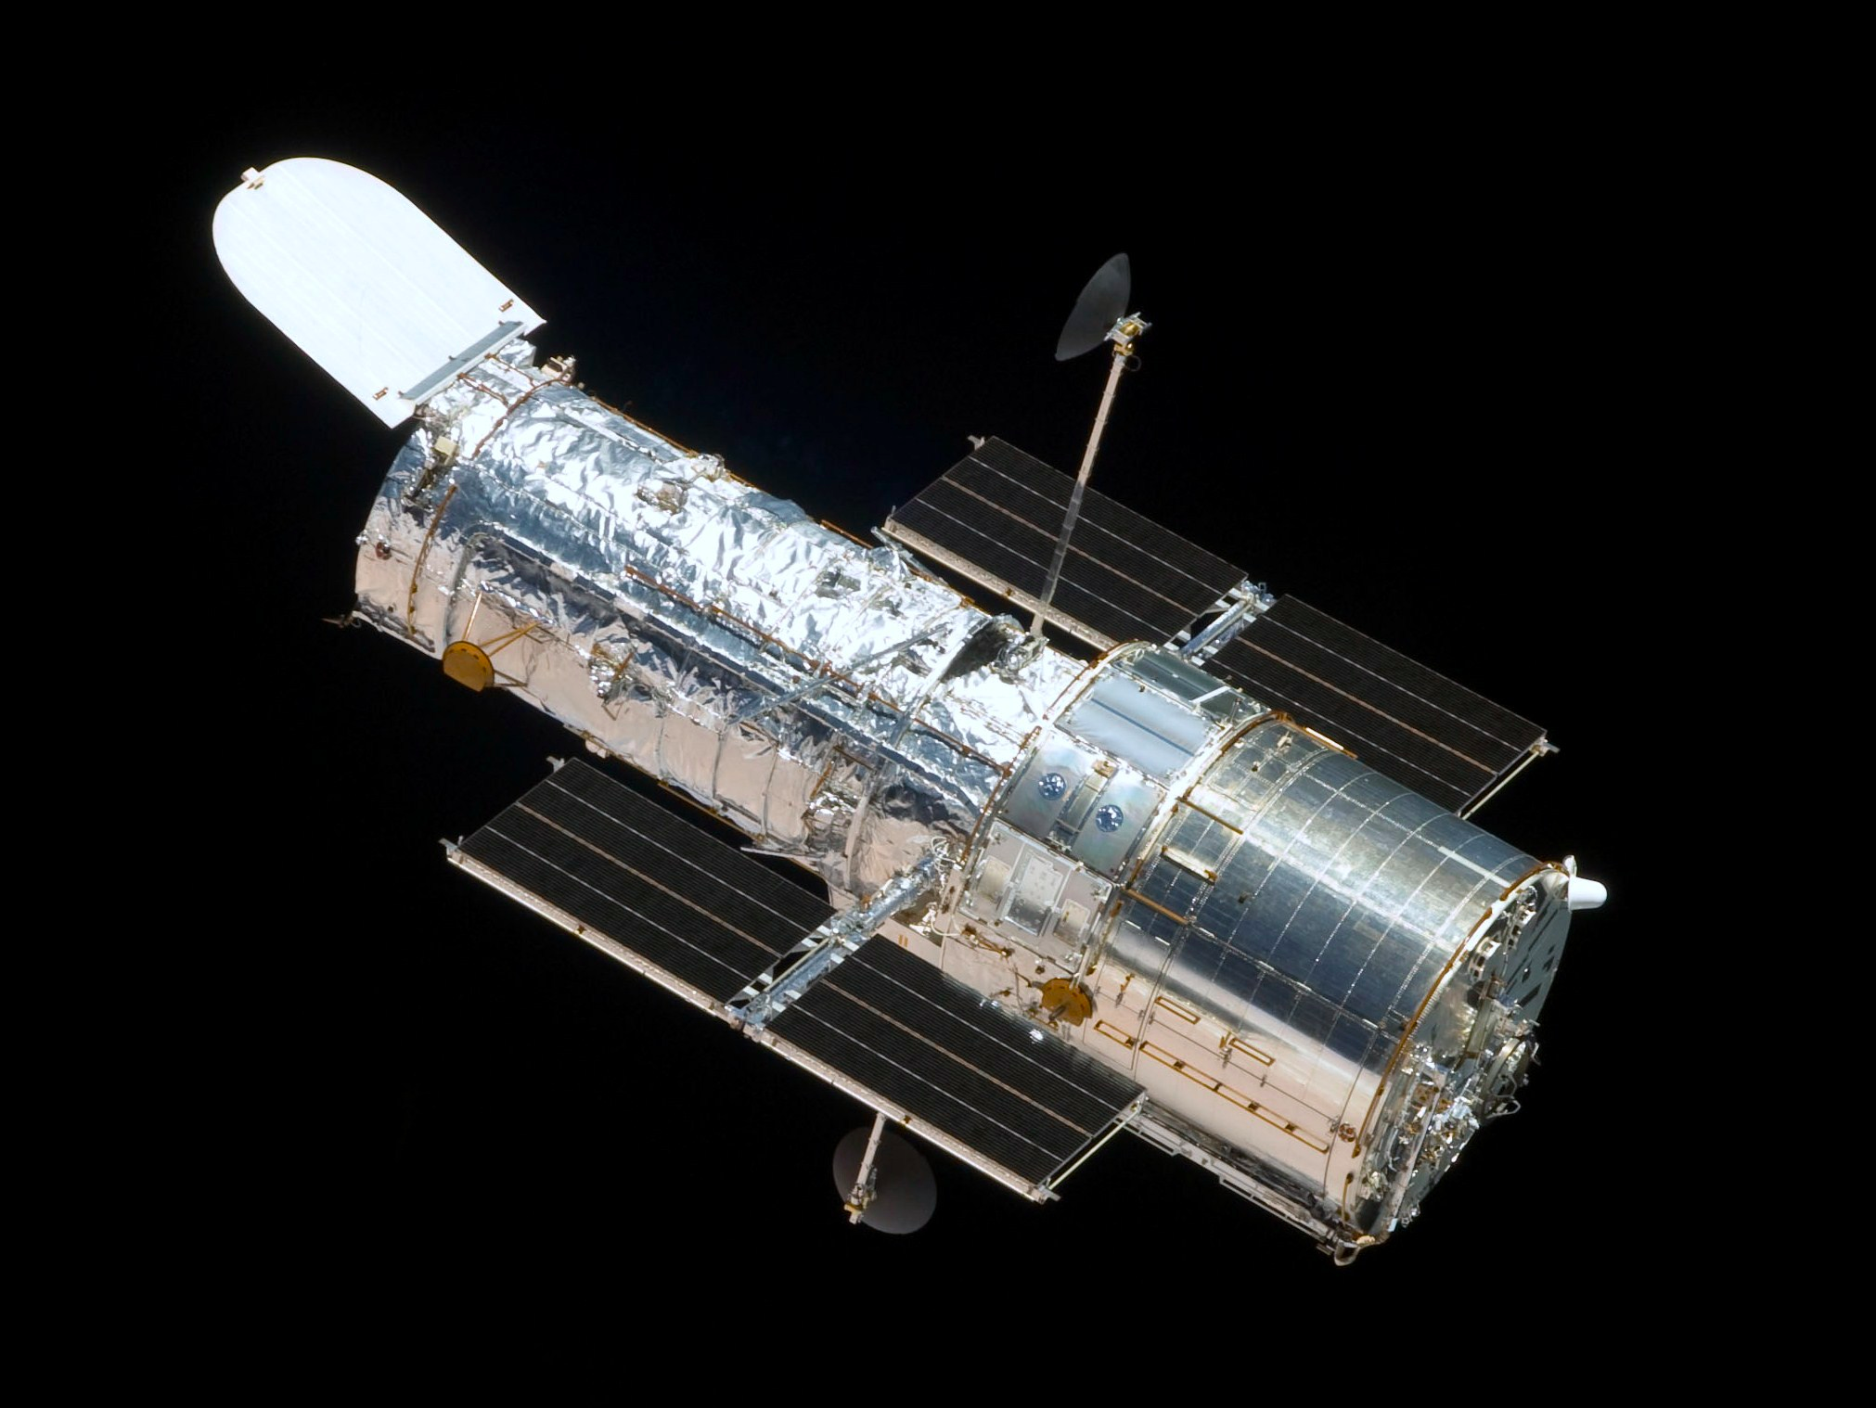
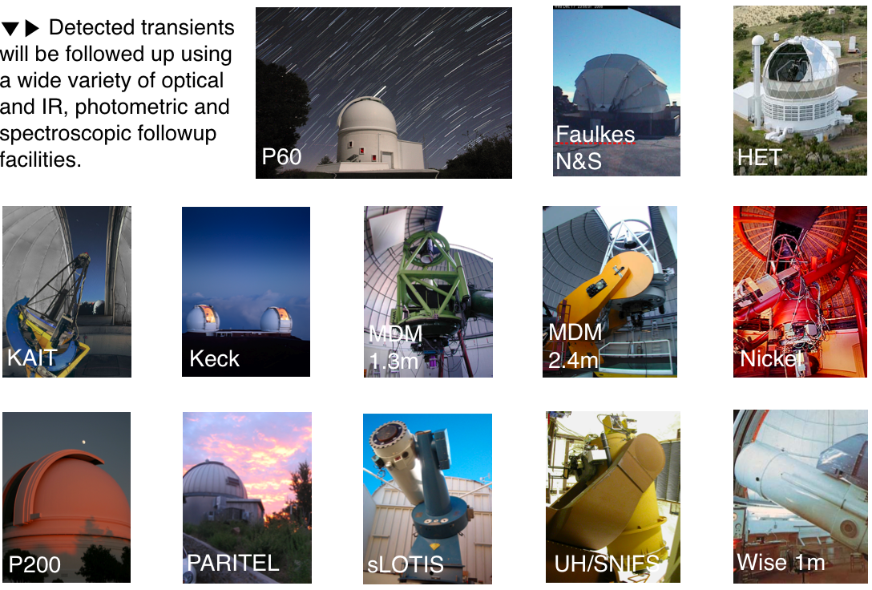
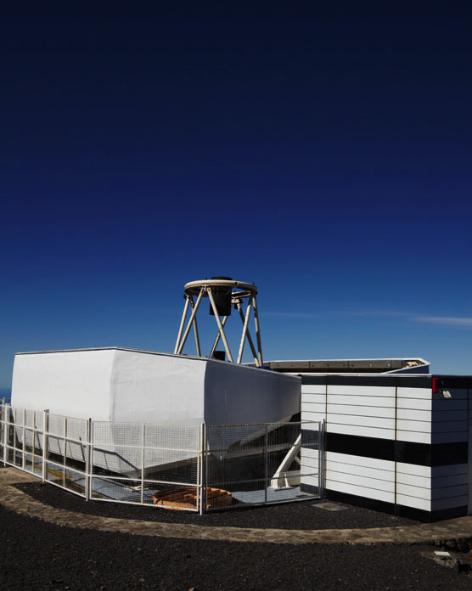
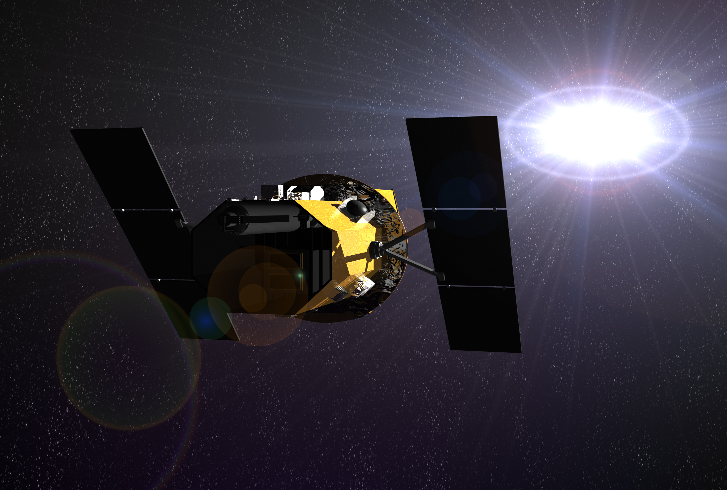
PTF Science
Hubble Space Telescope
Liverpool Telescope
Swift Space Telescope
The power of PTF resides in its diverse science goals and follow-up.

Slide 13
Palomar
48” Telescope
100 TBs of Reference Imaging
HPWREN Microwave Relay
Computing – I/O
Reference Image Creation
Astrometric Solution
Real-Time
Trigger
SDSC to ESNET
Image Processing / Detrending
Image Subtraction
Nightly Image Stacking
30 Minutes
NERSC Data Transfer Node
Networking Data Transfer
Star/Asteroid Rejection
Transient Candidate
Real-Bogus ML Screening
Heavy DB Access
500 GB/night
1.5B objects in DB
Scanning Page
Wake Me Up – Real Time Trigger
Publish to Web
Outside Telescope Follow-up
Outside Database for Triggers
Web UI Marshal
Notes:
About 100 GB of raw optical imaging data is taken every night at Palomar Observatory, which is subtracted from existing reference images from the same part of the sky to look for new astrophysical transients, including supernovae, variable stars and other cataclysmic explosions. This data is processed at NERSC and produces nearly 500GB of subsequent new, reference and subtraction imaging data after detrending and alignment. These are scanned using machine learning algorithms to find the needle in the haystack, about 1 in 1M objects recorded is of interest. A nearly 1TB database containing over 1.5B objects is scoured to compare this event to previous detections at that location on the sky. The results are published to the web in < 40 min after an individual image is taken at Palomar.

Slide 14
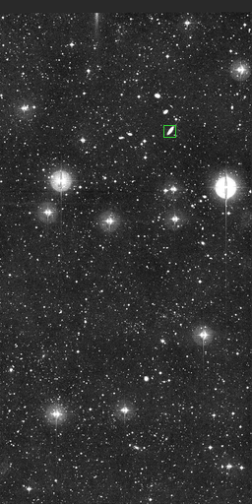
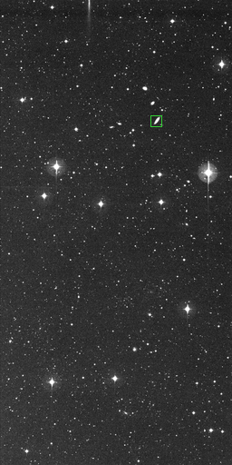
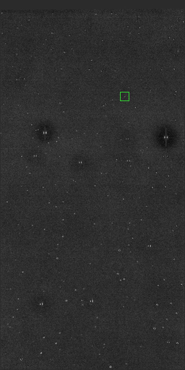
Real or Bogus – Machine Learning Analysis
New Image
Reference Image
Subtraction
moon
4096 X 2048 CCD images - over 3000 per night – producing 1.5M bogus detections,
50k known astrophysical objects and only 1-2 new astrophysical transients of interest
every night. Machine learning is used to wade through this sea of garbage.
Notes:
An example new, reference, subtraction triplet image with the detection of a new supernova in a nearby galaxy. Note the artifacts in the subtraction which the ML Analysis scours to remove.

Slide 15
PTF Database
 | R-band | g-band
images | 1.82M | 305k
subtractions | 1.52M | 146k
references | 29.2k | 6.3k
Candidates | 890M | 197M
Transients | 42945 | 3120
All in 851 nights from 2009-2012.
An image is an individual chip (~0.7 sq. deg.)
The database is now 1 TB.
Now doubled in size from iPTF from 2013-2016.
Notes:
*The number of transients per candidate is much smaller in g-band since we have already tagged all the varstars from the R-band images.

Slide 16
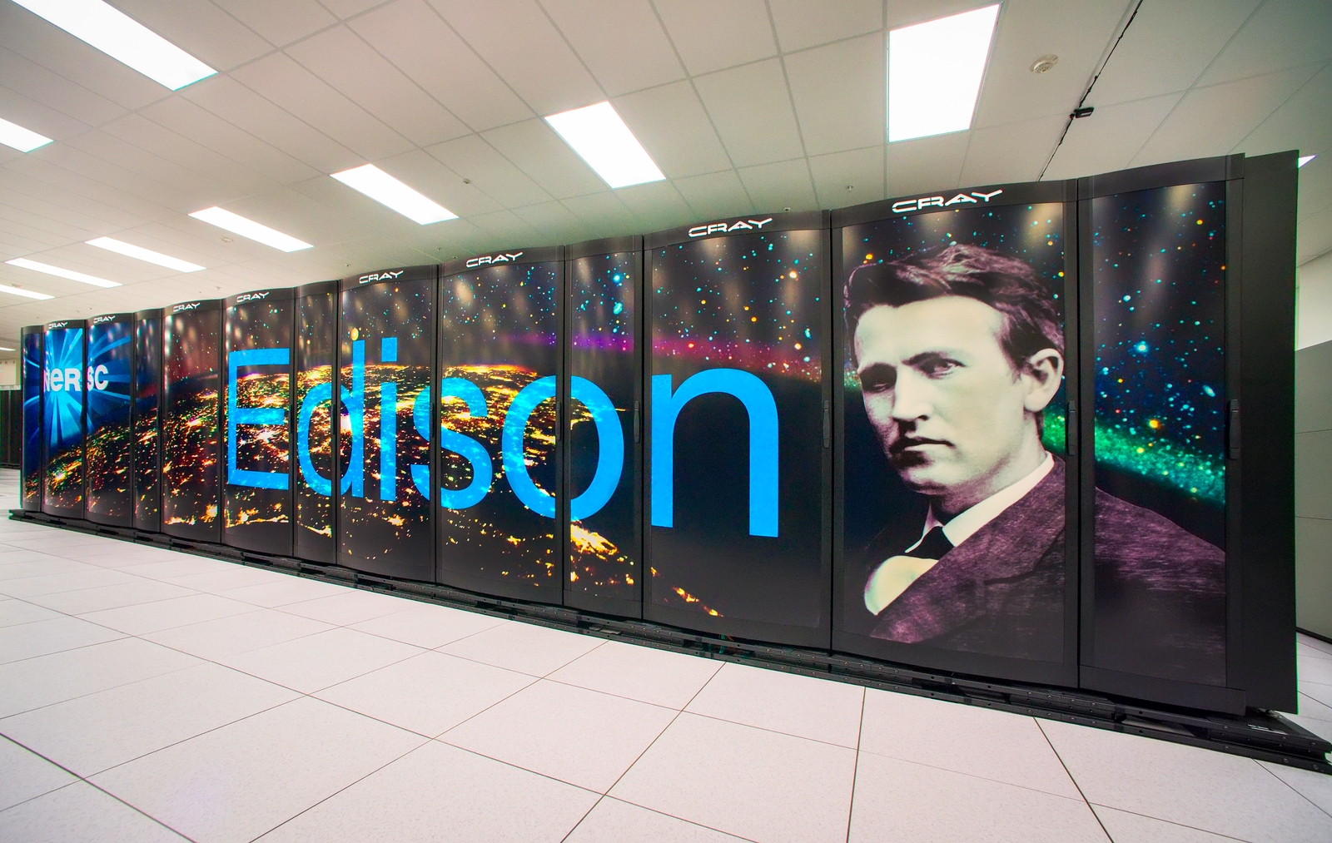
Pipeline...
Observatory
PTF
Classification
2.5 MB/s
12 MB/s
Subtractions
Processing/db
4 MB/s
(crude)
Data
Transfer
Nodes
Science
Gateway
Node 2
Science
Gateway
Node 1
1 GB/s
0.5 MB/s
(full)
NERSC GLOBAL FILESYSTEM
250TB (185TB used)
One of 4 such pipelines
running at NERSC...

Slide 17
PTF Turn-around
Typical night: 2012-07-06
What does “real-time” subtractions really mean?
For 95% of the nights all images are processed, subtractions are run, candidates are put into the database and the local universe script is run in < 1hr after observation.
Median turn-around is 30m.

Slide 18
iPTF turn-around
Due to the X-SWAP project (Extreme-Scale Scientific Workflow Analysis and Prediction), funded through the ASCR LAB-1088 call (Analytical Modeling for Extreme-Scale Computing Environments), we have been able to understand and eliminate a lot of our inefficiencies and decrease the turn-around by an order of magnitude!
Better use of the Lustre filesystem (for everything), better use of OpenMP in all codes, reserved nodes, etc.

Slide 19

iPTF turn-around
We made major changes to the old pipeline.
Pipeline completely instrumented for timings.
Identified and fixed python load time on Edison (15min to 5 sec).
Moved all I/O in processing to Lustre
/scratch filesystem
Now optimizing db access
Typical turnaround is now
< 5 minutes for 95% of the data!
Yi Cao’s Caltech thesis May 3, 2016. Became an eScience Postdoctoral Fellow at University of Washington → Google!

Slide 20
Instrumented Pipeline with 39 Checkpoints
Covers everything from:
Pulling the data from the telescope
I/O on scracth
Subtraction software
Running ML algorithms
Loading the db with discoveries
Performing difficult geometric queries to match with known stars, asteroids, previous discoveries, etc.
Copying data from scratch to project

Slide 21
For 8 hours every night, we now know more about the NERSC center than they do in real-time.
Given 3000 images per night with 39 checkpoints for each, we are monitoring some aspect of NERSC or ESnet every quarter second.
Notes:
Networking is very stable. Improves after 11pm and gets worse as folks wake up in the morning.

Slide 22
Decent correlation between number of objects and the total time for our queries with some scatter likely due to overlapping queries.
Notes:
The number of objects can be predicted from the current sky conditions and the location on the sky of our field and chip.

Slide 23
Now exploring relationship between nightly conditions and the bulk of the data through ML.
While getting a hold of the outliers via NERSC system information.

Slide 24
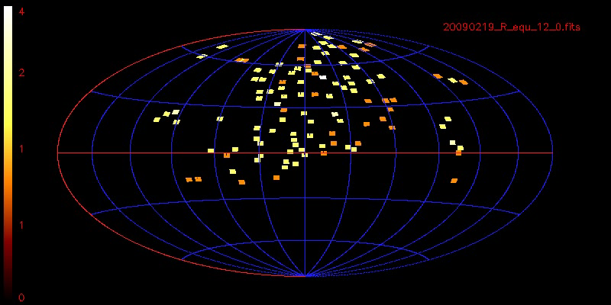
PTF Sky Coverage
To date:
2338 Spectroscopically typed supernovae
10⁶ Galactic Transients
10⁴ Transients in M31
139 publications, 6 in Nature and 2 in Science since late 2009
Notes:
Greatest depth for g-band is 2 hrs, R-band is 4 hrs (red)

Slide 25
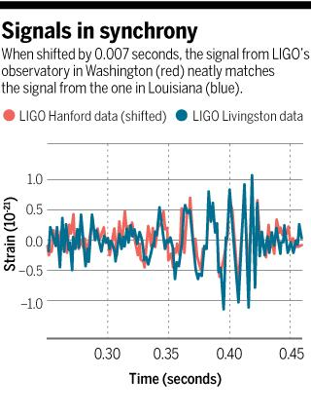
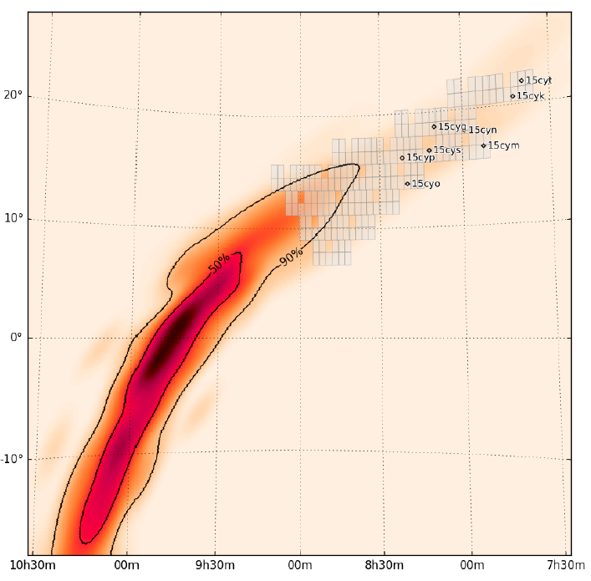
Gravitational Wave Trigger GW150914
Kasliwal et al. (2016)
(arXiv and ApJL)

Slide 26
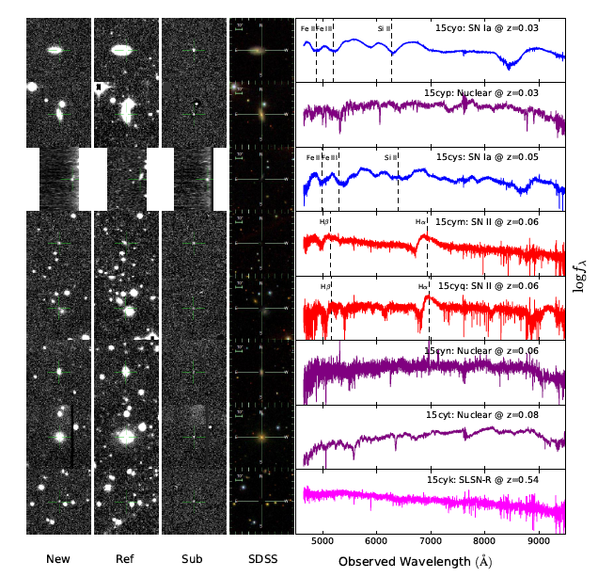
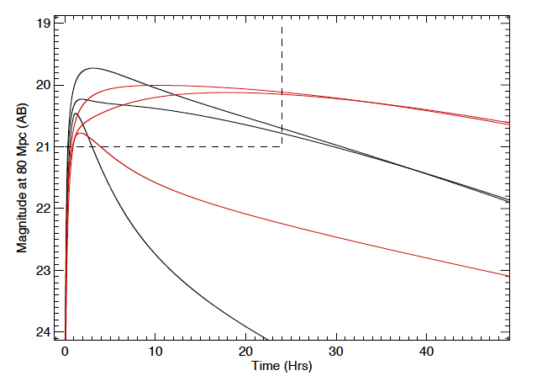
GW150914
Going to have to be able to sift through a lot of stuff, and react quickly with follow-up, to get on the optical companion for a GW trigger.
Notes:
Predicted EM counterpart signatures based on free neutron decay (Metzger et al. 2014). Black lines are g-band and red lines are i-band light curves at 80 Mpc. The three curves assume three diﬀerent values for opacity and neutron mass to represent the fast, intermediate and slow light curve evolution cases i.e. (κr = 30 cm2gm−1, Mn = 3×10−5M˙ 􀀀), (κr = 3cm2gm−1, Mn = 3×10−5M˙ 􀀀), (κr = 3 cm2gm−1, Mn = 3×10−4M˙ 􀀀). The fastest light curves decay below 22 mag in less than 1 day and the slowest light curves decay below 22 mag in less than 1 week.

Slide 27
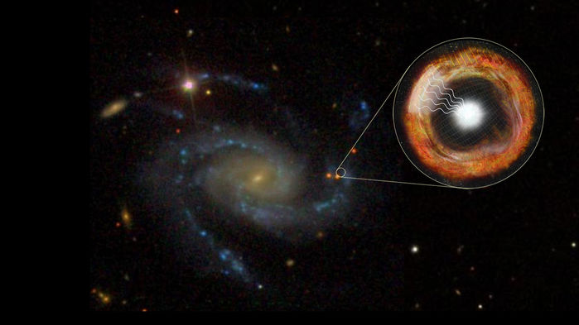
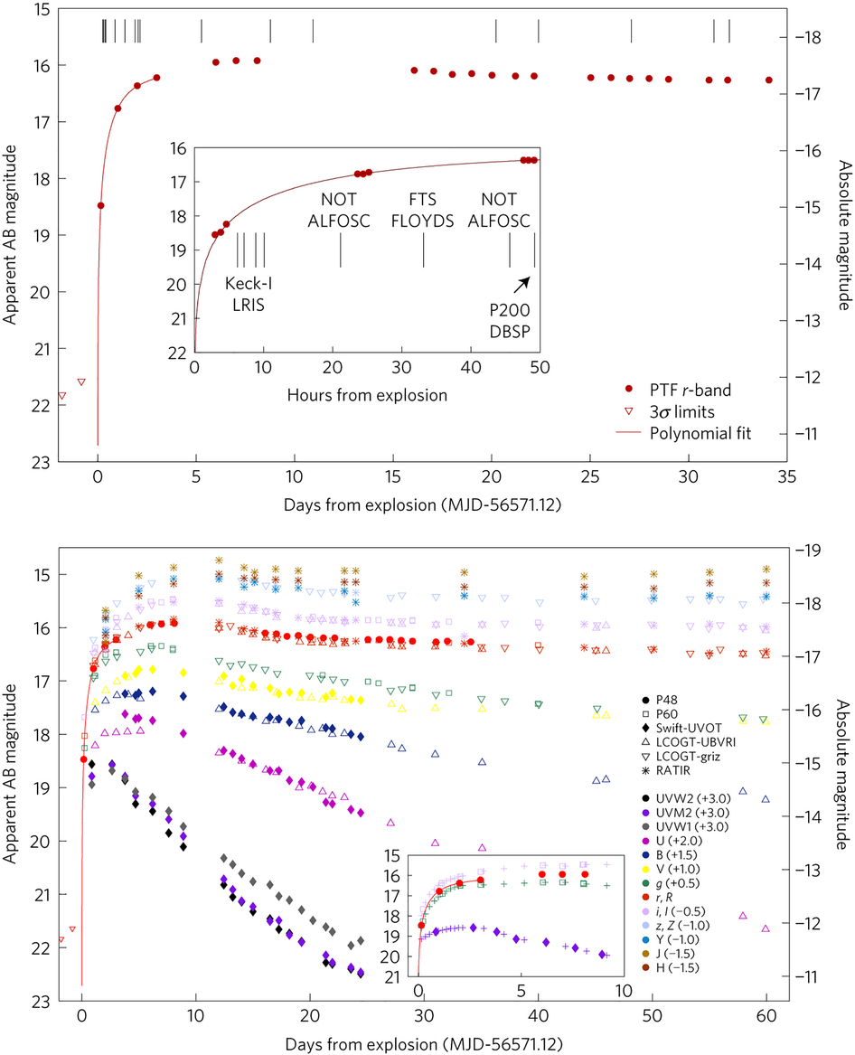
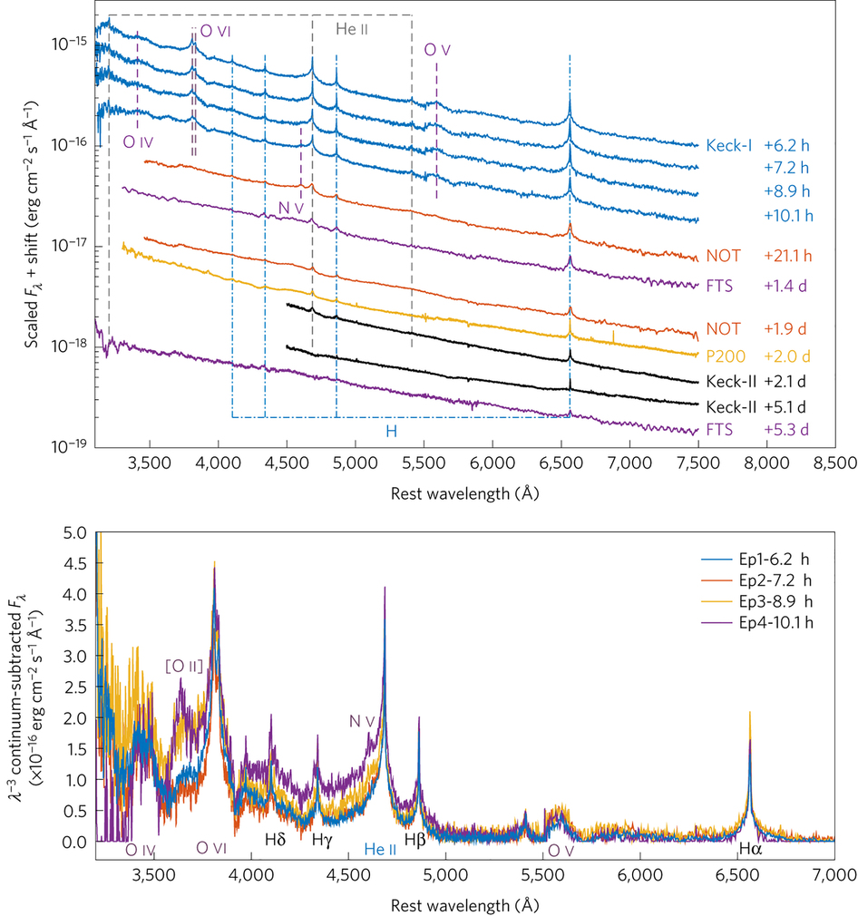
iPTF 13dqy – Yaron et al.
Nature Feb 13, 2017

Slide 28
Bottlenecks…crude vs. real
- upper limit
- detection
brightness
5-σ data in db
time

Slide 29
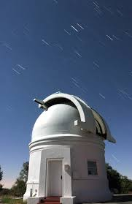

Discovery of first multiply gravitationally lensed Type Ia Supernova
C3-developed the pipeline for the intermediate Palomar Transient Factory discovery of the first multiply gravitationally lensed Type Ia supernova.
Published in Science, “The discovery of the multiply-imaged lensed Type Ia supernova iPTF16geu”, Goobar et al. (2017) and ApJ Letters, “How to Find Gravitationally Lensed Type Ia Supernovae”, Goldstein & Nugent (2017)
Above: the light paths for the supernova at 4 billion light years away, gravitationally lensed by an elliptical galaxy 2.5 billion light years away into a system of 4 images. Below: an SDSS image of the host galaxy and an HST image of the galaxy and 4 supernova images.

Slide 30
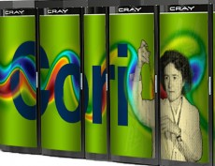
Pipeline...
Observatory
PTF
Classification
2.5 MB/s
12 MB/s
Subtractions
Processing/db
Data
Transfer
Nodes
Science
Gateway
Node 2
4 MB/s
Science
Gateway
Node 1
1 GB/s
0.5 MB/s
NERSC GLOBAL FILESYSTEM
250TB (185TB used)
Trigger new subtractions:
output now greater than input
~ 1 TB/night

Slide 31
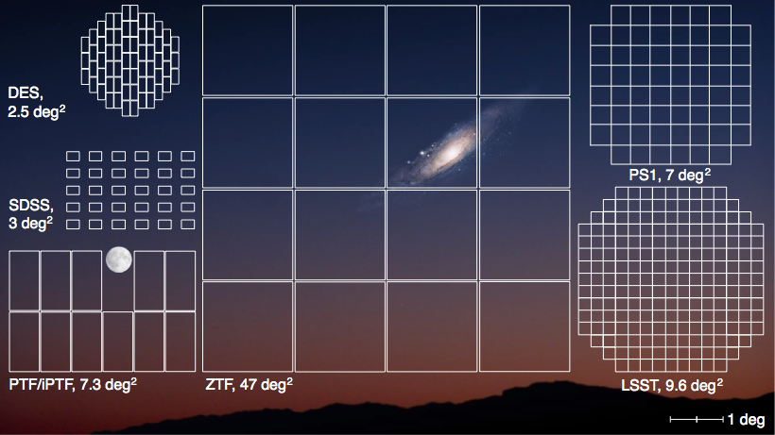
Zwicky Transient Facility

Slide 32
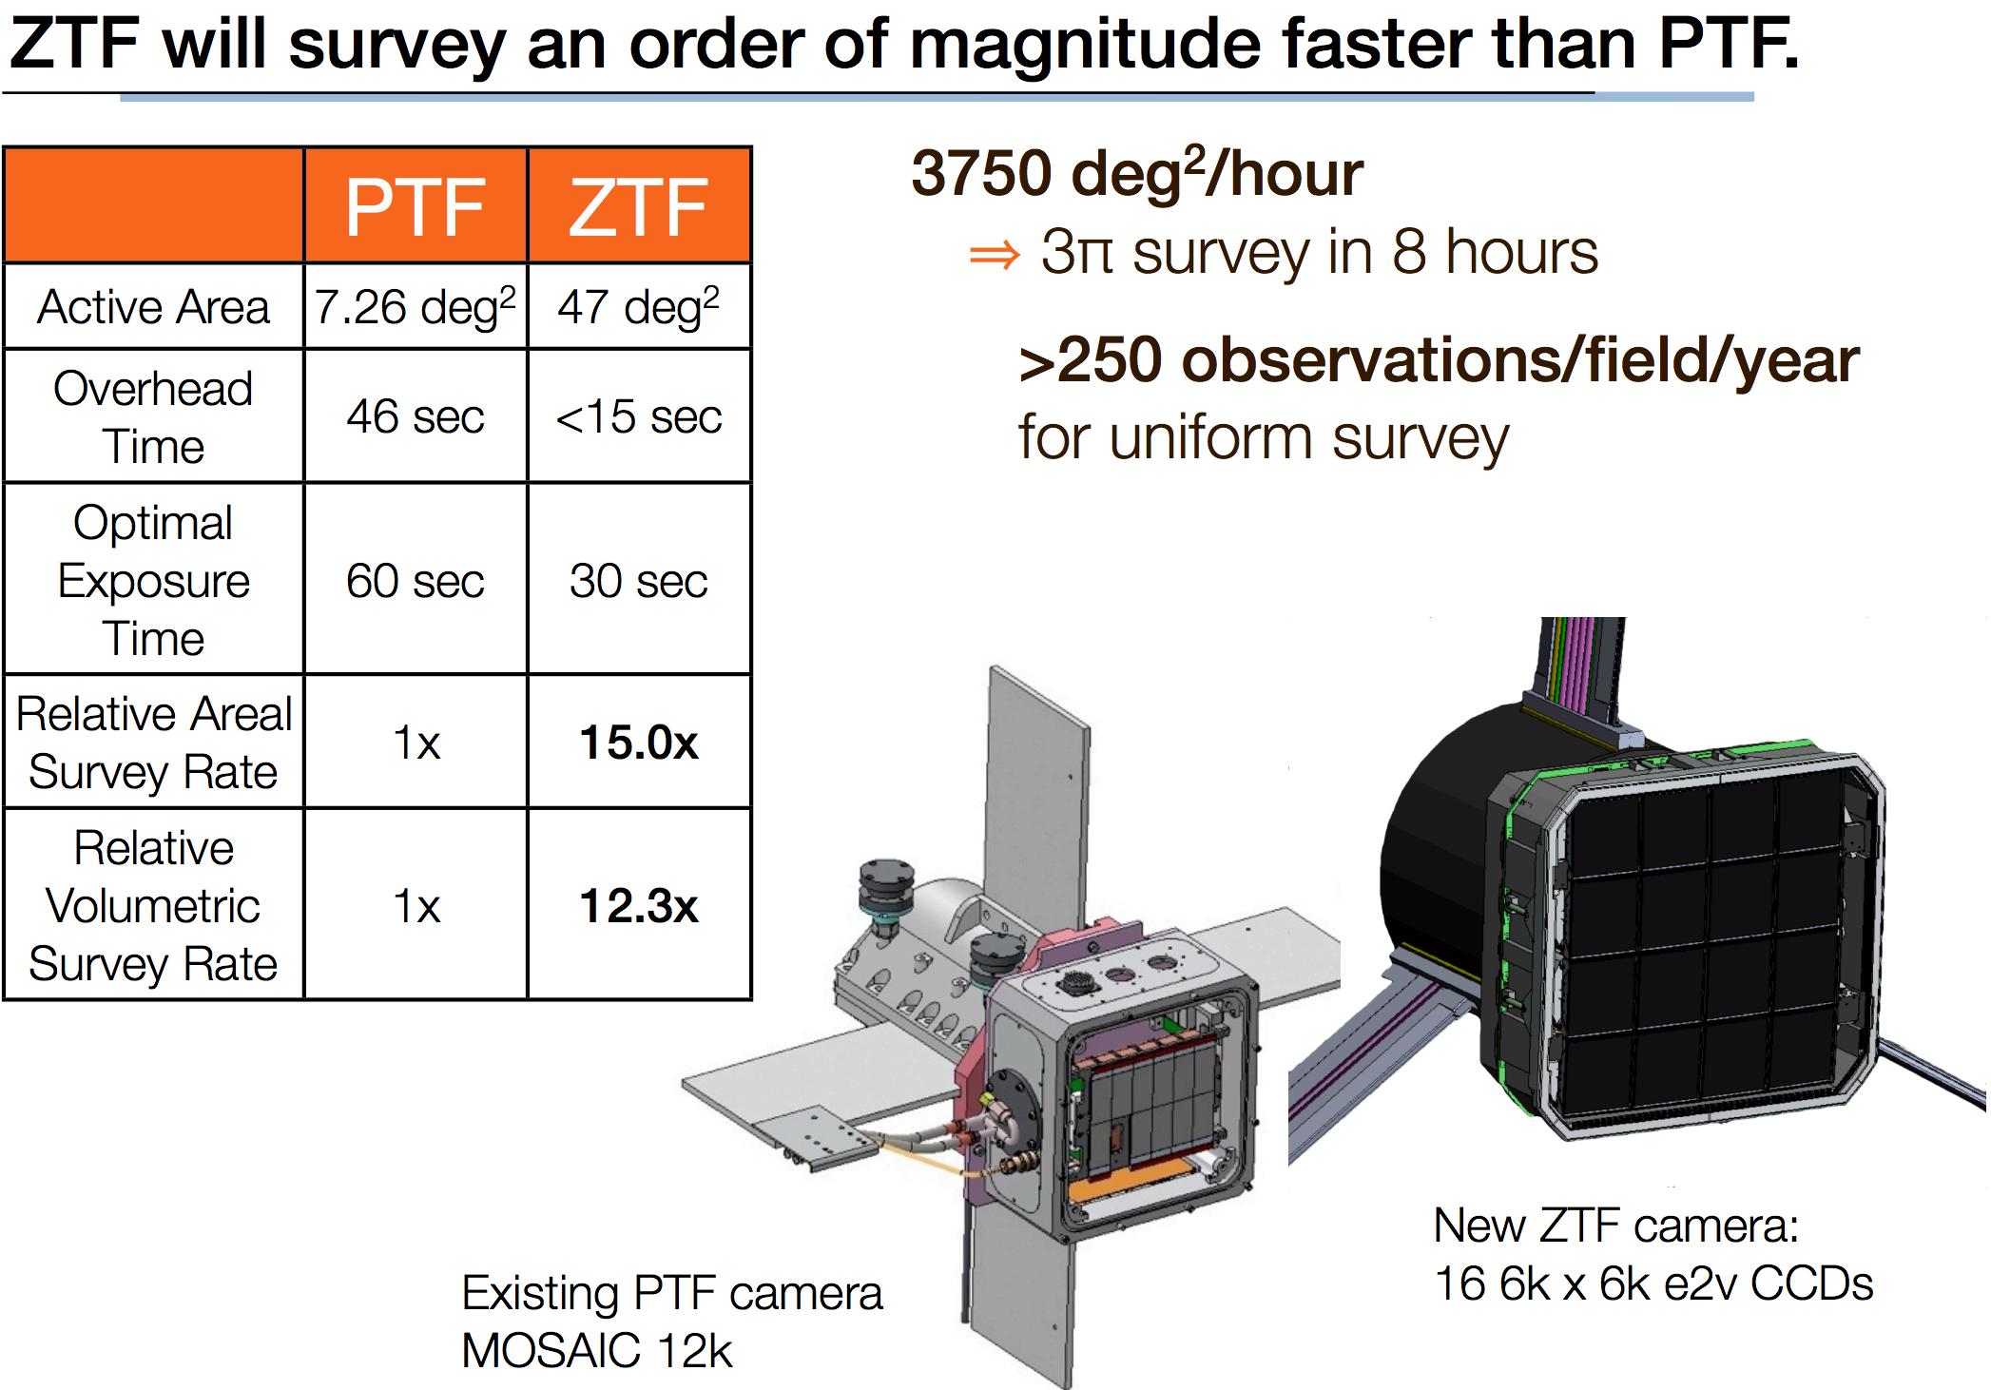

Slide 33
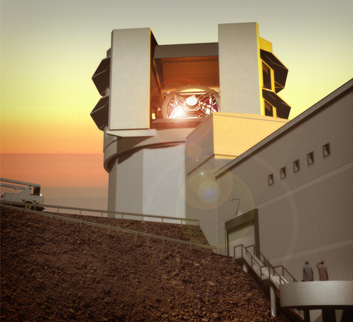
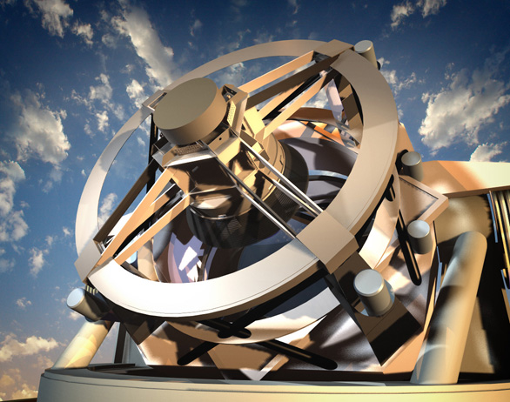
Future
LSST - 15TB data/night
Only one 30-m telescope
How many triggers can we handle???

